Slide 1
ESSA Accountability Updates
Teacher Leader Summit

Slide 2
Agenda
ESSA Plan Development
Elementary and Middle Schools
High Schools
Combination Schools
Transition
Subgroups
Upcoming Policy Considerations
Resources and Next Steps

Slide 3
ESSA in Louisiana
On July 1, 2017, the Every Student Succeeds Act (ESSA) replaces the No Child Left Behind as the country’s federal education law. The law will be in effect when the 2017-2018 school year begins.
ESSA provides Louisiana with an opportunity to collaborate with educators, parents, business and community leaders to create an improved K-12 education system that provides all students with equal access and opportunity to high-quality learning.
ESSA requires that every state capture these improvements in a state plan that is submitted to the federal government.
Louisiana submitted its plan to U.S. Department of Education on April 15 with the intent of receiving feedback and final approval of the plan prior to the start of the 2017-2018 school year and in order to provide educators and families with clarity and consistency.

Slide 4
Louisiana’s ESSA Plan Development
After engaging with stakeholders for months, the Department released a draft ESSA framework on September 28, to provide the general public with examples of what policies, supports, and resources could be used to provide targeted support for disadvantaged students.
Since that release, the Department has been in continuous conversations with educators, advocacy groups, civic leaders and others to refine the proposals within the framework.
During this time, the Louisiana Accountability Commission has also been meeting to make recommendations regarding the state’s accountability system. To view the Commission’s recommendations, you can view previous meeting videos and presentations in the Accountability library.
On Monday, February 6, the Department released an updated framework that included greater detail from the initial framework as well as stakeholder feedback.
On February 20, the Department released the draft state plan for public comment.
The final state plan is available here.

Slide 5
Development Timeline
In developing its recommendations for accountability system changes under ESSA, the Commission considered numerous models and metrics in order to address priority issues within student achievement and as articulated by stakeholders over the past five years. Commission recommendations were developed over the course of eight meetings across nine months.
February 17, 2017
February 8, 2017
January 9, 2017
December 5, 2016
November 1, 2016
October 17, 2016
September 12, 2016
June 27, 2016

Slide 6
Guiding Beliefs
Louisiana’s students—all of them, no matter race, disability, or creed—are as smart and capable as any in America. They have gifts and talents no lesser than those given to any children on this earth.
Louisiana has worked hard to raise expectations for students, and as a result, students are performing at higher levels than ever before.
While Louisiana has made great strides in increasing life opportunities for its students, there remain serious challenges in Louisiana’s schools. Often these challenges are experienced to the greatest extent by children of historically disadvantaged backgrounds.
As educators, we have a powerful role to play in helping all students overcome the challenges they will experience on the way to leading healthy and productive lives as adults.

Slide 7
Improvements to Louisiana’s K-12 System
The updated ESSA framework, highlights several unique improvements to Louisiana’s K-12 system:
raise fundamental expectations for students to be equal with their peers across the country;
reduce end-of-year state testing, while simultaneously improving the quality and depth of information provided to educators and families;
recognize growth for all students;
allow students taking the LAA 1 the opportunity to earn diplomas into the state graduation rate;
deliver targeted funding to students and schools who are the most in need;
foster and fund relationships between persistently struggling schools and partners that have demonstrated success in turning around struggling schools;
place future teachers in classrooms under a mentor educator for full–year, classroom-based residencies that prepare them for day one in their own classrooms; and
provide every student with enriching experiences and a well rounded education that is recognized in the state’s accountability system.

Slide 8
Improvements to Louisiana’s Accountability System
These formulae represent three critical shifts in the design of the accountability system.
Ensuring an “A” in Louisiana’s letter grade system signals mastery of fundamental skills. This will be achieved by raising expectations for what is required in order for a school to earn A-level points based on student achievement and growth.
Adjusting school rating calculations to value more the progress of every individual child, including (a) measuring whether students are on a path to master fundamental skills; and (b) measuring how effectively students are advancing relative to their peers. This growth index will replace the current progress point system.
Expanding the school performance score formula to emphasize interests and opportunities for students, in addition to traditional assessment and graduation outcomes, as five percent of school scores.

Slide 9
School Performance Score Formulae
Beginning in 2017-2018, Louisiana will use the following formulae when evaluating school performance:
NOTE: The interests and opportunities measure will not be included within annual results until 2019-2020.

Slide 10
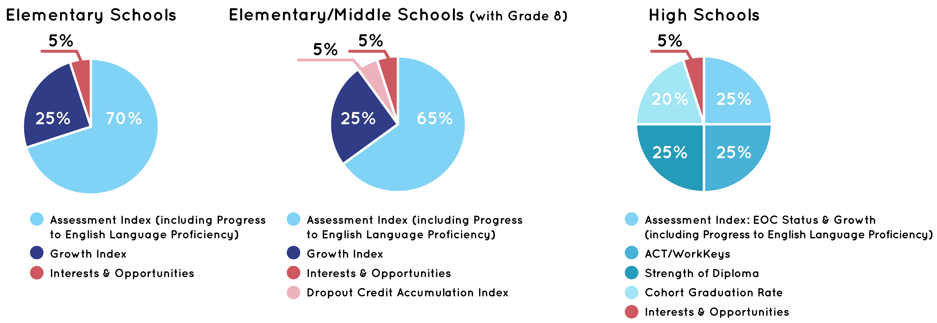
School Performance Score Formulae (2019-2020 and beyond)
The interests and opportunities measure will not be included within annual results until 2019-2020.

Slide 11
Agenda
ESSA Plan Development
Elementary and Middle Schools
High Schools
Combination Schools
Transition
Subgroups
Upcoming Policy Considerations
Resources and Next Steps

Slide 12
Current Formula for School Performance Scores (SPS)
ESSA requires states to maintain accountability systems that evaluate school quality and protect the interests of historically disadvantaged students.
Elementary Schools
Elementary/Middle Schools (with Grade 8)
+ Up to 10 Progress Points
+ Up to 10 Progress Points

Slide 13
Future School Performance Score (SPS) Formulae
Beginning in 2017-2018, Louisiana will use the following formulae when evaluating school performance:
NOTE: The interests and opportunities measure will not be included within annual results until 2019-2020.

Slide 14
Future School Performance Score (SPS) Formulae (2019-2020 and beyond)
The interests and opportunities measure will not be included within annual results until 2019-2020. Until the interests and opportunities measure is added, the assessment index shall be worth 75% for elementary schools and 70% for schools with an eighth grade.

Slide 15
K-8 School SPS: Assessments
Purpose
Louisiana students in grades 3-8 take assessments in ELA, math, science and social studies to measure student mastery of the knowledge and skills reflected in the standards of that grade and subject.
Accountability
The school performance score includes the points assigned to achievement levels earned by students for each subject tested.
LEAP Achievement Level | 2017-2018 and beyond
Advanced | 150
Mastery | 100
Basic | 70
Approaching Basic/Unsatisfactory | 0

Slide 16
K-8 School SPS: Celebrating Student Growth Through Two Key Questions
Question 1: If students are not yet achieving Mastery, are they on track to doing so?
Every student scoring below Mastery will receive a simple, clear growth target for the following year that illustrates the growth required to be on track to Mastery in ELA and math by 8th grade.
If a student achieves the target, the school shall earn 150 points, equivalent to an A+. Otherwise, move to question 2.
Question 2: Are students growing at a rate comparable to their peers?
Using Louisiana’s value-added measurement, it is possible to compare students’ individual performance to that of similar peers.
Schools will earn points based on students’ growth percentile as compared to peers.
80th-99th percentile (150 points)
60th-79th percentile (115 points)
40th-59th percentile (85 points)
20th-39th percentile (25 points)

Slide 17
How Can High Achieving Students Show Growth?
For students scoring Advanced (the highest possible rating) in the prior year:
If the student maintains a score of Advanced, the school earns 150 points or an A+.
If the student drops to the Mastery level or below, the school is awarded points based on the student’s performance compared to similar peers (Question 2).
For students scoring Mastery in the prior year:
Once students achieve Mastery, they will receive a Continued Growth target that illustrates what it will take to get to Advanced by 8th grade. If a student achieves this target, then the school is awarded 150 points or an A+.
If a student does not achieve the Continued Growth target, the school is awarded points based on the student’s performance compared to similar peers (Question 2).

Slide 18
Value-Added Calculation
Under ESSA, Louisiana will utilize the full value-added model (VAM) model for the school growth index, as it does for teacher VAM.
The model includes the following characteristics: prior achievement on assessments up to three years, special education status and disability category, economically disadvantaged status, student absences, and student suspensions.
Example:
Suzy scored Approaching Basic in ELA each of the past three years with no grade retention. As a result, she is expected to score Approaching Basic (719) this year.
Because Suzy has a speech/language disability, her expected score is reduced to 717.5.
Because Suzy missed ten days of school, her expected score is further adjusted to 716.
No other characteristics listed above apply to Suzy so they do not impact her score.

Slide 19
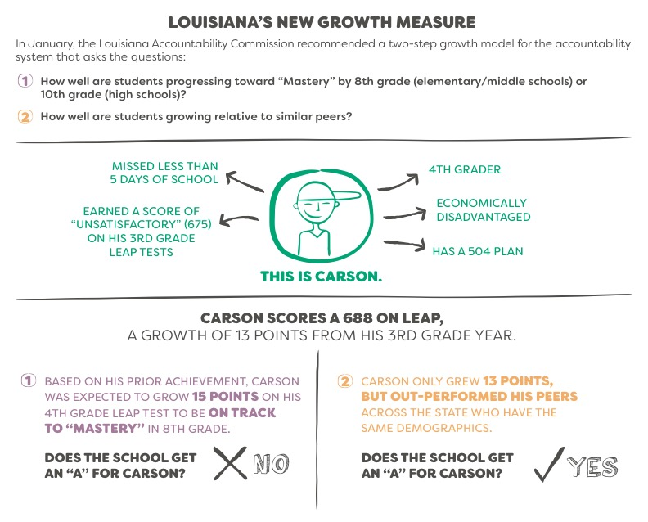
Student Growth Example

Slide 20
K-8 School SPS: Dropout/Credit Accumulation Index (DCAI)
Purpose
This measure encourages successful transition to high school, as well as access to Carnegie credits in middle school.
Accountability
Calculated for schools that include grade 8 in prior year.
Points based on number of Carnegie credits earned through the end of 9th grade (and transitional 9th, where applicable) and/or dropout status.
Policy
To count toward DCAI, students must be full academic year in 8th and 9th grade (or transitional 9th, where applicable), if earning Carnegie credits.
Students transferring between public districts between 8th and 9th grade are still eligible to earn points for DCAI.
Carnegie Course Credits | 2017- 2018 and beyond
7 or more | 150
6.5 | 125
6 | 100
5.5 | 75
5 | 50
4.5 | 25
4 | 0
3.5 | 0
3 or less | 0
3rd year 8th grader | 0
Dropout | 0

Slide 21
Agenda
ESSA Plan Development
Elementary and Middle Schools
High Schools
Combination Schools
Transition
Subgroups
Upcoming Policy Considerations
Resources and Next Steps

Slide 22
2016 School Performance Score (SPS) Formula
ESSA requires states to maintain accountability systems that evaluate school quality and protect the interests of historically disadvantaged students.
High Schools
+ Up to 10 Progress Points

Slide 23
Future School Performance Score Formula
Beginning in 2017-2018, Louisiana will use the following formulae when evaluating school performance:
NOTE: The interests and opportunities measure will not be included within annual results until 2019-2020.

Slide 24
Future School Performance Score Formula (2019-2020 and beyond)
The interests and opportunities measure will not be included within annual results until 2019-2020. Until the interests and opportunities measure is added, cohort graduation rate will continue to count as 25% of the score.

Slide 25
High School SPS: EOC Achievement and Growth
Purpose
The End-Of-Course (EOC) exams assess whether students have mastered the standards of core high school core subjects. EOC exams are required in Algebra I, Geometry, English I (beginning in 2017-2018), English II, Biology, and U.S. History. English III will phase out over the next couple of years.
Policy All high school students, except for students who participate in LAA 1, are required to take an ELA and math EOC exam by their 3rd cohort year regardless of graduation pathway.
Scores from high school students who are retaking an EOC are not used in the school performance score (unless taken in middle school where current practice of counting scores in middle school (with incentive points) and again in high school will continue).
LEAP 2025 EOCs Achievement Level | 2017-2018 and beyond
Advanced (or Excellent) | 150
Mastery | 100
Basic (or Good) | 70
Approaching Basic/Unsatisfactory (or Fair/Needs Imp.) | 0

Slide 26
High School SPS: EOC Achievement and Growth
Like schools serving grades 3 to 8, high schools may earn credit for both achievement and growth with students, as measured by the EOCs. High achieving students will be treated the same as in elementary schools.
Question 1: If students are not yet achieving Mastery, are they on track to doing so?
Every student scoring below Mastery in grade 8 will receive a simple, clear growth target for the following year that illustrates the growth required to be on track to Mastery in ELA and math by 10th grade.
If a student achieves the target, the school shall earn 150 points, equivalent to an A+. Otherwise, move to question 2.
Question 2: Are students growing at a rate comparable to their peers?
Using Louisiana’s value-added measurement, it is possible to compare students’ individual performance to that of similar peers.
Schools will earn points based on students’ growth percentile as compared to peers.
80th-99th percentile (150 points)
60th-79th percentile (115 points)
40th-59th percentile (85 points)
20th-39th percentile (25 points)

Slide 27
High School SPS: ACT and WorkKeys
Purpose
The ACT/WorkKeys index is to ensure student readiness for postsecondary learning.
Policy
All students in grade 11 take the ACT, a nationally recognized measure of college and career readiness.
Schools earn points for the highest composite score earned by a student through the spring testing date of their senior year or a student who graduates at the end of grade 11.
Beginning in 2015-2016, WorkKeys was included in the ACT index for accountability when the WorkKeys score yielded more index points than the ACT score.
ACT / WorkKeys | 2017- 2018 and beyond
36 | 150
31 or Platinum | 134
27 | 120.4
25 | 113.6
24 or Gold | 110.2
23 | 106.8
21 (ACT Readiness marker) | 100
20 | 90
19 | 80
18 or Silver | 70
17 or below | 0

Slide 28
High School SPS: Graduation Rate
Purpose The cohort graduation rate measures percentage of students who enter grade 9 and graduate four years later, adjusted for students who transfer in or out.
Policy All 9th grade students who enter a graduation cohort are included in calculations of the cohort graduation rate, regardless of diploma pathway, unless they are legitimate leavers. Beginning in 2017-2018, per ESSA, students assessed on an alternate assessment who earn a diploma will be included in the cohort in the year they graduate.
Legitimate leavers are students who are removed from the cohort and exited enrollment for one or more of the following reasons: death (07); transfer out of state (10); transfer to approved nonpublic school (14); transfer to BESE-approved home study program (16); transfer to early college (20).
Cohort Grad Rate | 2017-2018 and beyond 100 = 90%
0-75% | CGR × 0.9
76-90% | CGR x 1.111112
91-100% | +5 points per percent increase (91=105, 92=110)

Slide 29
High School SPS: Strength of Diploma
The graduation index measures the quality of the diploma earned by each 12th grader. The “A” bar will remain at receipt of a diploma.
Quality of Diploma (Graduation Index): Student Results | Points Awarded
HS Diploma plus Additional points awarded for students who graduate on time and meet requirements for one or more of the following: Advanced Placement International Baccalaureate JumpStart credentials CLEP TOPS-aligned dual enrollment course completion Associates Degree | 110-160
Four-year graduate (Includes Career Diploma students with a regional Jump Start credential, as well as students earning a diploma who are assessed on an alternate diploma) | 100
Five and six-year graduate with any diploma (Five-year graduates who earn an AP score of 3 or higher, an IB score of 4 or higher, or a CLEP of 50 or higher will generate 140 points.) | 50-75
HiSET/GED + JumpStart credential | 40
HiSET/GED (earned no later than October 1 following last exit record) | 25
Non-graduate without HiSET/GED | 0

Slide 30
Agenda
ESSA Plan Development
Elementary and Middle Schools
High Schools
Combination Schools
Transition
Subgroups
Upcoming Policy Considerations
Resources and Next Steps

Slide 31
Combination Schools: Weighting
School Accountability
Schools with students in both K-8 and 9-12 grades will receive a school performance score based on both the K-8 and 9-12 formulas and weighted by students included in the formula.
Example Calculation
Calculate K-8 SPS for all students who test or are included in DCAI as for all K-8 schools.
Calculate HS SPS for EOC and ACT testers, without duplication, and cohort graduation members.
Determine number of students that are K-8 and number that are high school.
Average the K-8 SPS and HS SPS using numbers of students to weight the SPS before averaging them.
K-8 | 50 Students | 33% of all eligible testers
HS | 100 Students | 67% of all eligible testers
Total Students Used for Weights | 150 Students | 100% of eligible testers

Slide 32
Agenda
ESSA Plan Development
Elementary and Middle Schools
High Schools
Combination Schools
Transition
Subgroups
Upcoming Policy Considerations
Resources and Next Steps

Slide 33
Transition Overview
The Accountability Commission developed a series of proposals for how student achievemnent and growth should be valued in Louisiana, as well as how Louisiana should transition to the more challenging school rating system over time – ensuring a high bar for students without precipitously dropping scores.
By endorsing Louisiana’s draft ESSA plan, BESE accepted the majority of the Commission’s recommendations.
However, in response to specific concerns raised, BESE directed the Department to make two changes to framework.
1. Beginning in 2018, schools will earn an “A” (100 points) in the accountability formula for students scoring Mastery on LEAP/EOCs, for earning a 21 on the ACT and for a 90% or higher cohort graduation rate. Schools will earn a “C” (70 points) for students scoring Basic on LEAP/EOCs or an ACT/WorkKeys of 18/Silver.
2. BESE required a simpler method for transitioning the rating system. Individual indices will be updated next year (e.g., Mastery = 100, Basic = 70); however, the overall letter grade scale will be made easier in 2017-2018. The bar for A, B, and C will rise in 2022 and one final time in 2025.

Slide 34
Letter Grade Scale Transition
Louisiana seeks a system that has high expectations for students but also allows time for schools to adjust, as informed by the historical pace of improvement. Thus, the letter grade scale will be adjusted down, with the minimum score dropping by 10 points for A, B and C. In 2022, the scales will partially increase by 5 points, and by 2025 the scale will return to the current distribution.
Letter Grade | 2013 Baseline Scale | 2016 Curved Elementary/ Middle Scale | 2018 Scale | 2022 Scale | 2025 Scale
A | 100.0 - 150 | 100.0 - 150 | 90.0 - 150.0 | 95.0 - 150.0 | 100.0 - 150
B | 85.0 - 99.9 | 85.0 - 99.9 | 75.0 - 89.9 | 80.0 – 94.9 | 85.0 - 99.9
C | 70.0 - 84.9 | 67.1 - 84.9 | 60.0 - 74.9 | 65.0 - 79.9 | 70.0 - 84.9
D | 50.0 - 69.9 | 47.2 - 67.0 | 50.0 - 59.9 | 50.0 - 64.9 | 50.0 - 69.9
F | 0.0 - 49.9 | 0.0 - 47.1 | 0.0 - 49.9 | 0.0 - 49.9 | 0.0 - 49.9

Slide 35
Reporting Growth and Achievement Performance
School report cards will continue to include the overall letter grade, as well as information about performance in each index (e.g., percentage of students Mastery and above, graduation rate percentage).
However, the Department will enhance the report cards in two ways:
The report cards will include a letter grade equivalent for the assessment index and the growth index, as if they were their own letter grade.
The report cards will include a greater number of metrics through a dashboard format.

Slide 36
Agenda
ESSA Plan Development
Elementary and Middle Schools
High Schools
Combination Schools
Transition
Subgroups
Upcoming Policy Considerations
Resources and Next Steps

Slide 37
Identification of Schools for Targeted Intervention
All subgroups of 10 or higher will be reported by percentage proficient, and in comparison to other schools (percentiled 1 to 99).
All subgroups of 10 or higher that are performing at an equivalent of D or F shall be labeled “Urgent Intervention Needed.” No required consequences result.
All subgroups of 10 or higher that are performing at an equivalent of F for two consecutive years shall be labeled “Urgent Intervention Required.” Any such school cannot earn an A overall letter grade and will be eligible for targeted funds based on a plan for improving outcomes.
Additionally, any school with an out of school suspension rates exceeding twice the national average for three consecutive years shall be labeled “Urgent Intervention Required.”
Schools that are labeled “Urgent Intervention Required” for three consecutive years will also be identified as “Comprehensive Intervention Required.”

Slide 38
English Learners in Accountability
ESSA requires that states include an accountability measure of English learners’ progress towards English language proficiency. Louisiana will measure school success with English language learners in two ways:
Progress towards English language proficiency, as measured by the English language proficiency exam, will be included within the assessment index of each school beginning in 2018-2019 (2017-2018 is baseline).
This ensures all student scores are included regardless of the number of English language learners in a school, and that all such scores are weighted equally with the assessment results of all students in the school.
As provided for in ESSA, the measure of progress towards English language proficiency will consider a student’s ELP level at the time of identification and may also account for other characteristics such as age, grade, native language proficiency level, and time in formal education.
Both the English language proficiency results and English learner subgroup results on all other SPS indicators will be publicly reported on school report cards.

Slide 39
English Learners in Accountability: Recently-Arrived Students
Under ESSA, states may utilize longer timeline before counting results of recently-arrived students. Currently, scores count after one year; under ESSA, achievement counts in the third year.
Example: If a student recently arrived to the United States enrolls in a school and is identified as an English learner in third grade, the following outlines how that student will assessed and included in accountability beginning in 2017-2018.
Assessment | Year 1 (3rd Grade) | Year 2 (4th Grade) | Year 3 (5th Grade)
Content (ELA, math, science, social studies) | Not in accountability | Growth only | Achievement and growth
English language proficiency | Not in accountability | Growth only | Growth only

Slide 40
Agenda
ESSA Plan Development
Elementary and Middle Schools
High Schools
Combination Schools
Transition
Subgroups
Upcoming Policy Considerations
Resources and Next Steps

Slide 41
Interests and Opportunities
The interests and opportunities indicator (five percent of each school's score) will measure whether schools are providing students with access to a well-rounded education, exposing them to diverse areas of learning in which they can develop their skills and talents, including visual and performing arts, foreign language, technology, co-curricular activities, advanced coursework, health/PE, career pathways, etc. Per BESE’s motion, this will be measured through a “menu” approach that will allow districts to demonstrate a strong effort in a variety of ways.
Development Workgroup
A working group predominantly made up of superintendents, principals, and other administrators, but also including experts and teachers in health, language, arts, and music, will develop long-term goals and valuable, fair ways to measure access to quality of student experiences.
The Accountability Commission will then use the programmatic and curricular expertise of the workgroup to propose a method for scoring these desired outcomes fairly for all school districts.
BESE will approve the method for use no later than the 2019-2020 school year, with the timeline being accelerated if the pace of progress is faster than anticipated.
Timeline for Implementation:
Summer 2017: Convene working group predominantly made up of education administrators
2017-2018: Collect all data necessary; Accountability Commission develops proposed method
2018-2019: Pilot index for all schools, report publicly with no stakes; BESE approved method
2019-2020: Interests and Opportunities measure included in SPS

Slide 42
Agenda
ESSA Plan Development
Elementary and Middle Schools
High Schools
Combination Schools
Transition
Subgroups
Upcoming Policy Considerations
Resources and Next Steps

Slide 43
Additional Support
To support educators, the Department will offer the following supports regarding Louisiana’s new accountability system:
Continued trainings through networks and by district as needed
Calculators, including (a) traditional SPS calculator but also (b) simple growth target calculator
Improved reporting on student assessment results including simple growth targets in anticipation of 2017-2018 school year
2016-2017 results calculated using current formula but also future formula as part of fall principal profile process
Contact Jessica Baghian (jessica.baghian@la.gov)

