Slide 1
State Administered K-3 Literacy Screening for MOY
November 28, 2023
Middle-of-Year (MOY)

Slide 2
Agenda Items
Overview of K-3 Literacy Screening
Roles and Responsibilities
Administration Using Amplify Platform
Special Populations
Remote Administration
Test Security
Reporting Results

Slide 3
Overview of K-3 Literacy Screening

Slide 4
Statewide K-3 Literacy Screening
State law mandates that all students in kindergarten through third grade participate in a single statewide literacy screening three times per year. This includes students with IEPs or IAPs, English learners, non-readers and students who qualify for alternate assessment based on the K-2 Alternate Assessment Participation Decision-making Tool for K-2 and the LEAP Connect criteria for grade 3.
The law stipulates three administration windows:
Window 1: First 30 days of school
Window 2: December
Window 3: April

Slide 5
Selection of Statewide Screener
Amplify was chosen as the vendor for the statewide screener that will be used by all public school systems for the mandated screening.
Amplify: The name of the publisher providing the testing platform
mCLASS: The name of the screening technology platform
DIBELS 8th: The name of the actual screening instrument (this is the same screener that was used in the fall by all school systems)

Slide 6
Middle-of-Year (MOY) Administration 2023
For 2023-2024, a one time only extension will be provided in December due to contract delays.
December 1-January 26: Regular reported screener required of all students, including those selected for field test.
December 1-January 9: Field tests administered prior to regular screener

Slide 7
Screener Content
Students must complete all sections for a composite score to be calculated and reported to the department by the vendor. The content of the screener varies by grade. Gating, discontinuing, or exemptions for sections of the screener will not be an option in the Louisiana K-3 screening system.

Slide 8
Literacy Measures Required by Grade Level
Measure | Kindergarten | Grade 1 | Grade 2 | Grade 3
Letter Naming Fluency | ✔ | ✔
Phonemic Segmentation | ✔ | ✔
Nonsense Word Fluency | ✔ | ✔ | ✔ | ✔
Word Reading Fluency | ✔ | ✔ | ✔ | ✔
Oral Reading Fluency |  | ✔ | ✔ | ✔
Maze (Basic Comprehension) |  |  | ✔ | ✔

Slide 9
Roles and Responsibilities

Slide 10
Role of the District Test Coordinator
District test coordinators are responsible for:
Redelivering portions of this webinar to STCs/other staff
Assigning school test coordinators in the system
Providing training in administration and test security for school test coordinators
Providing specific testing schedules for all schools to the department
Reporting any irregularities to the department
Establishing forms of communication with STCs for questions, technology support, reporting to and from the department
Maintain records that include but are not limited to:
Doctor’s letters for students who cannot test due to extreme medical illness
Testing irregularities and breaches

Slide 11
Role of the School Test Coordinator
School test coordinators are responsible for:
Assigning logins for test administrators
Assigning preloaded student records into classes
Assure that all teachers are provided with accommodations for students that are being screened, if applicable
Confirm required administration training and provide test security for test administrators
Reporting any irregularities to the District Test Coordinator
Establishing forms of communication with TAs for questions, technology, support within the school

Slide 12
Role of the Test Administrator
Complete required training and earn 80% on the test
Administer the entire screening to students
Follow all test security protocols
Implement accommodations provided by the STC
Report any testing irregularities to the STC
The department does not require that teachers be TAs. The role of the TA is determined by the school system.

Slide 13
Training for Test Administrators

Slide 14
Test Administrator Required Training
Prior to administration of the screener, all test administrators must complete the training found at this link and score at least 80%. The date on which the training was completed must be entered into the test administrator oath signed by the test administrator.
Online Course(s) for Leaders:
An outline of the course as-is for leaders.
A link to self-enroll in the Administration and reporting training for leaders online course: https://elearning.easygenerator.com/b2975530-9e54-42ff-a31d-1137869d6ff2/
Online Course(s) for Teachers:
An outline of the course as-is for teachers.
A link to self-enroll in the Administration and instruction essentials for teachers online course: https://elearning.easygenerator.com/6ae65f32-8c1c-4e77-bd04-5f86d95a73fe/

Slide 15
Access to mCLASS for Training
Much of the training can be completed using a user-created account. However, to complete all components, users will need an mCLASS account. Currently, no district user has been given an account. However, we have worked with Amplify to provide access to a demo account that will allow users to complete the training. More information will be provided to DTCs via email ASAP.
If a school system used the Amplify platform to administer the screener in Window 1 and required training, it is not necessary to repeat the training. However all TAs should have confirmation of earning an 80% on the test.

Slide 16
Suggested Training Models
Session training: Teachers are trained in special large group session. TAs must take the assessment individually.
Individual training: Teachers take the training on their own schedule. TAs will submit their assessment results to the STC/DTC.
MIxed models: Some sections are completed as a group and some sections are completed individually. TAs must take the assessment individually.
STCs must maintain assessment results and make them accessible for any audit.

Slide 17
Screening Administration

Slide 18
Amplify Portal
All schools will administer the statewide screener using the state portal. Statewide screeners cannot be administered with any other option.
In a supported web browser, navigate to my.amplify.com/login/louisiana
when you are notified that the system is open.

Slide 19
Technology
Prior to testing District Technology Coordinators should ensure the following sites are open on the district’s network.
https://amplify.com/allowlist/
DTCs, STCs, District Technology Coordinators and TAs can use to tool below prior to testing to ensure the device and network are working appropriately.
https://my.amplify.com/allowlist/

Slide 20
Logging into Amplify and Setting Up Accounts
Once DTCs have been notified, they can log in using the state platform shown on the left that is clearly labeled as the state administered screening.
Louisiana State Administered K-3 Literacy Screening
Other Amplify
Products

Slide 21
Accessing Testing Manuals
District test coordinators will be notified when the Amplify testing manual is available. The manual will contain specific directions for assigning STCs, TAs and students. Helpful links will be included throughout the manual. However, the training modules provide all of the instructions as well.
An additional manual, Louisiana Specific Instructions and Oaths Guide, will include oaths of security, details about accommodations, and test security reminders.

Slide 22
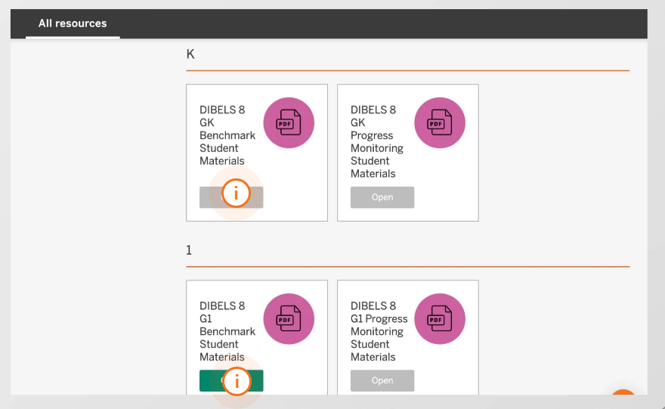
Preparation of Testing Materials for Students
Amplify will not ship any printed materials. Materials needed for screening are included in the system. The training explains this process.

Slide 23
Online Screening
The mCLASS system is considered an online screening platform and was not intended as a paper administration. All scores must be entered into the system for students unless they are eligible for alternate assessment and the LAAR is used for scoring.
There is no opportunity outside of the system to report scores to the department for students who are not participating in the alternate assessment.

Slide 24
Paperless Screening
Test administrators can use two devices to administer the screener without printing materials.
Directions for teachers (assuming already logged in on primary device)
1. Log into mCLASS using teacher credentials on the second device
2. Navigate to the PD library
3. Access the PDFs in the PD library. Choose the correct measure and time of year
4. Open the pdf and navigate to the correct page for the student

Slide 25
Notice to District Test Coordinators
DTCs will be invited to begin the mCLASS process and create a password through an email from Amplify.
Emails were provided to Amplify by the department. The only persons who will have a district account are the DTCs of record.
DTCs and STCs will be directed to an Admin Portal in Amplify that allow for management of:
Staff
Students
Classes
Permissions are set by access level (DTCs have district access to all schools and students; STCs have access for their site only)

Slide 26
District Test Coordinator Setup
In a supported web browser, navigate to my.amplify.com/login/louisiana.
Under the “State Administered K-3 Screener” tab, select Staff Login.
Log in with the credentials you set in Step 1.
Educator Home displays. Click the first recommendations card, for Admin Portal.
In the Admin Portal, you should see:
The Rosters Homepage with links to all sections of the site
Help articles specific to the K–3 Literacy Screener implementation
Student data provided by the Louisiana Department of Education

Slide 27
Assigning School Test Coordinators
Once DTCs have completed setting up their account and password, they will add school test coordinators (STC).
All staff accounts must be connected to a genuine email inbox for the staff to set their own passwords. If you intend to manage all enrollment and rostering for your district, you can skip this step and review the School Test Coordinator Rostering Guide.
In the Admin Portal, navigate to the Staff List.
Follow the instructions to create a single staff member or many staff members: https://my.amplify.com/help/en/articles/8482846-ldoe-admin-portal-create-staff-accounts

Slide 28
Sending Password Email Links to STCs
Once your School Test Coordinators’ accounts are set up, navigate back to the Staff List.
Select all staff and follow the instructions to send them to a login link to reset their passwords. This will send the staff the same email you received in Step 1 for your password. https://my.amplify.com/help/en/articles/8481523-ldoe-admin-portal-staff-list#h_b3c38eb639

Slide 29
Assigning Test Administrators
Staff accounts must be created for all individuals who serve as Test Administrators.
Note: All staff accounts must be connected to a genuine email inbox for the staff to set their own passwords.
In the Admin Portal, navigate to the Staff List.
Follow the instructions to create a single staff member or many staff members: https://my.amplify.com/help/en/articles/8482846-ldoe-admin-portal-create-staff-accounts

Slide 30
Assigning Students to Classes
All students in grades K through three who have been provided to the vendor based on enrollment data submitted by each school system to EdLink.
Some student information cannot be edited, and all students must be screened. Please note that without a data sharing agreement, the department and school systems by law cannot upload full PII to the system.
Students will need to be assigned to classes to be screened.

Slide 31
Class Rosters
In order for students to be assessed in mCLASS, staff and students must be rostered in a class together. For the K–3 Literacy Screener, Amplify recommends students should be rostered in only one class. Each class supports up to 80 students without impacting performance.
Any class with no subject, “English/Language Arts”, or “Other” subject in Grades KG, 01, 02, or 03, will be synced to mCLASS.
In Admin Portal, navigate to the Students list.
Follow the instructions to add students to a new class: https://my.amplify.com/help/en/articles/8482848-ldoe-admin-portal-add-students-to-classes.
After saving the class with students, add at least one Staff member as the Primary Teacher in the class. New classes will appear in mCLASS within 24 hours.

Slide 32
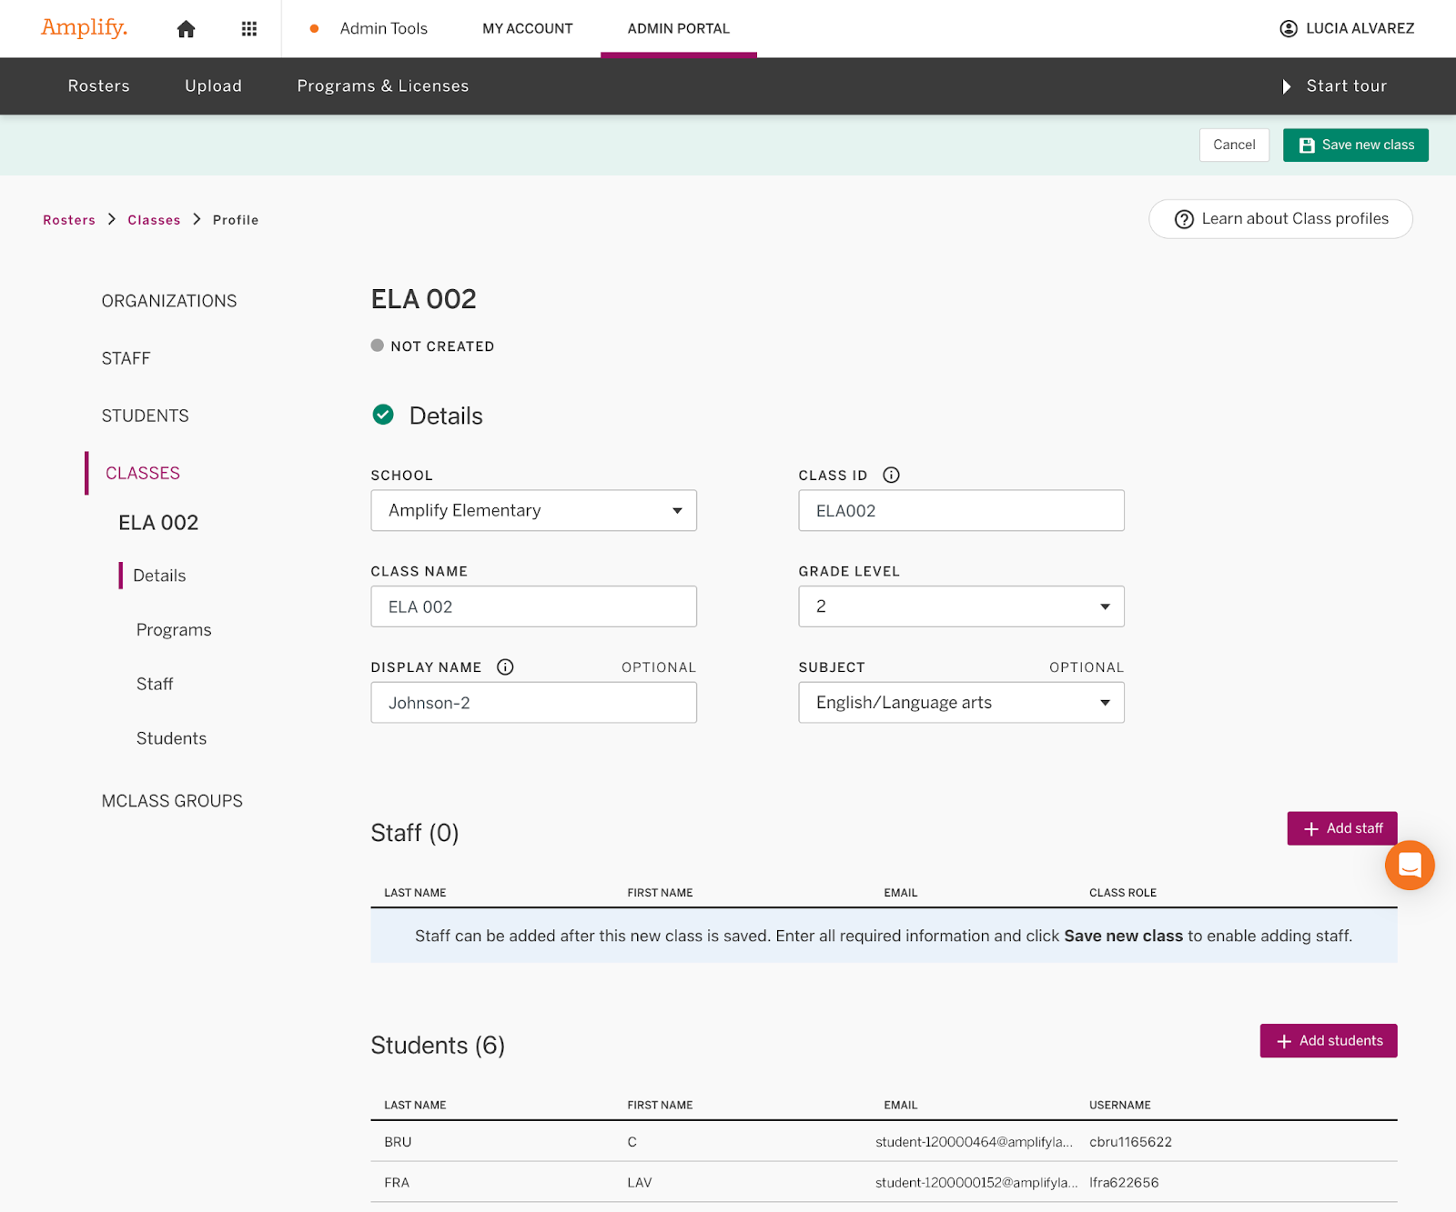
Creating a Class
You can add students to a new class from the Student list page.
Select the students.
From the Actions list, click Create a new class.
The new Class profile page displays.
The students you selected are in the new class.
Input the class information.
Click Save new class to save your changes.

Slide 33
Adding a Student
To enroll students, you must have System or Enrollment access.
Click the Students button on the Rosters page to view the list of students you have access to.
Click + Create new students.

Slide 34
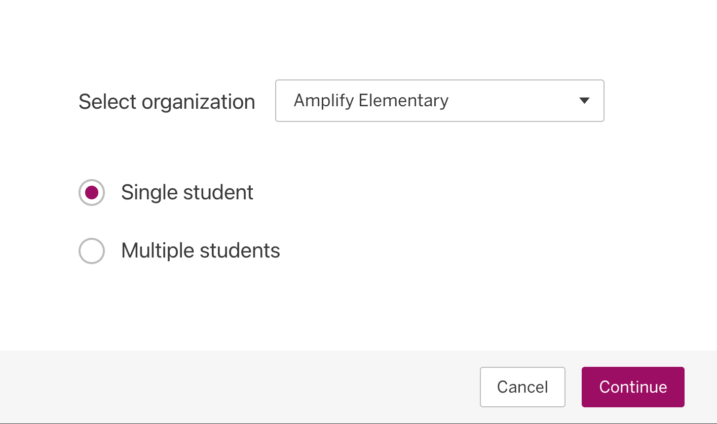
Adding a Student: Single or Multiple
Students can be added one at a time or in multiples.

Slide 35
Transferring a Student
Procedures for moving a student to a different school within a district
The student should be removed from the original school and added to the new school using the “Add Student” function in the Admin Portal.
Procedures for moving a student into your district from another district
This is still being discussed, but until there is other guidance, the department will provide a standard form for submission to assessment@la.gov for transfers.

Slide 36
Timeline for Student Updates in Amplify
Updates made in the Admin Portal will be reflected in mCLASS within 24 hours, with the exception of removals. If you have removed students from schools or classes, the removal will be reflected in mCLASS after the weekend sync, on Monday morning.

Slide 37
Removal of Students from the Roster
Students should only be removed for the following reasons:
Students who have been exited from enrollment in EdLink
Students who are being added to another school in the district
Students who participate in alternate assessment using LAAR
A request has been submitted to assessment@la.gov by another district to have them added to their roster.
The LDOE approved removal for some exceptional reason
Students should not be removed if they are absent but still enrolled.

Slide 38
Restarting the Screener
In the event of a critical disruption, the screener may be restarted. However, these restarts will be reported to the department and monitored. A testing irregularity form should be submitted to assessment@la.gov.

Slide 39
Accountability Codes
There will be no accountability codes collected or reporting during the 2023-2024 Window 2 December administration.
In 2024-2025 accountability codes will be required during all three testing windows.

Slide 40
Special Populations

Slide 41
Accommodations
Some accommodations may be applied during the screener if they are documented on an IEP, IAP or EL Checklist and they are used routinely during regular class instruction.
Breaks in between sections
Hearing aids, assistive listening devices, glasses, Smartwatches if used for medical reasons (Smartwatches and or phones that are used for medical reasons must be carefully monitored)
Enlarged student materials (magnification)
Covered overlays, filters or lighting adjustments
Marker or ruler for tracking
Whisper phones

Slide 42
Extended Time
For the administration of the state K-3 Literacy Screener, extended time is defined as double the time that is prescribed. For example, if all students must complete the subtest in 1 minute, extended time allows for 2 minutes. The screener sections should be strictly timed. Extended time is only available for the following students:
English learners as identified in EdLink 360 enrollment
Students with fluency-based speech disorders documented on IEPs
Students assessed with LAAR alternative rubric
Students with limited verbal language skills, as documented on the IEP, that are not participating in an alternate assessment
Students who require braille

Slide 43
Providing Extended Time in the Amplify System
The Amplify system will not provide extended time. However, users can provide the extended time by doing the following:
An additional timer will be needed for all test administrators who screen students with extended time (double time.)
The system will send the typical notification that time is up, but the TA can continue to administer the screening.
At the end of the extended time period, the TA should click “End.”

Slide 44
Braille
A hardcopy braille form is available for students with a visual impairment who are unable to take the computer-based test. Requests should be submitted as soon as possible using the following link:
K-3 Literacy Screener Request for Braille
No braille forms will be produced for the field tests, and students will not need to participate in field testing.

Slide 45
Testing Accommodations Not Permitted
The following test accommodations are not permitted on the K-3 Literacy Screener.
Test read aloud (all forms)
Word prediction
Communication assistance
Any other accommodation that subverts the measure

Slide 46
Remote Administration

Slide 47
Window 2 Remote Administration
Test administrators should not use the BOY remote PPTs. These decks have been replaced with MOY decks that must be used for any remote administration. Each deck is grade specific and can be found at this link: K3 Literacy Screener in the “Administration” Section
There will be no remote administration option for secure forms used for field test and for the Window 3 screening in April for grades K-2. When a secure form is added to grade 3 in future years, grade 3 will no longer be a remote option.

Slide 48
Test Security

Slide 49
Test Security
BESE policy regarding test security for all state administered administrations must be followed during each screening administration.
A. The state Board of Elementary and Secondary Education holds the test security policy to be of utmost importance and deems any violation of test security to be serious.
1. Tests administered by or through the SBESE shall include but not be limited to:
a. all alternate assessments;
b. all criterion-referenced tests (CRTs) and norm-referenced tests (NRTs).

Slide 50
Oaths of Security
Anyone who may come into contact with secure materials should have a signed oath of security prior to the adminsition window opening.
Test Administrators administering the MOY field test must complete an additional MOY field test oath of security. The field test forms are secure documents and cannot be copied for future use, shared, or memorized.
Oaths should be maintained at the school for three years.

Slide 51
Prohibited Materials
Prohibited materials can compromise test security and violate the construct being measured by the assessment, thus producing invalid results. Prohibited materials must be covered or removed from the testing room. This includes any document or display that provides content from the screener or content related to the items on the screener.

Slide 52
Reporting Results

Slide 53
Receiving a Report from the System
The statewide Amplify program will provide real-time reports to schools and systems. The department will host a separate webinar for administrative directions to review reports.
All results for screening in the Amplify platform to the department will be completed by the vendor. Schools and systems will NOT send results, with the exception of scores from LAAR. As there is no need for the Composite Score Calculator, it is being removed from the website.
Results from field testing will not be reported.

Slide 54
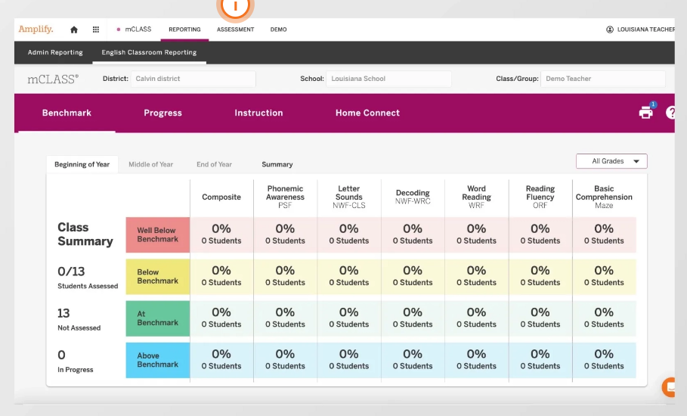
Example of Reporting

Slide 55
Alternate Assessment: Reporting to EdLink
For the 2023-2024 academic year, alternate assessment scores from LAAR must continue to be reported in EdLink using a format similar to the one used in Window 1. Please make sure that you indicate that the student participated in alternate assessment and provide the reason for participation.
Please note that for regular screening, all administration MUST BE DONE IN THE AMPLIFY PLATFORM AND NO REGULAR SCREENING CAN BE REPORTED IN EDLINK FOR ANY REASON.

Slide 56
Qualifying for Alternate Assessment
The IEP in place by the deadline should reflect that the student qualified for alternate assessment based on qualification guidelines for their official enrolled grade. Links for criteria are provided below. The IEP should also reflect the current grade.
K-2 Alternate Assessment Participation Decision-making Tool
Grades 3-8 Alternate Assessment Criteria
Grade 3:

Slide 57
Field Testing

Slide 58
Sites Selected for Field Testing
District test coordinators were notified and provided with sites selected for field testing prior to the Thanksgiving break. Students in field testing schools will be required to take three versions of the screener:
Students participating in alternate assessment or who need braille will not be included in field testing.
Two versions of the field test have been color coded. While students in selected schools must participate in both versions, the color of the field test form determines which screener must be administered first.
The deadline for completing field testing is January 9.
The deadline for completing the regular screener is January 26.

Slide 59
Remote Administration of Field Test
Field test forms cannot be administered remotely. Any remote administration of any field test form (orange or purple) will be considered a serious violation of test security.

Slide 60
Resources
For ease, all K-3 Literacy department created guidance is found in a central location:
https://www.louisianabelieves.com/academics/louisiana-literacy/literacy-screener
For questions about literacy policy, contact the literacy team.
For questions about administration of the screening, contact assessment@la.gov.

