Slide 1
Off Campus Registered Apprenticeships: Development

Slide 2
Kelly DiMarco
Jefferson Parish Schools
Ellis Bourque
New Orleans Plumbers and Steamfitters Local 60

Slide 3
Registered Apprenticeship
Development

Slide 4
Agenda
Introduction and Overview
Year I-The Beginning
Year II-Progress
Questions & Answers
Closing Remarks

Slide 5
Overview
High school registered apprenticeship programs combine work-based, on-the-job learning with relevant technical education in the classroom.
Students who participate in apprenticeship programs graduate with a high school diploma and industry credentials.
Cluster: Architecture & Construction
Program of Study: Plumbing/Pipe Trades

Slide 6
Year I-The Beginning
Once the students complete the Fast Forward program and successfully graduate, they have earned two years of registered apprenticeship credit toward the five year registered apprenticeship program.

Slide 7
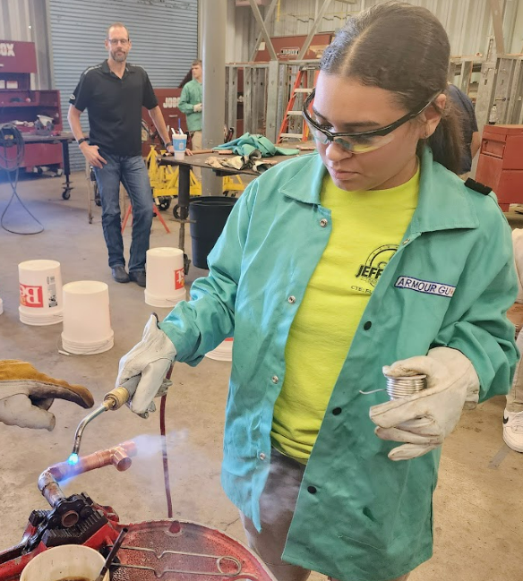
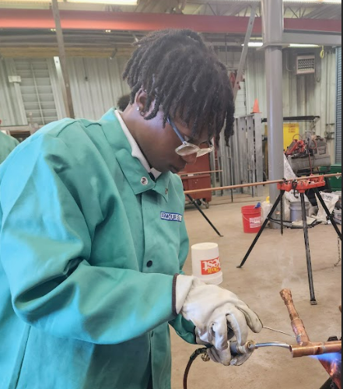
Student Supports
Pulse Points Orientation Signing Day Parent/Student Open House Dual Enrollment Summer Internships Job Recruitment Event

Slide 8
Funding/Transportation
CDF- pre-apprenticeship course code for transportation
Intended CDF Course Codes:
Fall 2022 Qualifying Pre-Apprenticeship I 080231 (2 credits)
Spring 2023 Qualifying Pre-Apprenticeship II 080234 (2 credits)
Fall 2023 Qualifying Pre-Apprenticeship III 080237 (2 credits)
Spring 2024 Qualifying Pre-Apprenticeship IV 080240 (2 credits)

Slide 9
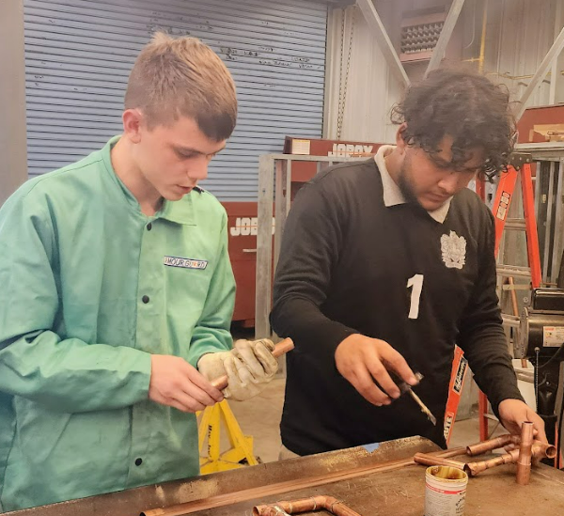
Year II-Progress
Attendance/Stipend
Dual enrollment
Behavioral Expectations
Transportation
Curriculum Adjustments
MOU
Notes:
Year III-additional schools and sections

Slide 10
Contact Information
Kelly DiMarco
Director of Workforce Development
Jefferson Parish Schools
kelly.dimarco@jpschools.org
Ellis Bourque
Director of Apprenticeship Training
New Orleans Plumbers and Steamfitters Local 60
ebourquelu60@gmail.com

