Slide 1
LWC Registered Apprenticeships (the second year…)

Slide 2
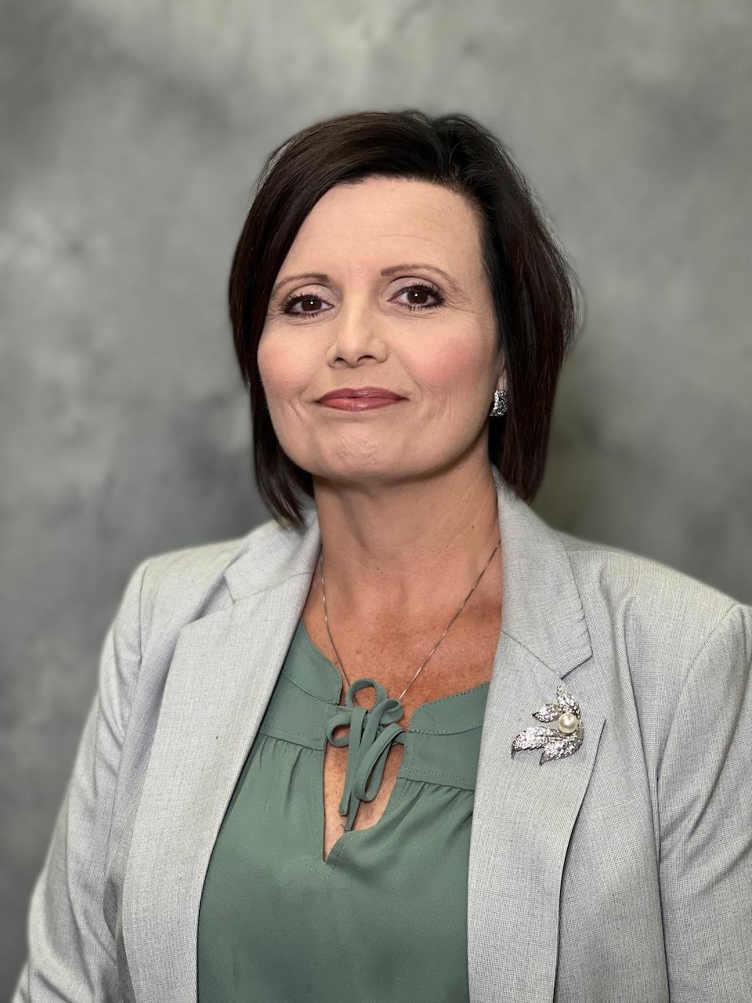
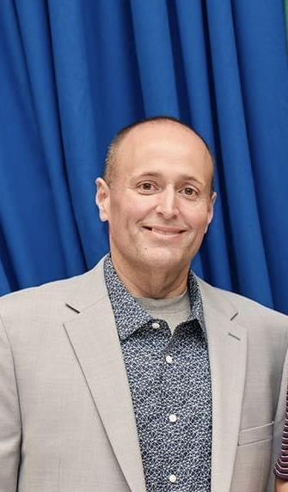
Lafourche Parish School District
Bonnie Lefort
CTE Coordinator
Jarad Walker
CMC Principal

Slide 3
Agenda
The Why?
1st Cohort
Lessons Learned
2nd Cohort
Future Plans
Questions

Slide 4
The Why?
Fast Forward High-Demand Apprenticeship Pathway
This pathway offers a wide range of careers and post-secondary pathways to pursue after participating in a Louisiana Workforce Commission registered pre-apprenticeship/apprenticeship program.
Notes:
This pathway encompasses a vast array of careers or postsecondary pathways students may enter after participating in a Louisiana Workforce Commission approved pre-apprenticeship/ apprenticeship program and dually earning a Jump Start TOPS Tech Career Diploma or a TOPS University Diploma. Students will spend grades 9 and 10 on the high school campus earning required diploma coursework. During grades 11 and 12 the majority of time will be spent in a state approved pre-apprenticeship/apprenticeship earning the 9 courses required to earn a Jump Start TOPS Tech Career Diploma or a TOPS University Diploma in addition to finishing the required coursework and electives to complete a full pre-apprenticeship/ apprenticeship experience.

Slide 6
The Why?
Student Benefits
Increase in wages
Discovering their “Why”
OTJ experiences
Completion Certificate
Notes:
Through the Apprenticeship Agreement, an apprentice, as an employee, receives supervised, structured on-the-job training and related technical instruction to perform at a highly skilled level. Some Registered Apprenticeship programs offer dual accreditation through post-secondary institutions that apply credit for apprenticeship completion toward an associate degree.
A progressively increasing schedule of wages is based on the journeyman's hourly wage of the apprentice's occupation. These increases occur with satisfactory progress in both related instruction and on-the-job training until wages reach up to 95 percent of the rate paid the journeyman in the occupation.
Upon completing a one- to four-year (2,000 to 8,000 hours) apprenticeship, the worker receives an Apprenticeship Completion Certificate and is recognized nationwide as a qualified journeyman. This certificate is one of the most respected and portable industry credentials in use today. The certificate is issued by the Louisiana State Apprenticeship Division.

Slide 7
The Why?
Employer Benefits
Attract adequate numbers of highly qualified applicants.
Address industry's need to remain competitive by investing in the development and continuous upgrade of the skills of its workforce.
Increase productivity.
Reduce cost of training.
Facilitate compliance with federal and state equal employment opportunity requirements.
Ensure availability of related technical instruction.
Enhance problem-solving ability of craft workers.
Ensure versatility of craft workers.
Develop a more committed workforce.

Slide 8
The Why?
School Benefits
The schools system as the “Sponsor”
Notes:
- Additional programs

Slide 9
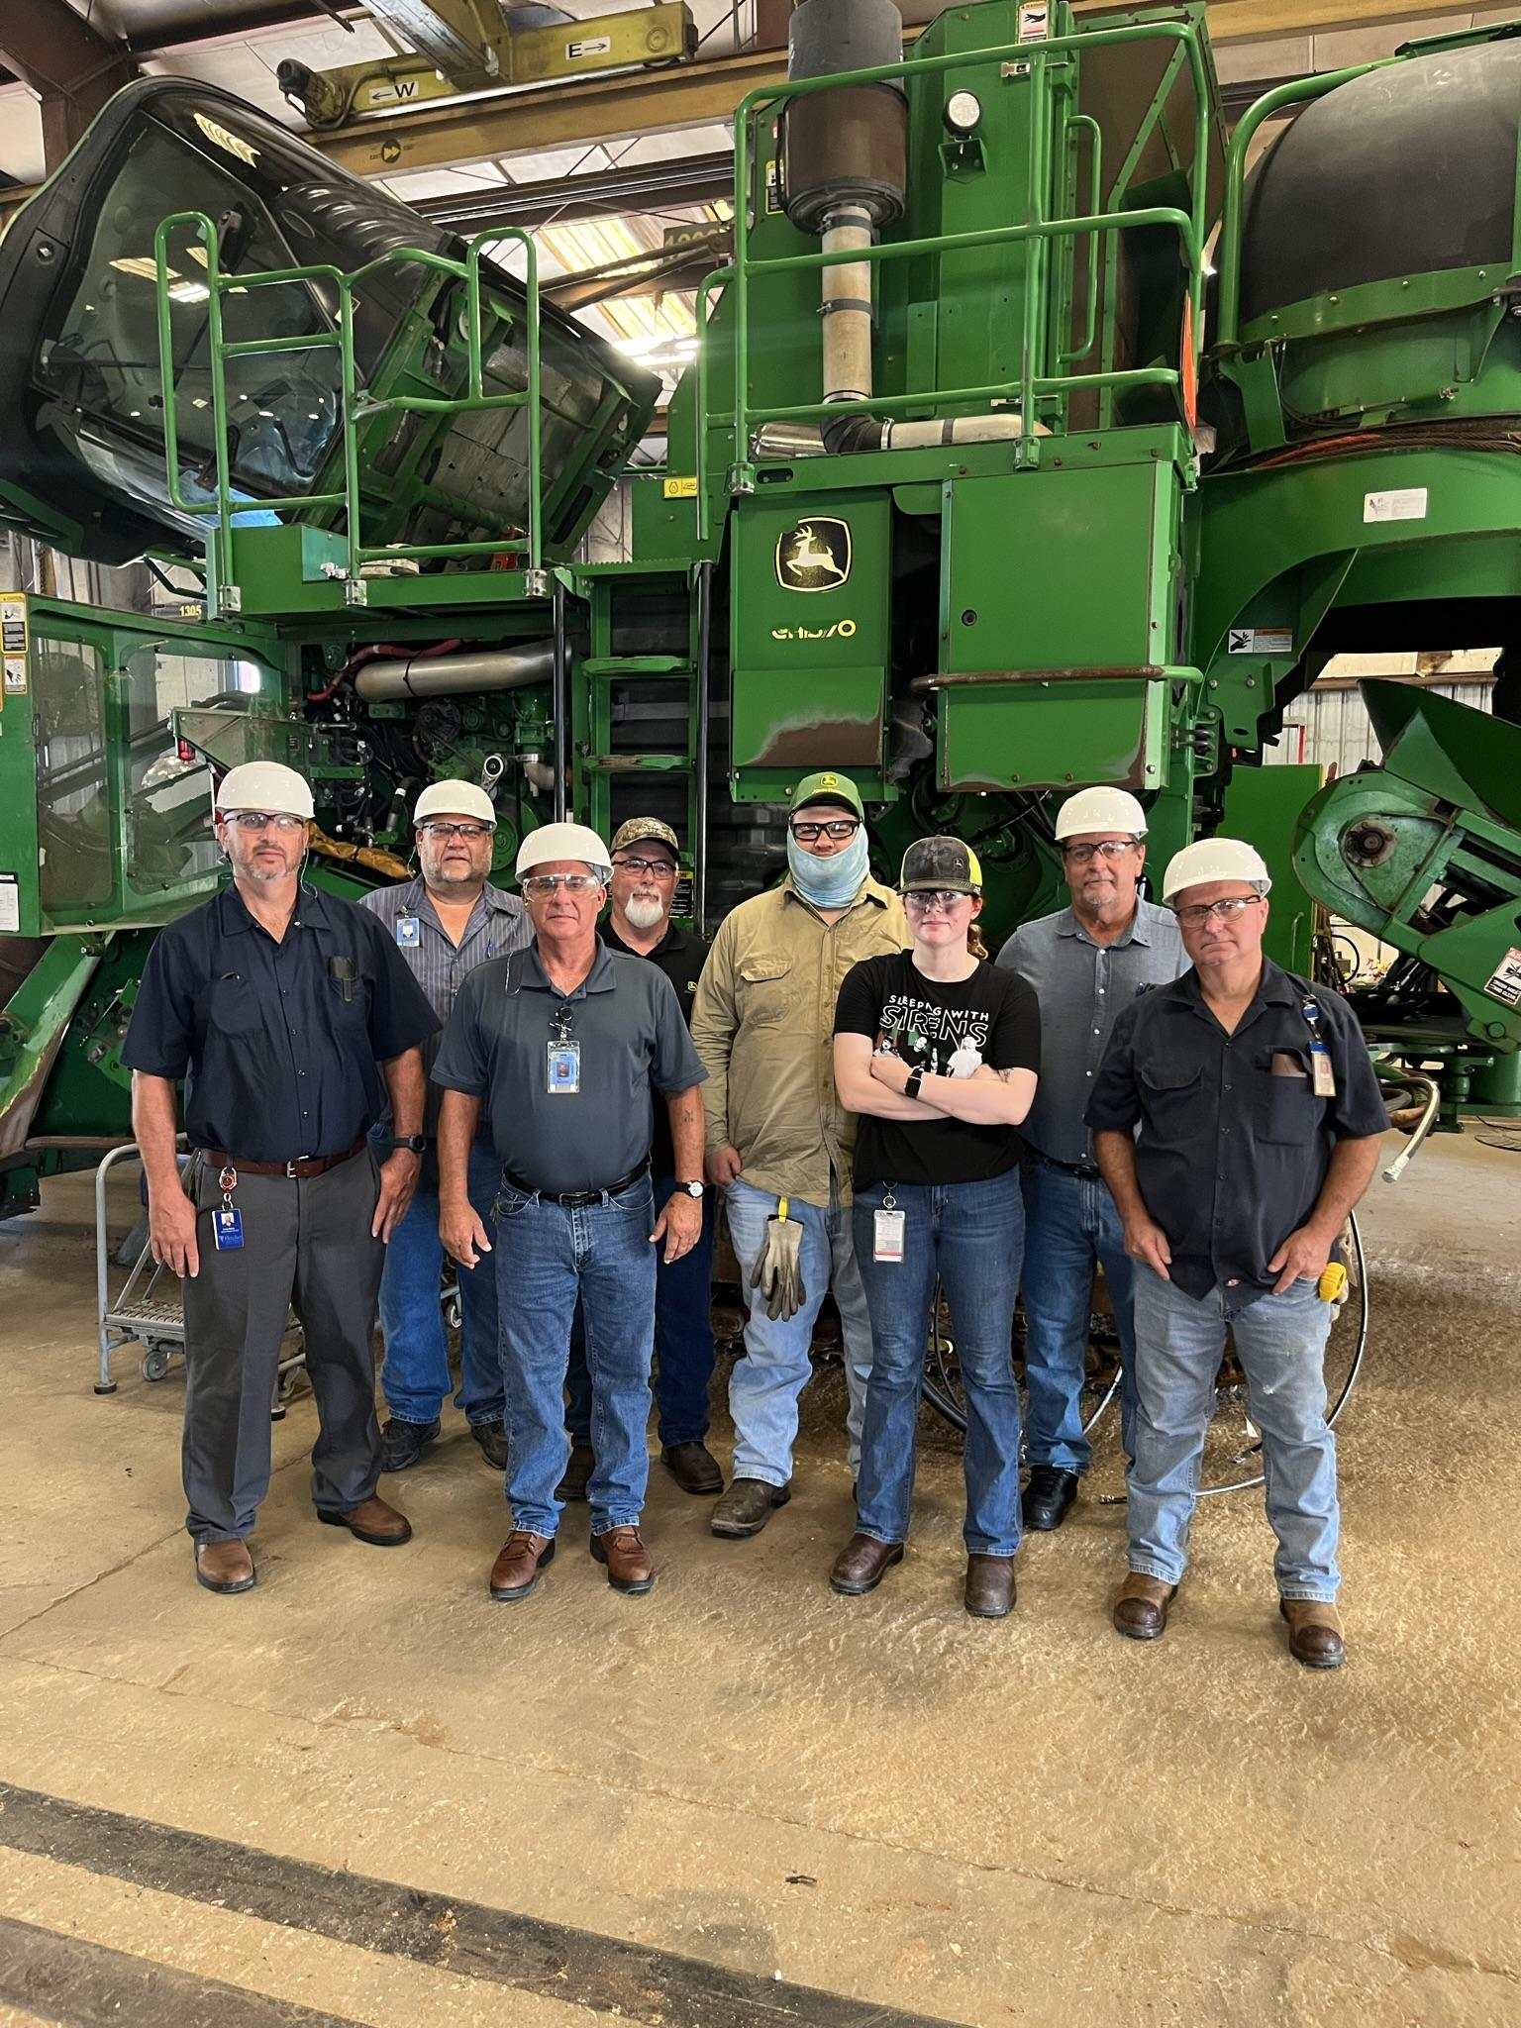
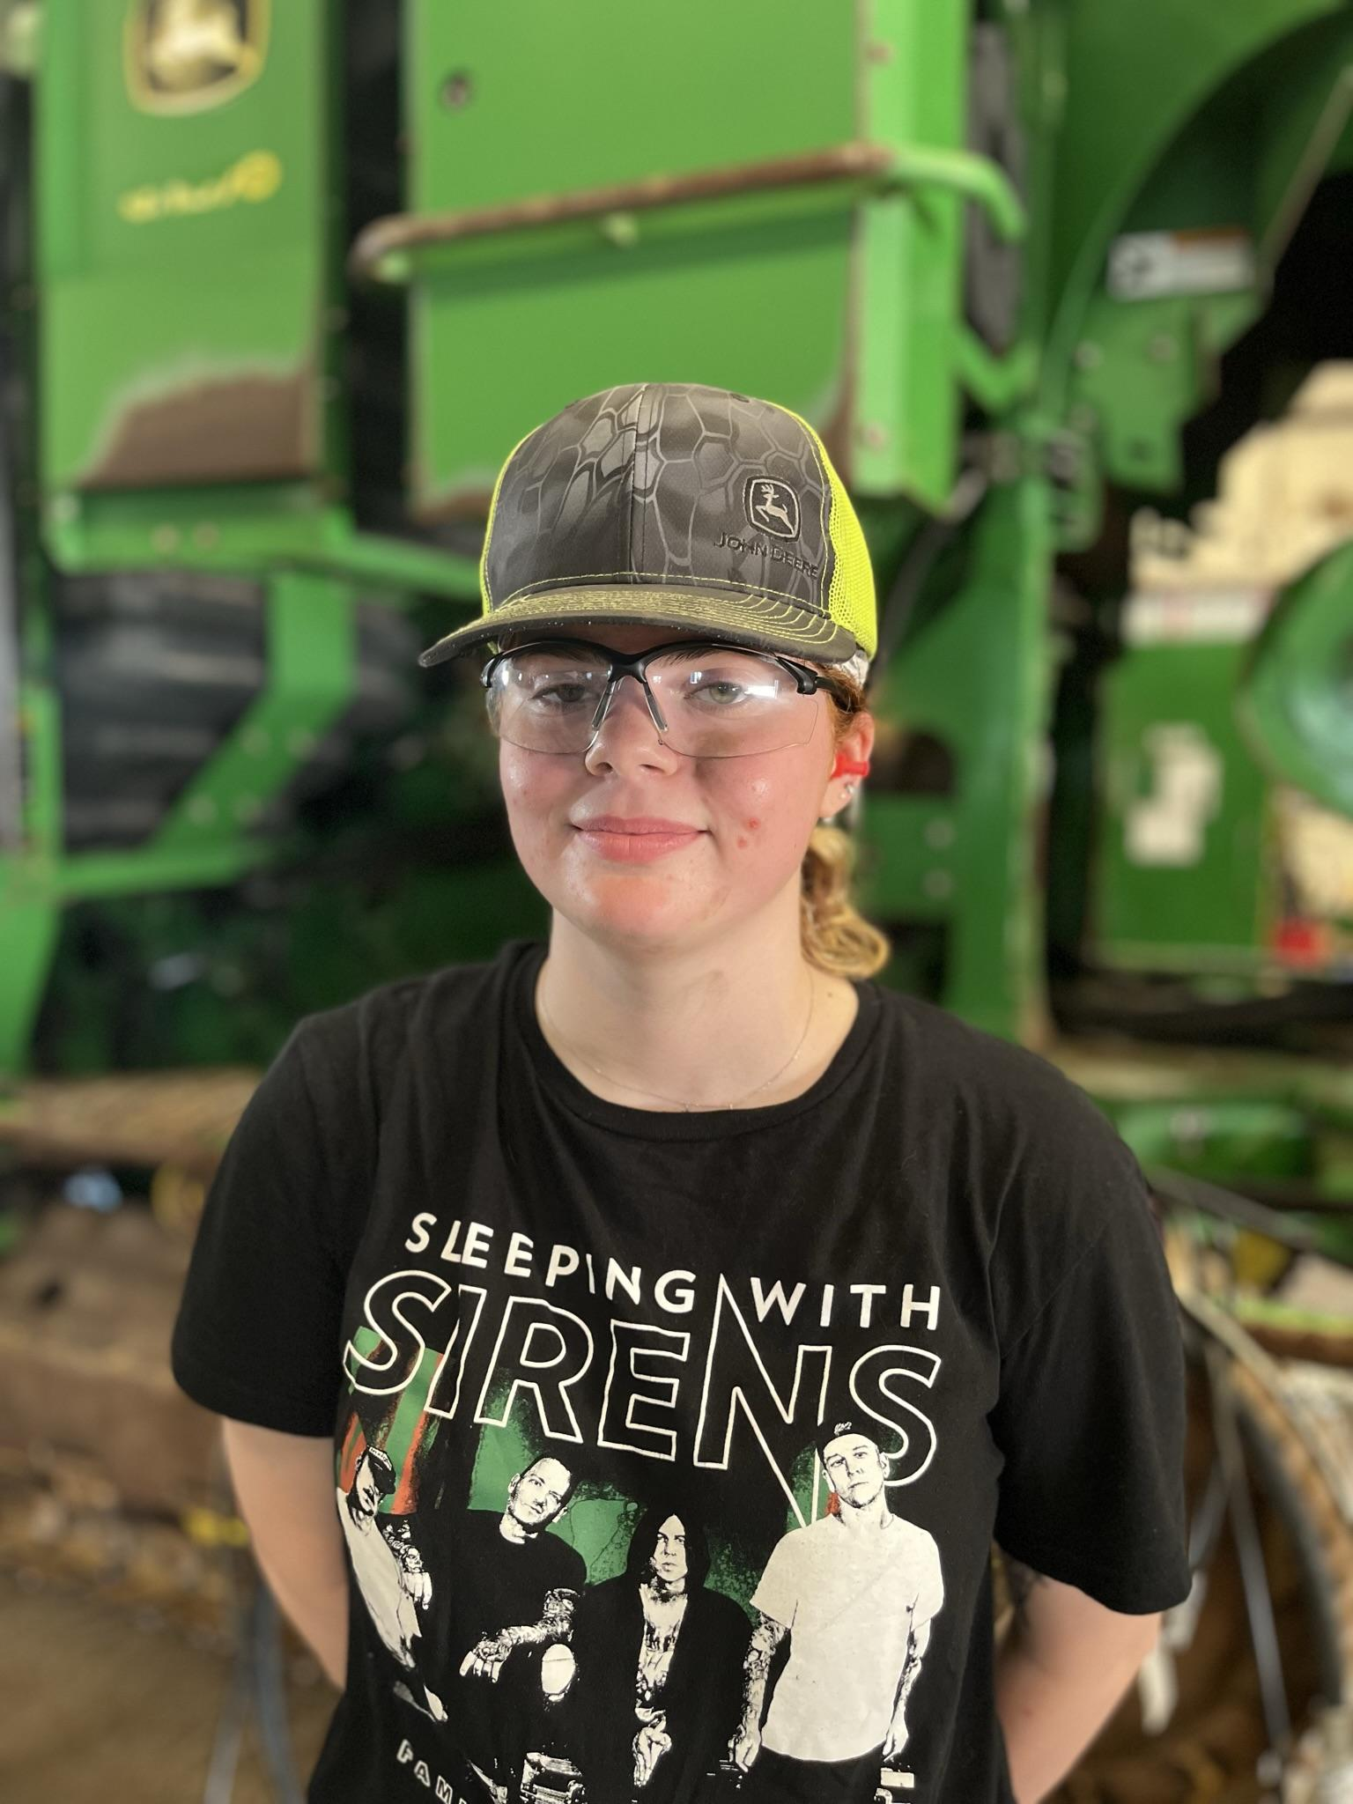
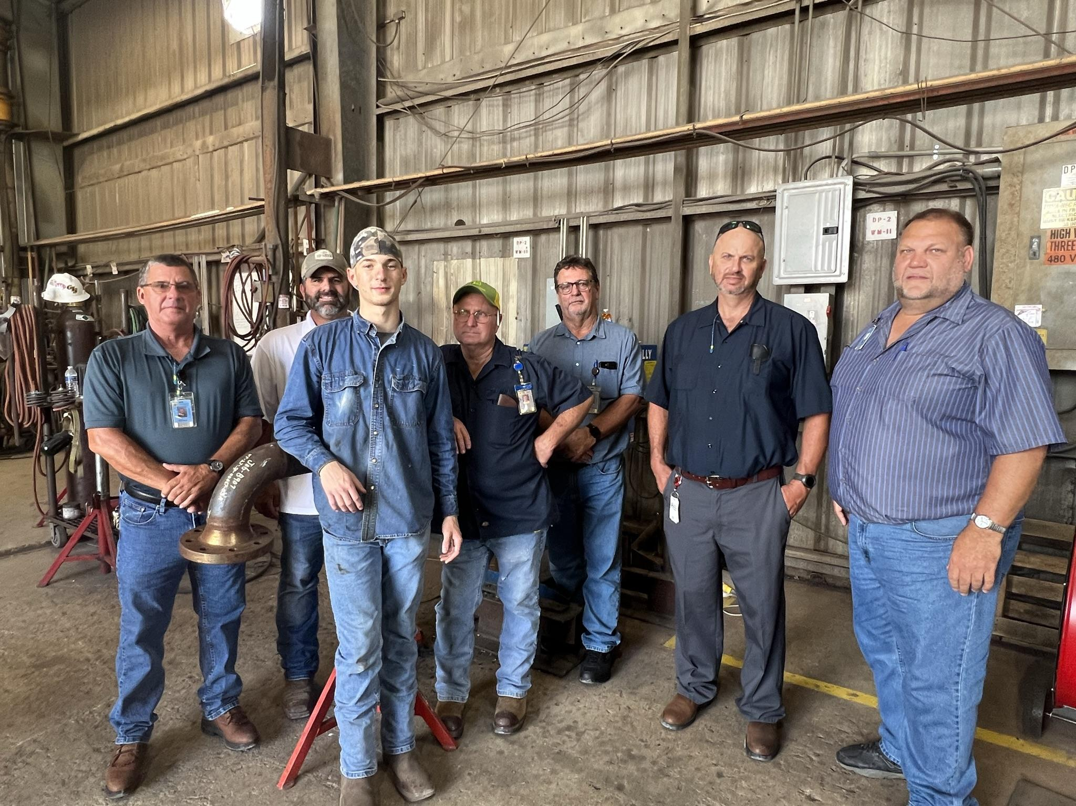
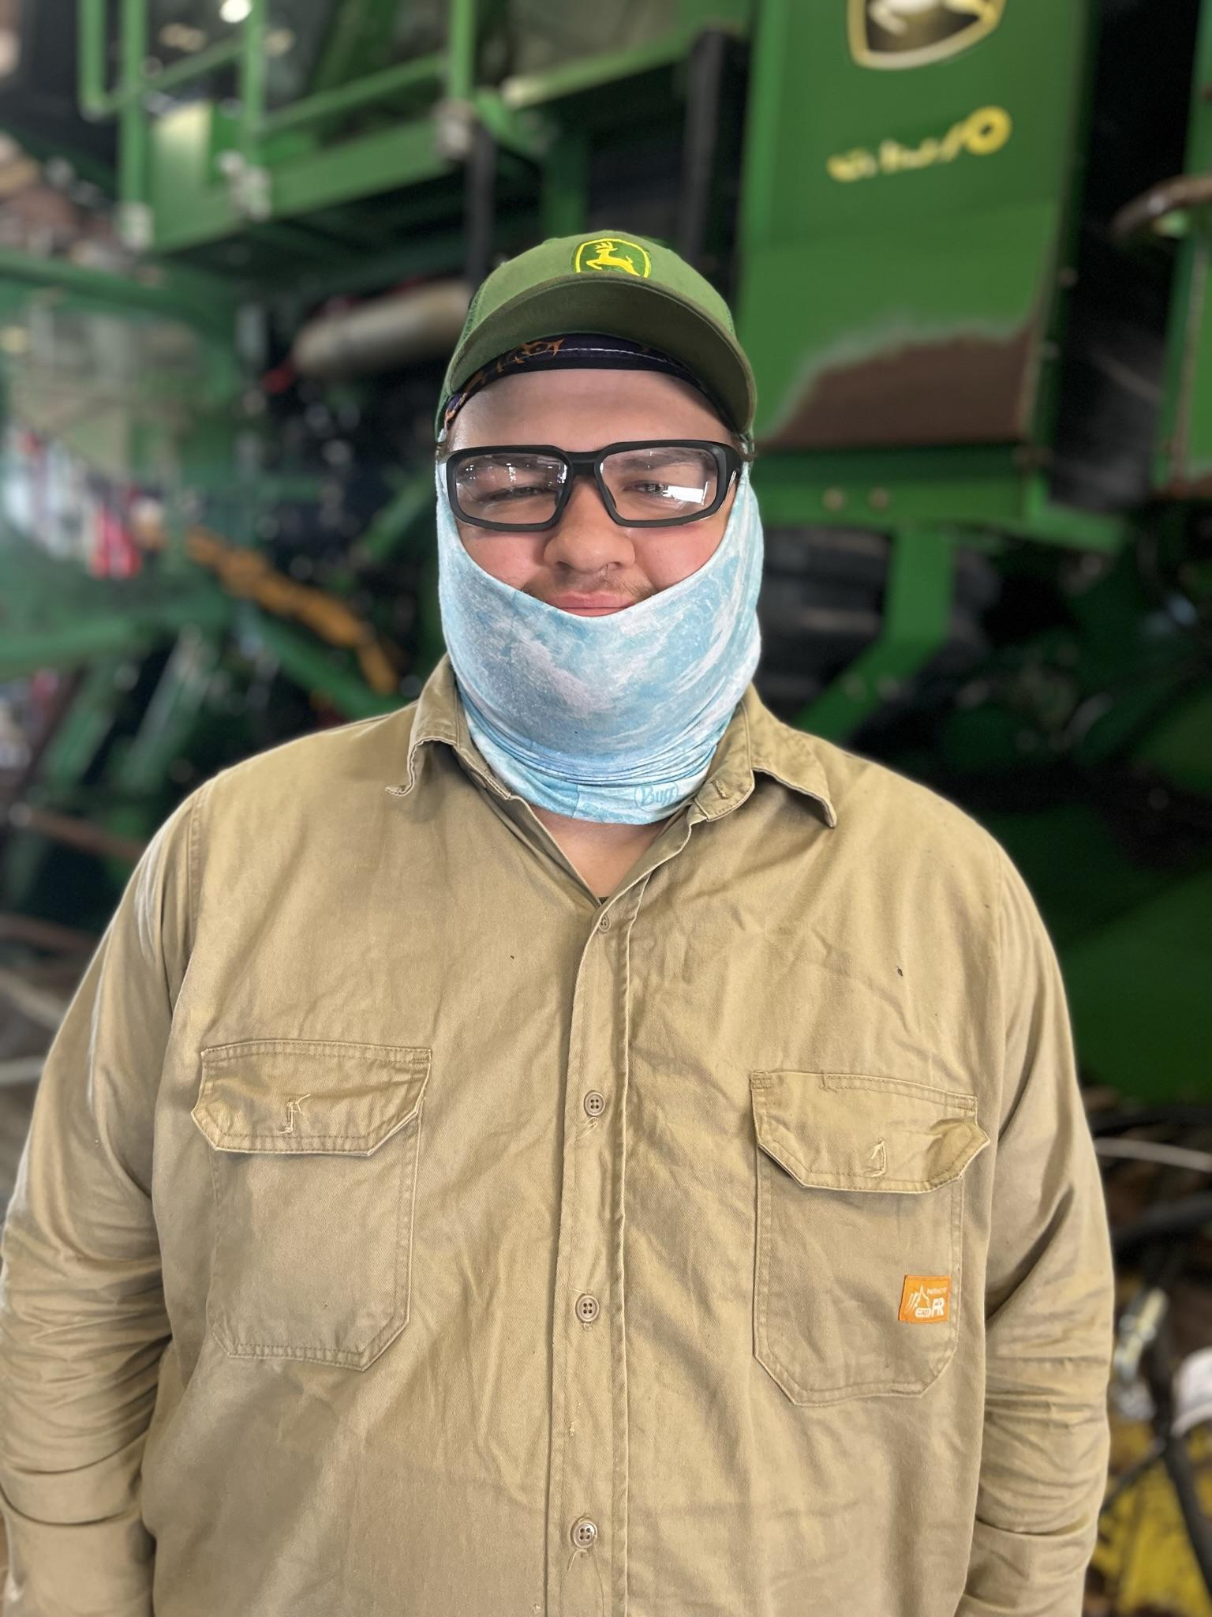
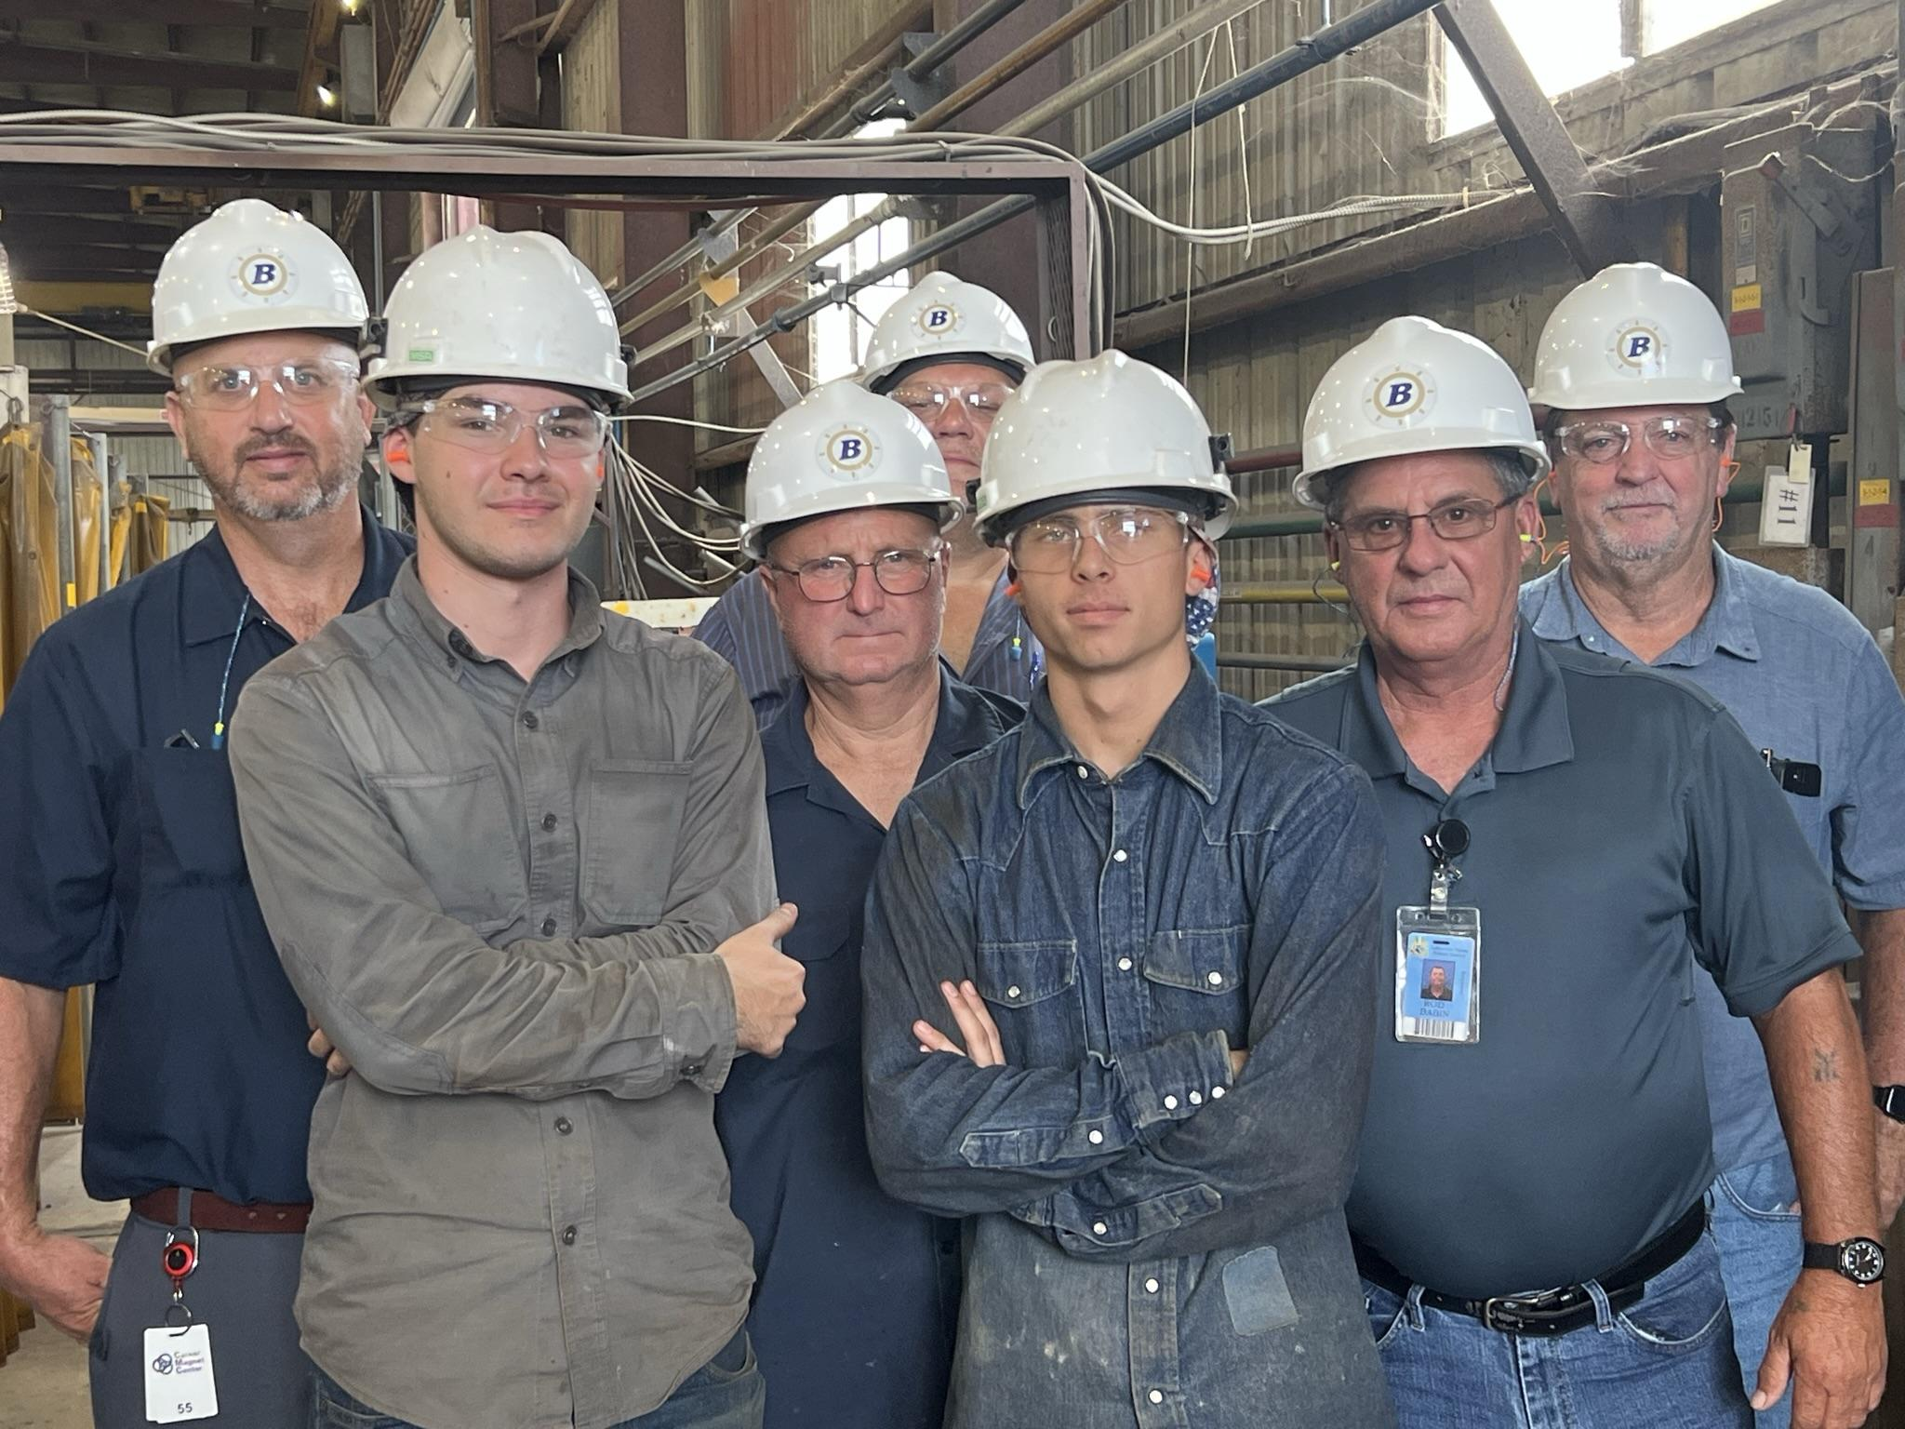
The “Real” Why?

Slide 10
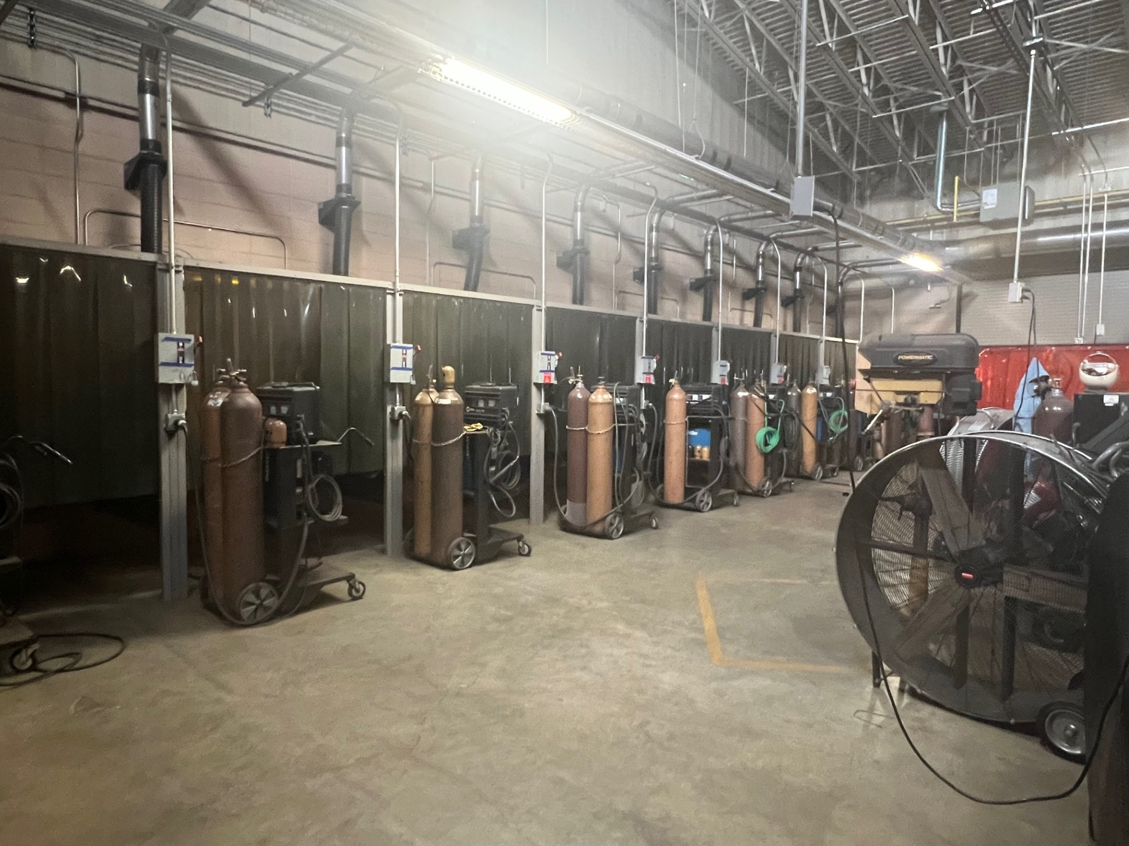
1st Cohort
Welding Apprenticeship
The Process
Active Advisory Board
Strategic Partnership with LCTCS (Fletcher Technical Community College)

Slide 11
Lessons Learned
Timing of Selection Process
Cohort 1 – Spring
Cohort 2 – Fall/Winter
Notes:
#of hours students accumulate begin once students are entered into RAPIDS

Slide 12
Lessons Learned
Interview Process
Cohort 1 & 2
Plans for Cohort 3
Notes:
Currently
Soft skills Lessons
Application Completion – students select companies based on their requests
Interview Schedule – over multiple days
Next Year
Soft Skills Lessons
Application Completion – students will apply to ALL companies
Interview Schedule – one day with student rotation

Slide 13
WELDING |  |  |  |  |  | DIESEL
ECO -- 2 |  | Interview Date |  | Interview Time |  | ECO -- 5 |  | Interview Date |  | Interview Time
Kaleb Guidry | ☑️ | 11/28/23 | 1 | 9:15 - 9:30 |  | Nathan Zirlott | ☑️ | 11/28/23 | 1 | 1:15 - 1:30
Crystal Owensby | ☑️ | 11/28/23 | 2 | 9:00 - 9:15 |  | Braydon Lepine | ☑️ | 11/28/23 | 2 | 1:00 - 1:15
 |  |  |  |  |  | Talan Bonvillain | ☑️ | 11/28/23 | 3 | 12:45 - 1:00
John Deere -- 2 |  | Interview Date |  | Interview Time |  | John Deere -- 1 |  | Interview Date |  | Interview Time
Adam Hebert | ☑️ | 11/29/2023 | 1 | 1:00 - 1:15 |  | Brady Benoit | ☑️ | 11/30/2023 | 1 | 12:30 - 12:45
Christian Martin | ☑️ | 11/29/2023 | 2 | 12:30 - 12:45 |  | Neily Rivet | ☑️ | 11/30/2023 | 2 | 1:30 - 1:45
Kaeden Koeberle | ☑️ | 11/29/2023 | 3 | 12:45 - 1:00 |  | Nathan Zirlott | ☑️ | 11/30/2023 | 3 | 1:15 - 1:30
Isaac Chavez | ☑️ | 11/29/2023 | 4 | 1:30 - 1:45 |  | Caden Rodrigue | ☑️ | 11/30/2023 | 4 | 12:45 - 1:00
Roland Vining | ☑️ | 11/29/2023 | 5 | 8:30 - 8:45 |  | Braydon Lepine | ☑️ | 11/30/2023 | 5 | 1:00 - 1:15
Darrell Jones | ☑️ | 11/29/2023 | 6 | 8:45 - 9:00
Ryan Vega | ☑️ | 11/29/2023 | 7 | 8:15 - 8:30
Braxton Lafleur | ☑️ | 11/29/2023 | 8 | 1:15 - 1:30
Crystal Owensby | ☑️ | 11/29/2023 | 9 | 8:00 - 8:15
GIS -- 1 |  | Interview Date |  | Interview Time |  | GIS -- 1 |  | Interview Date |  | Interview Time
Kaleb Guidry | ☑️ | 12/04/2023 | 1 | 9:15 - 9:30 |  | Braydon Lepine | ☑️ | 12/04/2023 | 1 | 1:00 - 1:15
Crystal Owensby | ❌ | 12/04/2023 | --- | 9:00 - 9:15 |  | Nathan Zirlott | ☑️ | 12/04/2023 | 2 | 1:15 - 1:30
 |  |  |  |  |  | Talan Bonvillain | ☑️ | 12/04/2023 | 3 | 12:45 - 1:00
Bollinger -- 1 |  | Interview Date |  | Interview Time
Crystal Owensby | ☑️ | 12/6/2023 | 1 | 8:45 - 9:00
Ryan Vega | ☑️ | 12/6/2023 | 2 | 9:00 - 9:15
Roland Vining | ☑️ | 12/6/2023 | 3 | 9:15 - 9:30
Gulf Island -- 2 |  | Interview Date |  | Interview Time
Kaeden Koeberle | ☑️ | 12/05/2023 | 1 | 12:30 - 12:45
Braylon Naquin | ☑️ | 12/05/2023 | 2 | 12:45 - 1:00
Ryan Vega | ☑️ | 12/05/2023 | 3 | 9:15 - 9:30
Crystal Owensby | ☑️ | 12/05/2023 | 4 | 9:00 - 9:15
Kenworth -- 1 |  | Interview Date |  | Interview Time |  | Kenworth -- 2 |  | Interview Date |  | Interview Time
Roland Vining | ☑️ | 12/1/23 | 1 | 9:00 - 9:15 |  | Brady Benoit | ☑️ | 12/1/23 | 1 | 1:30 - 1:45
Ryan Vega | ☑️ | 12/1/23 | 2 | 9:15 - 9:30 |  | Nathan Zirlott | ☑️ | 12/1/23 | 2 | 1:00 - 1:15
Braxton Lafleur | ❌ | 12/1/23 | ---- | 12:30 - 12:45 |  | Neily Rivet | ☑️ | 12/1/23 | 3 | 12:45 - 1:00
 |  |  |  |  |  | Braydon Lepine | ☑️ | 12/1/23 | 4 | 1:45 - 2:00
 |  |  |  |  |  | Talan Bonvillain | ☑️ | 12/1/23 | 5 | 1:15 - 1:30

Slide 14
Lessons Learned
Time Management
Cohort 1
Cohort 2
Notes:
Current
School calculates hours & waits for business partners to supply work hours
Going forward
Develop a shareable spreadsheet to update hours which can calculate projections

Slide 15
Lessons Learned
Flexibility with Business Partners
Site Visits
Competency Reviews

Slide 16
2nd Cohort
Welding & Diesel Apprenticeships
New Business Partners

Slide 17
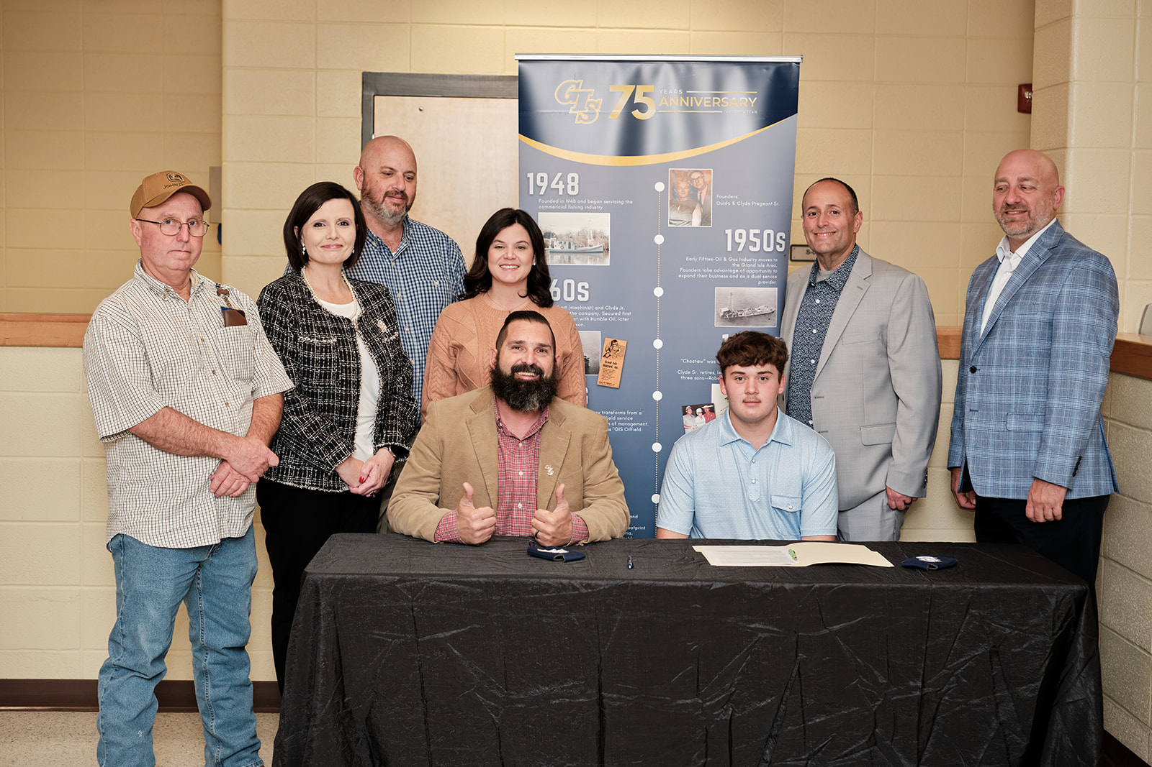
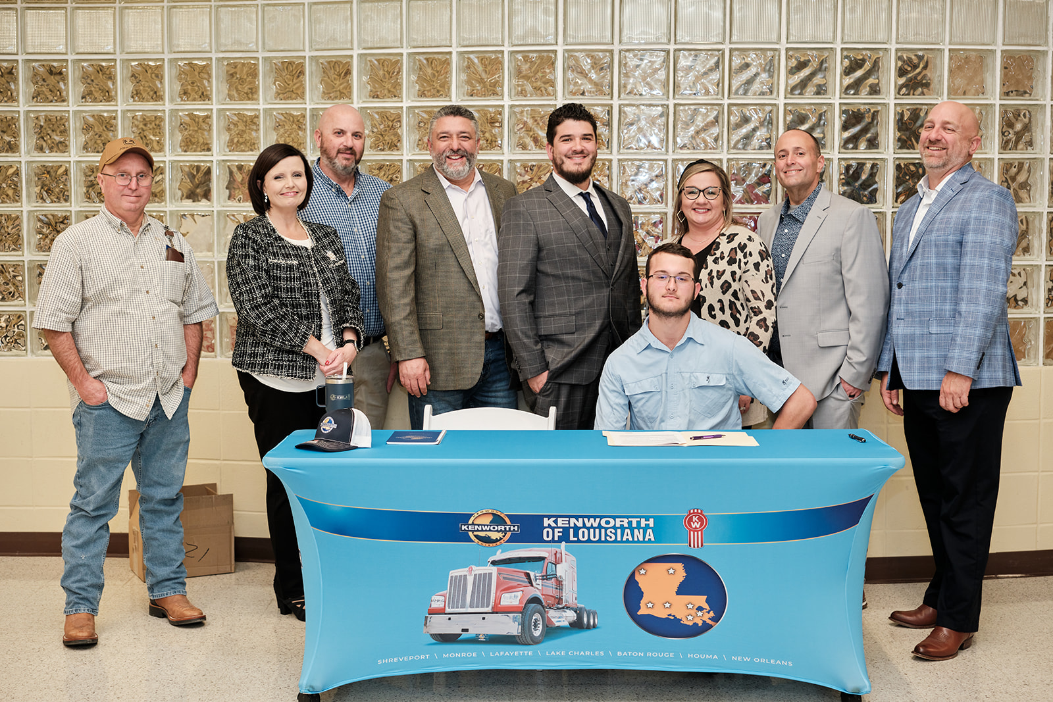
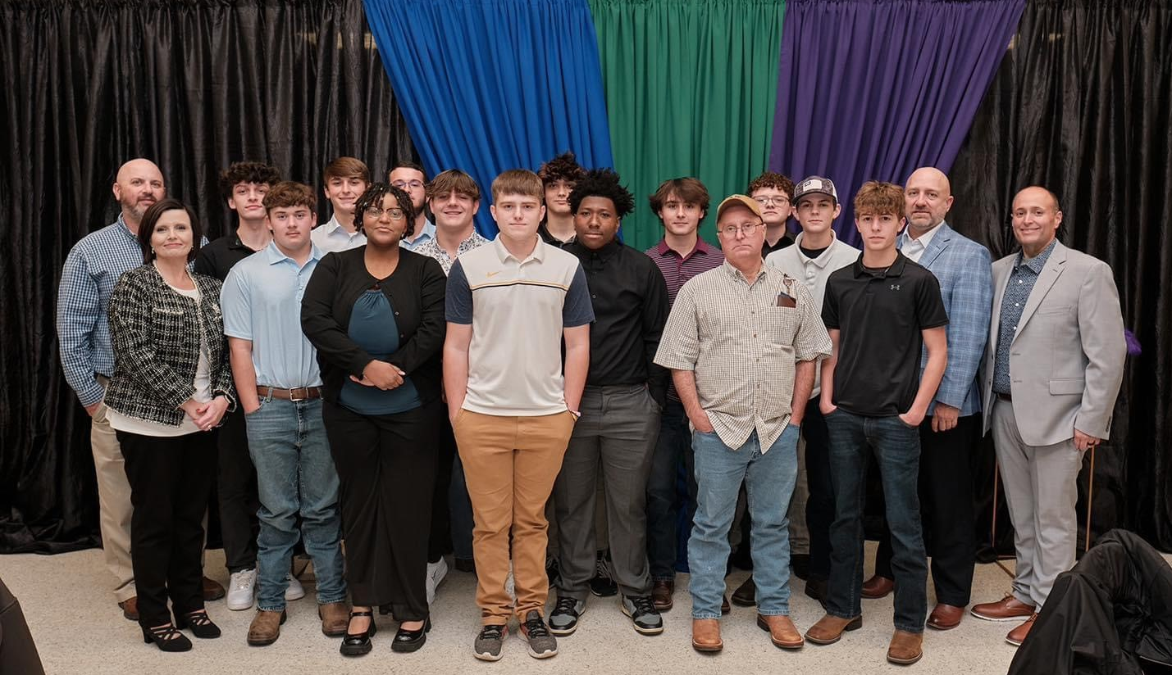
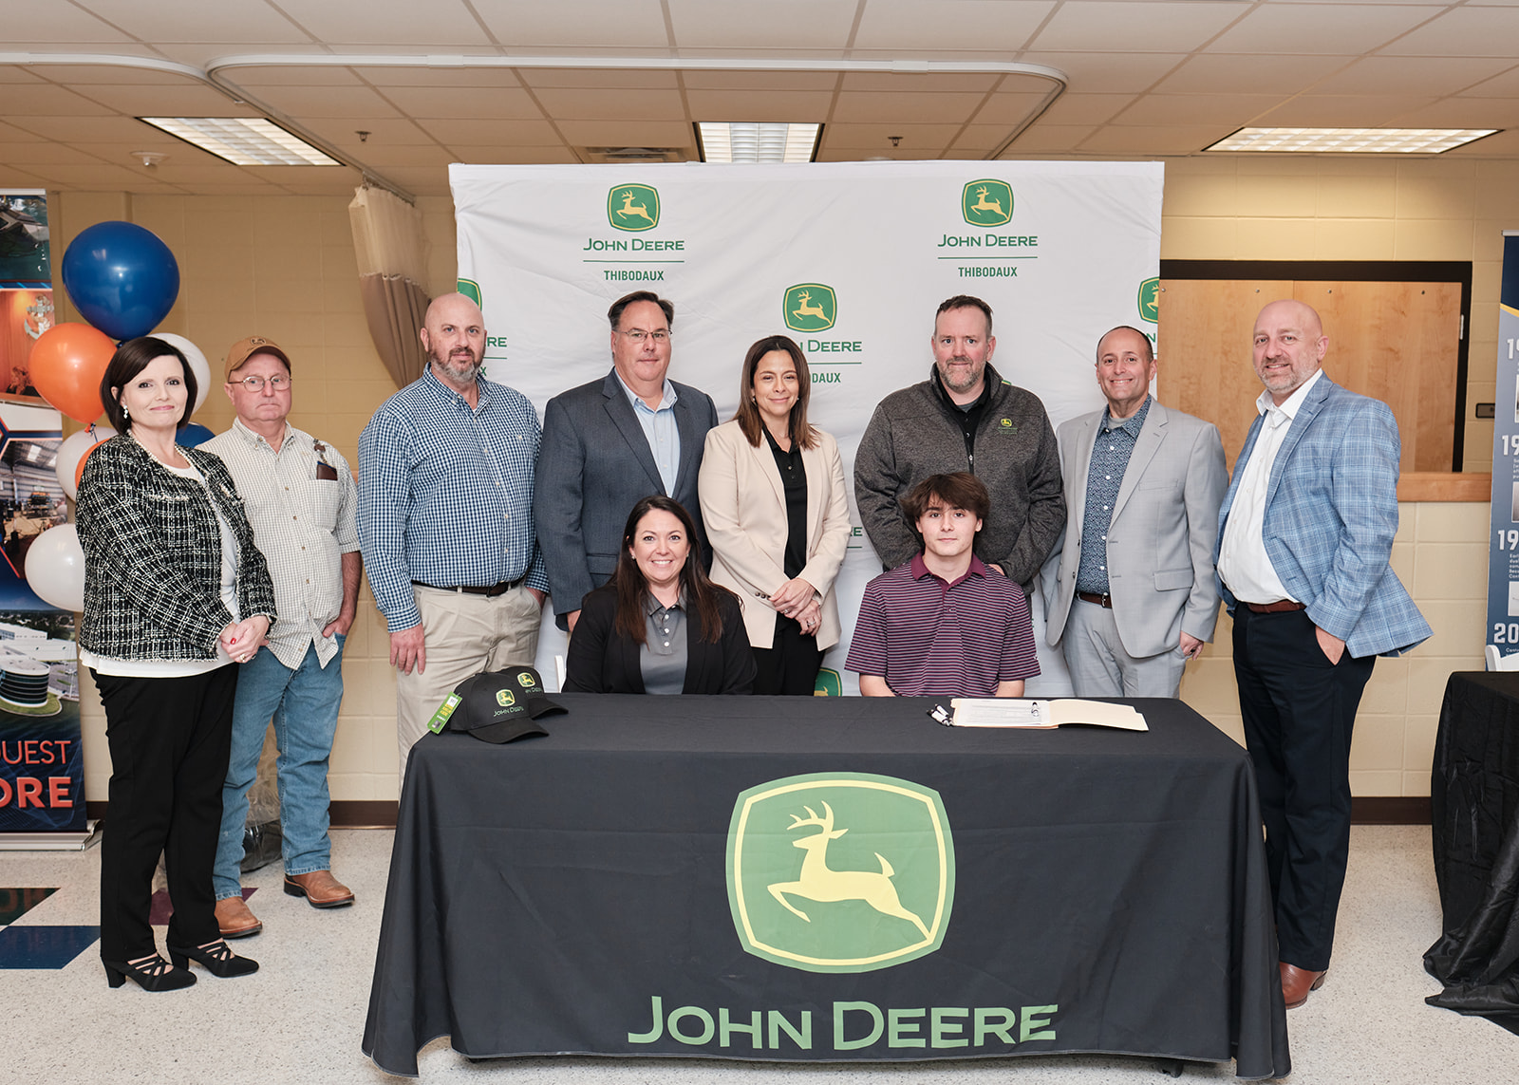
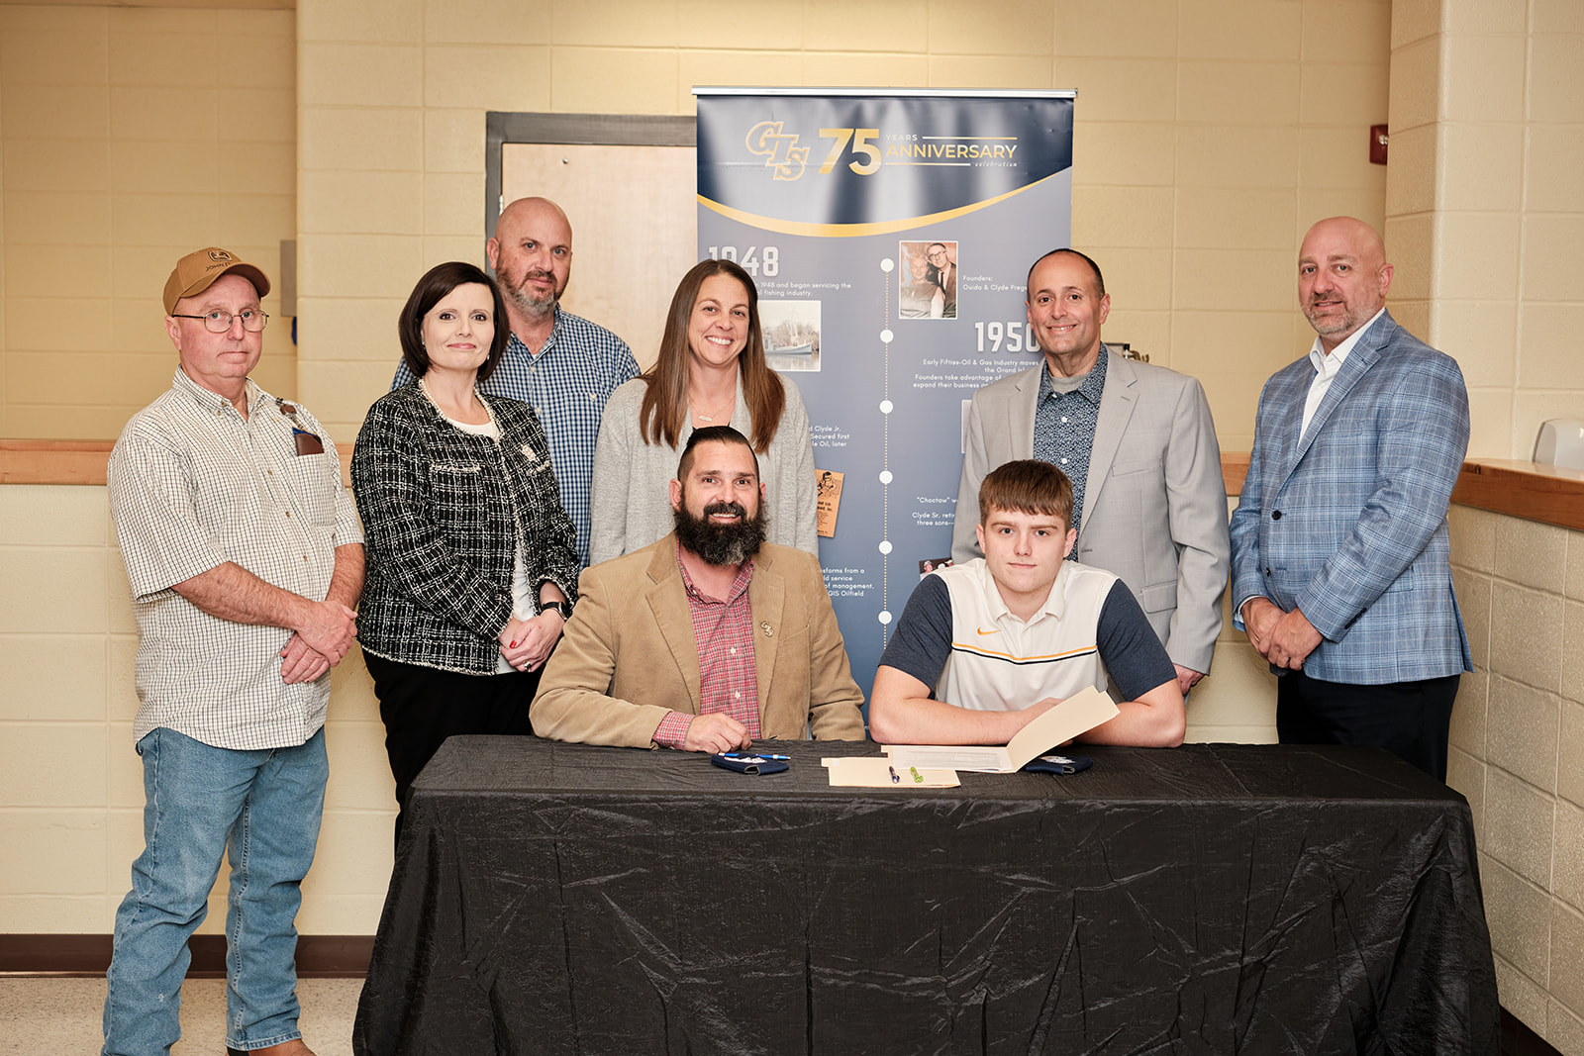
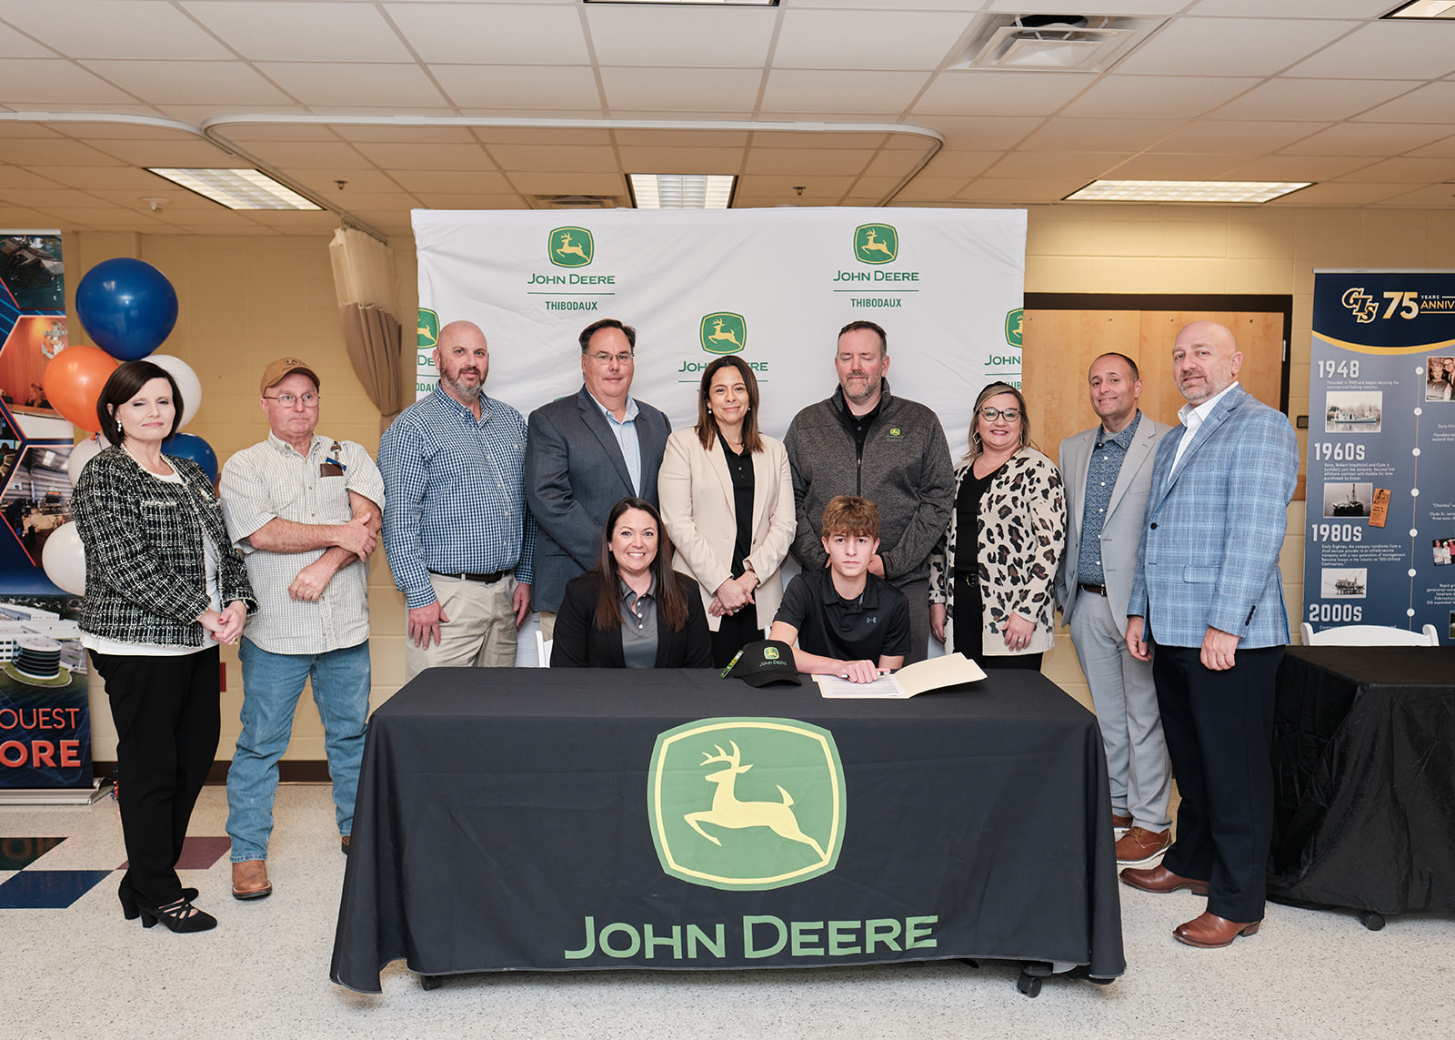
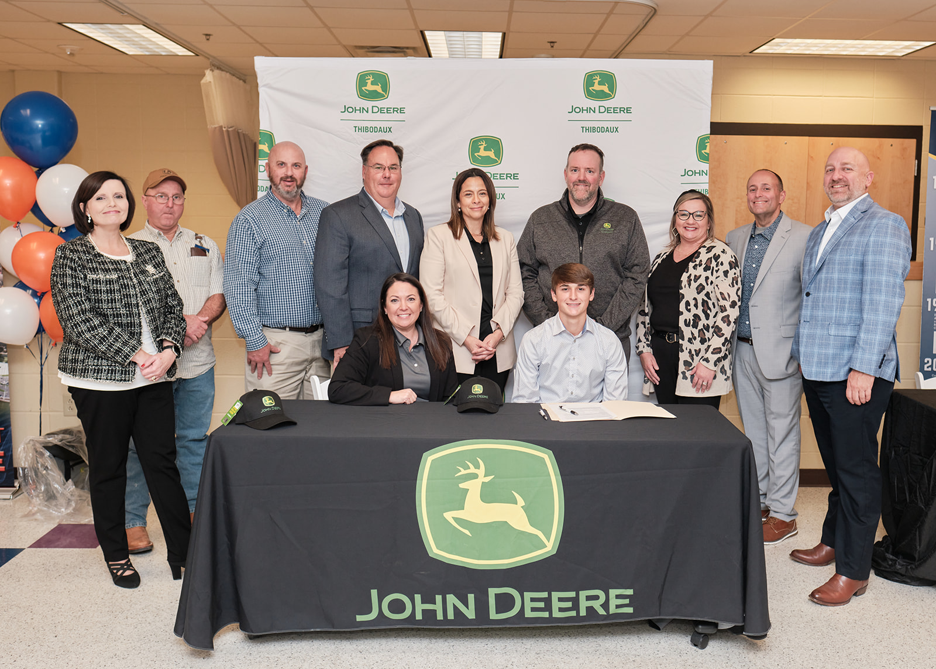
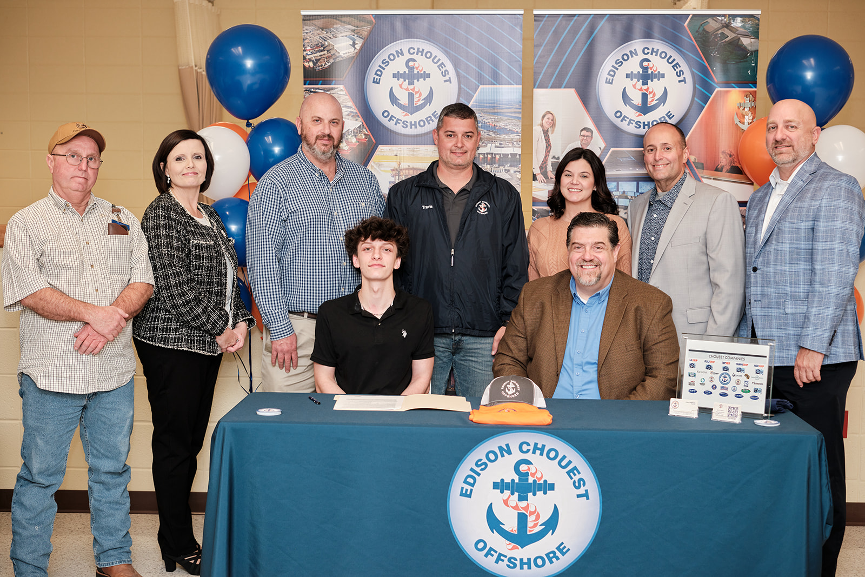
2nd Cohort

Slide 18
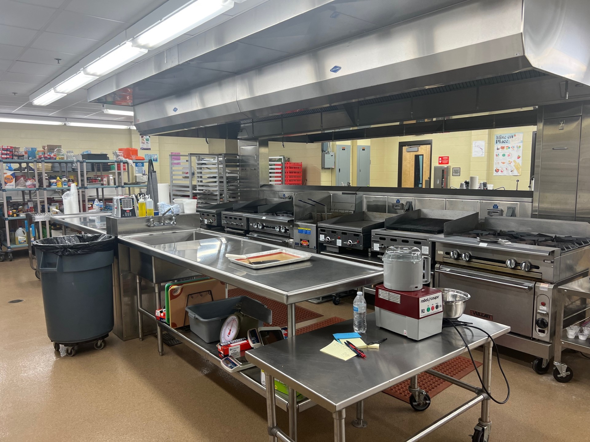
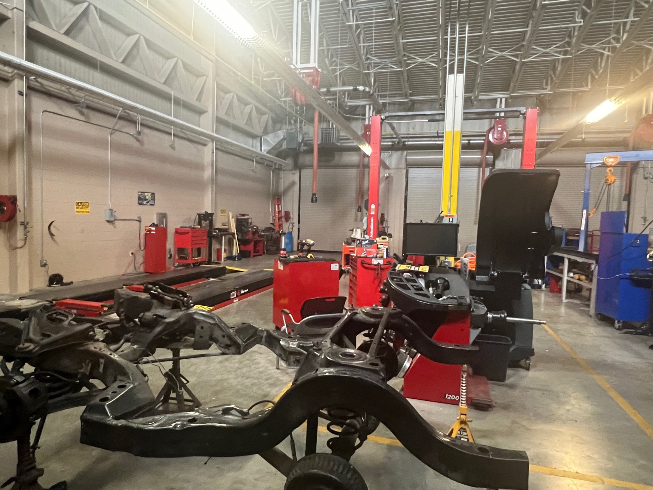
Future Plans
Culinary Apprenticeship
Automotive Apprenticeship
Electrical Apprenticeship
Notes:
Challenges

Slide 19
Questions

Slide 20
Contact Information
Mrs. Bonnie Lefort
Lafourche Parish School District
CTE Coordinator
6419 Highway 308
Lockport, Louisiana 70374
(985) 532-6596
blefort@mylpsd.com
Mr. Jarad Walker
Principal
Career Magnet Center
6419 Hwy. 308
Lockport, LA. 70374
(985) 532-6596
jpwalker@mylpsd.com

