Slide 1
Implementing the Firefighter Credential

Slide 2
Agenda
1. Program Overview with Amy Washington
2. Setting up a Firefighter Program with Gray Young
3. Q&A with Amy Washington and Gray Young

Slide 3
Program Overview
BPSTIL
Implementing a Firefighter Program
Firefighter Credentials
Courses
Pathway Alignment
Employment Outlook

Slide 4
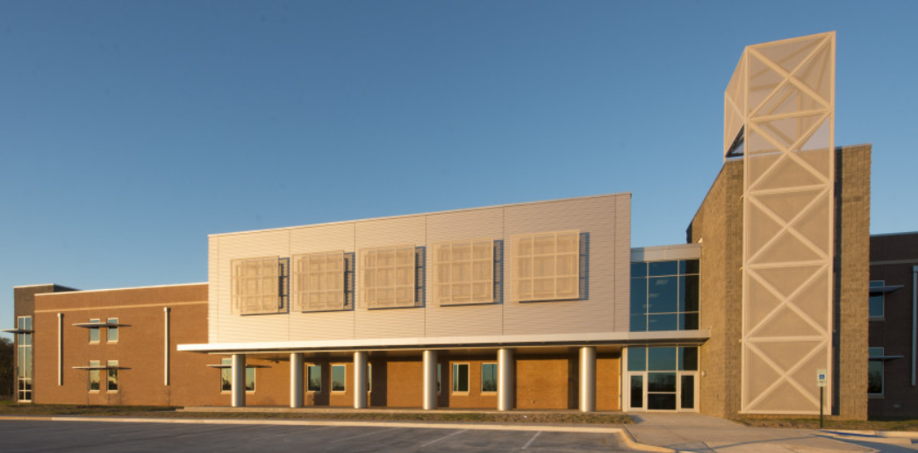
BPSTIL
The Bossier Parish School of Technology and Innovative Learning reflects both a business and college atmosphere instead of that of a traditional high school.

Slide 5
Implementing a Firefighter Program
Amy Washington
Principal
Gray Young
Firefighter Instructor

Slide 6
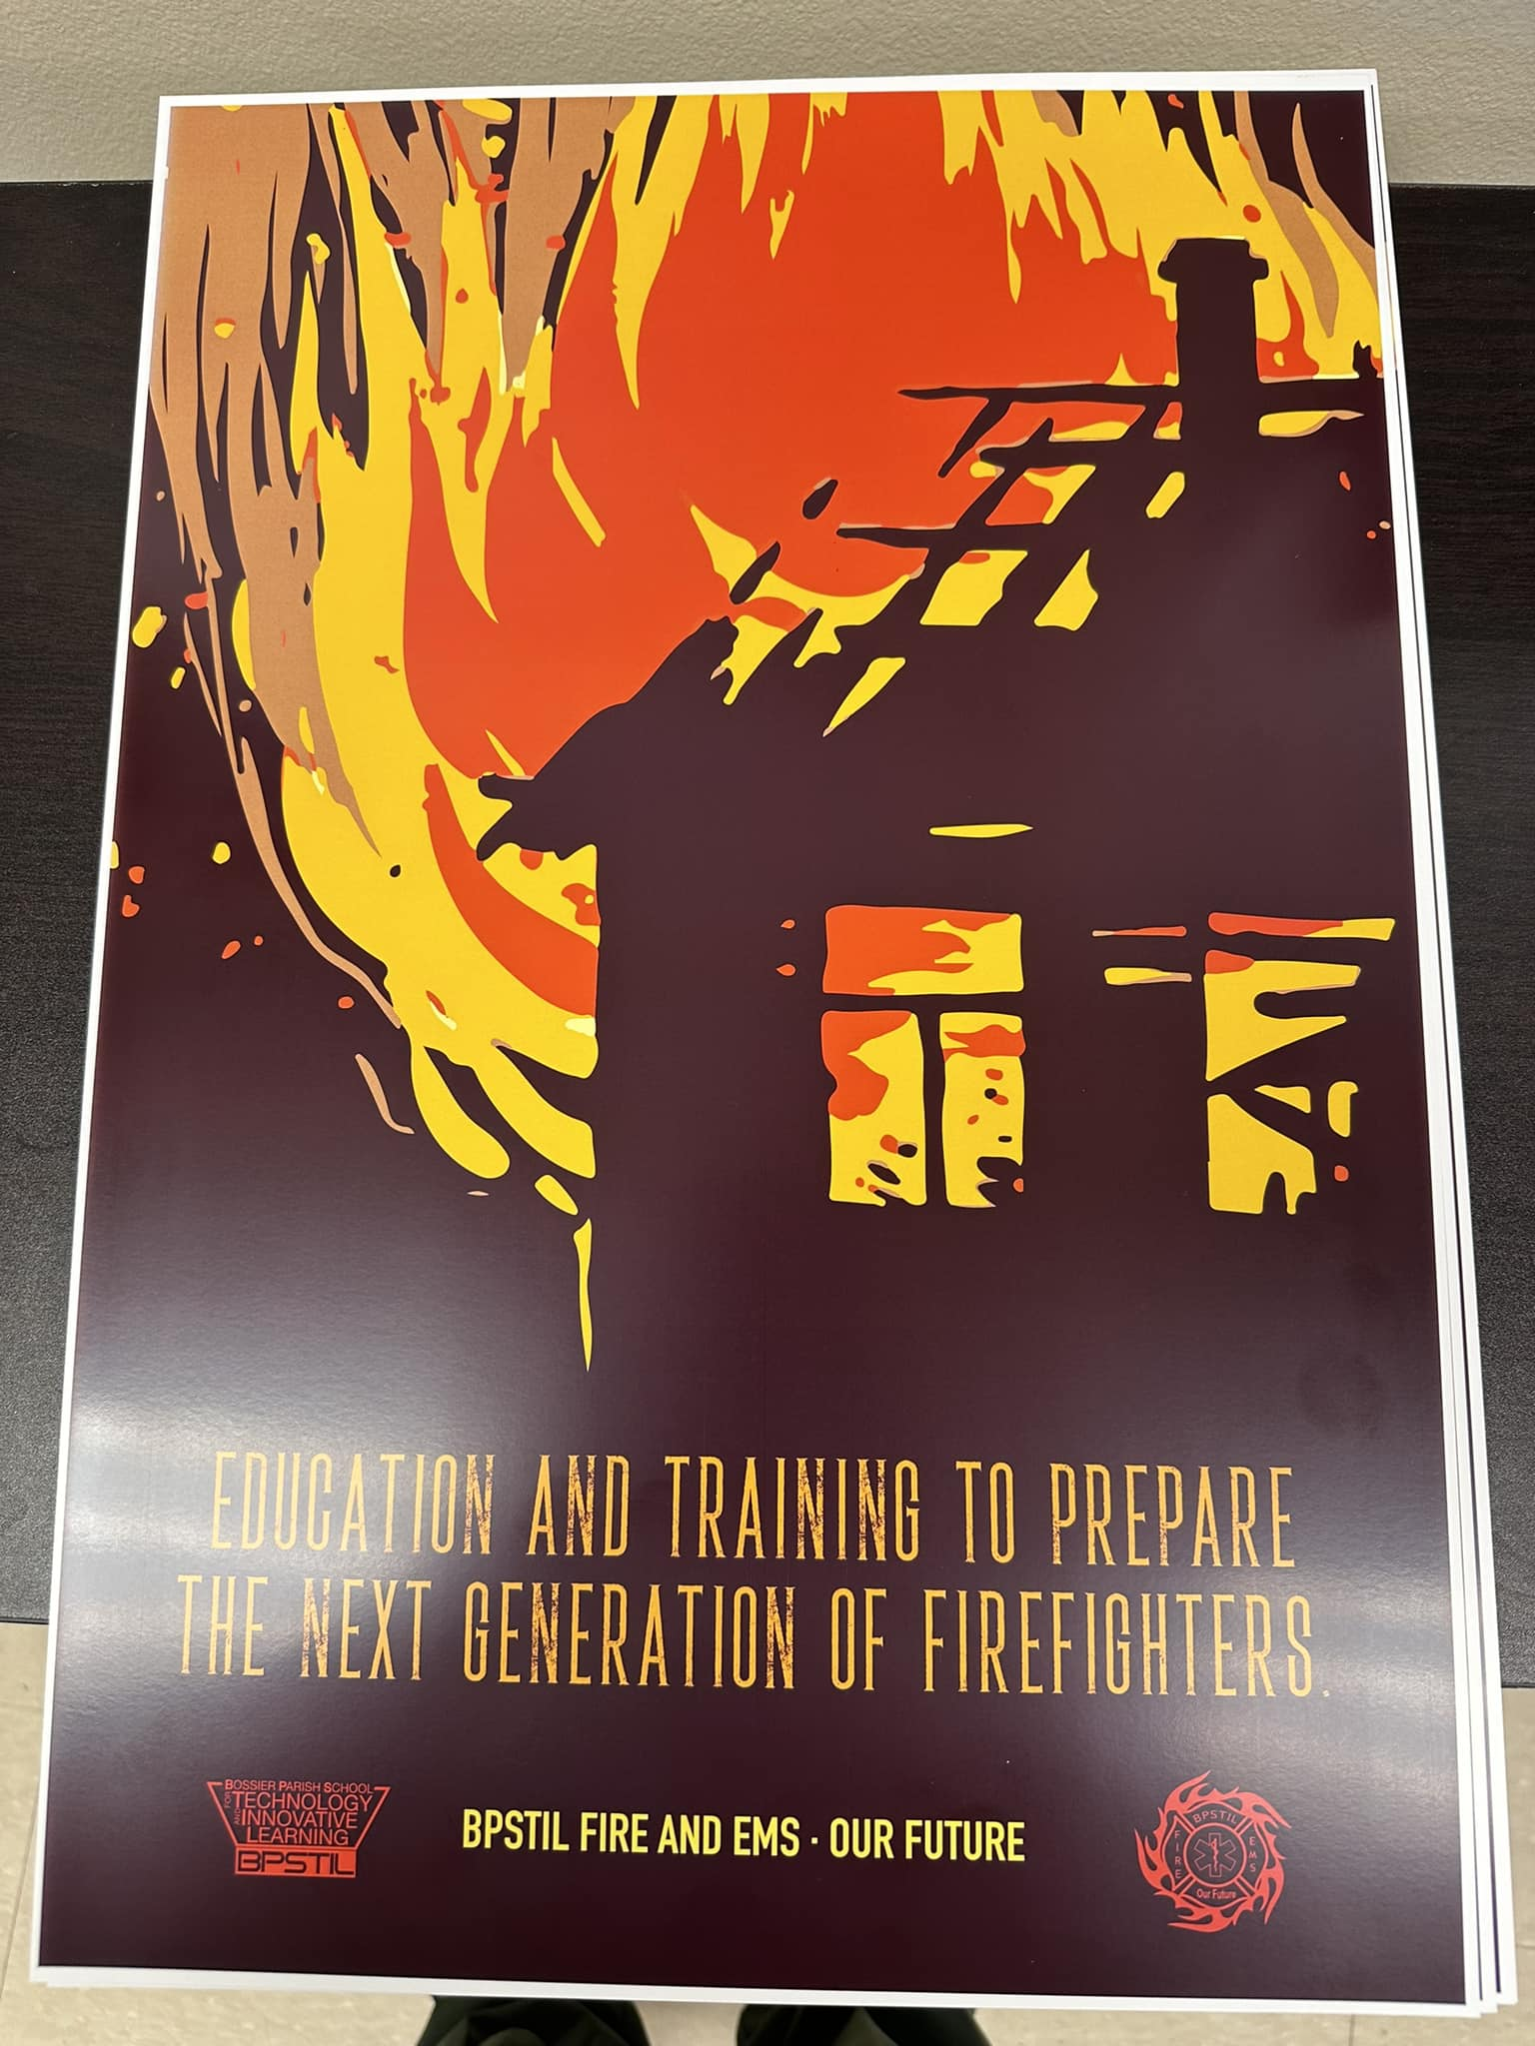
Firefighter Credentials
IFSAC Hazmat Awareness (Local)
IFSAC Hazmat Operations (Local)
IFSAC Firefighter I (Basic)
IFSAC Firefighter II (Advanced)

Slide 7
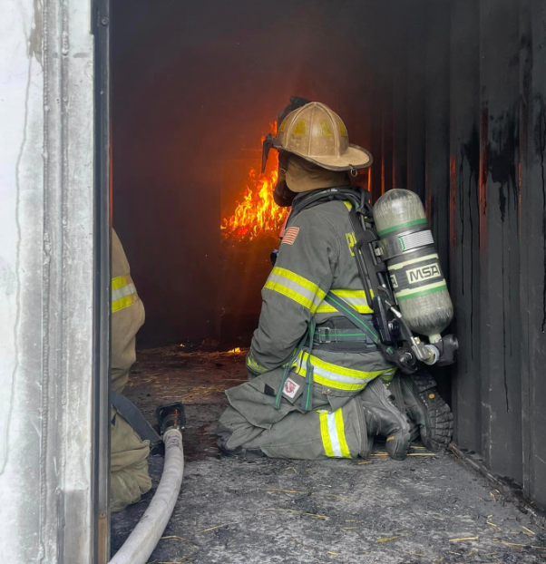
Courses
Emergency Medical Responder
Firefighter I
Firefighter II

Slide 8
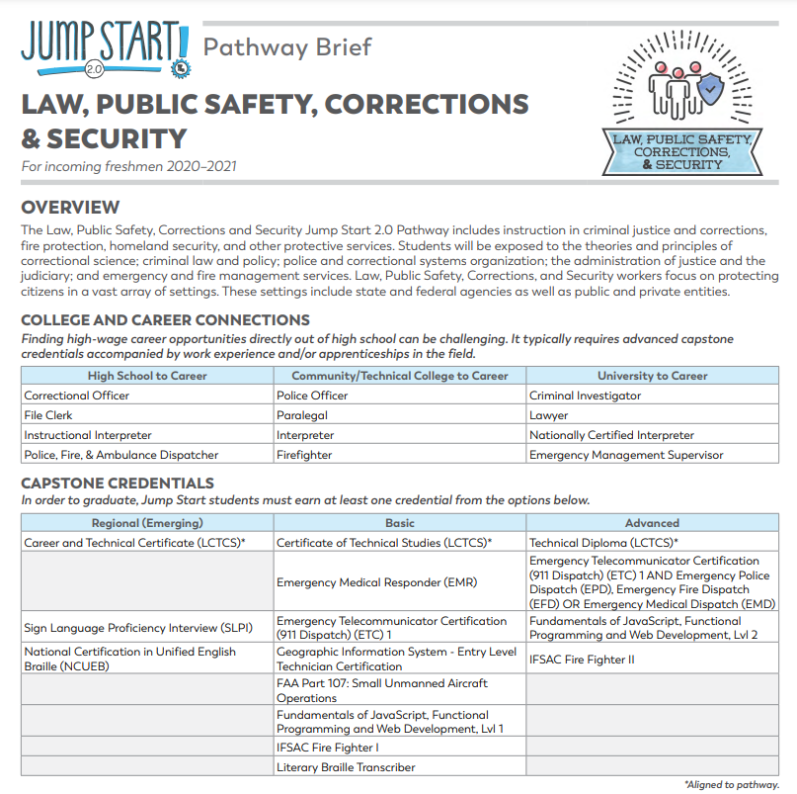
Pathway Alignment
Law, Public Safety, Corrections, and Security

Slide 9
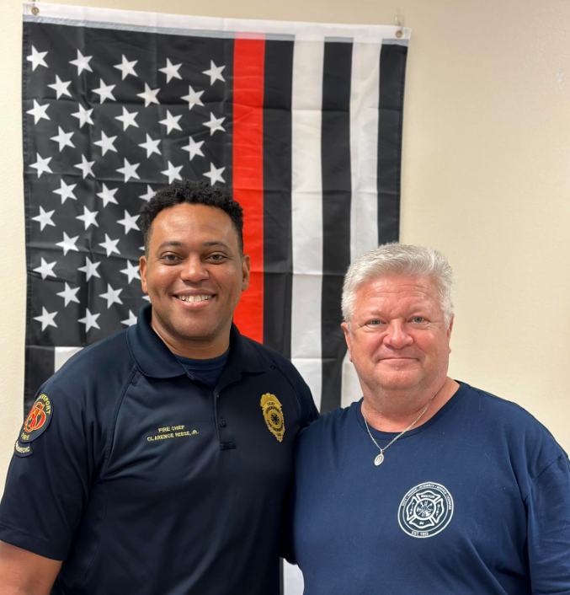
Employment Outlook
Firefighter II students are immediately eligible for employment at every local Fire Department.
Every local Fire Department has reached out to students with employment opportunities.

Slide 10
Setting Up A Firefighter Program
Curriculum
Student Recruitment
Partnerships
Gear Requirements

Slide 11
Firefighter Curriculum
International Fire Service Accreditation Congress (IFSAC)

Slide 12
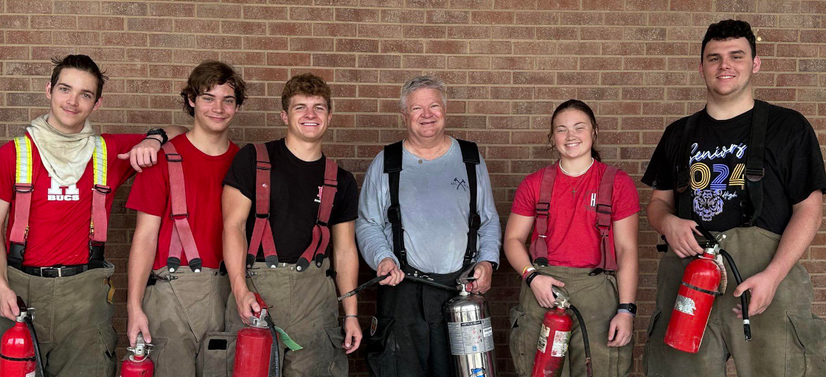
Student Recruitment
Where we found our Firefighter students.

Slide 13
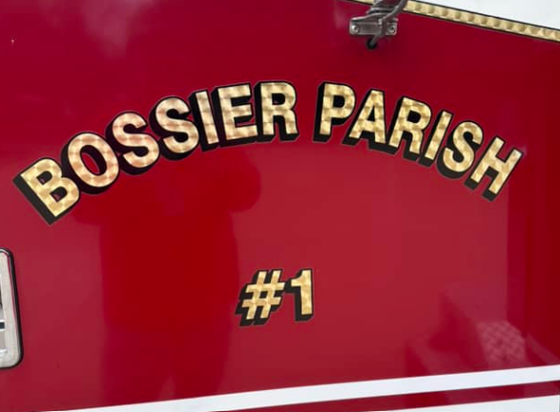
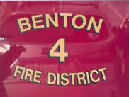
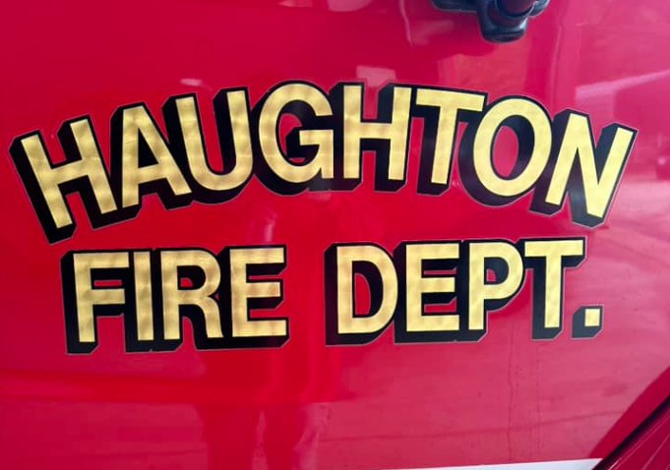
Partnerships
Local Fire Department Support

Slide 14
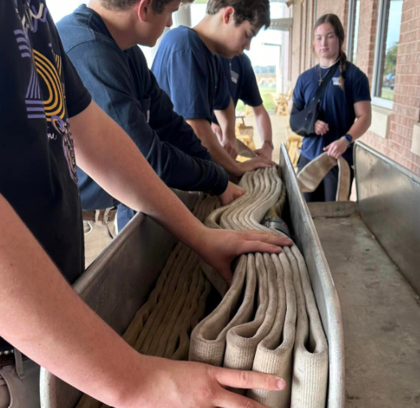
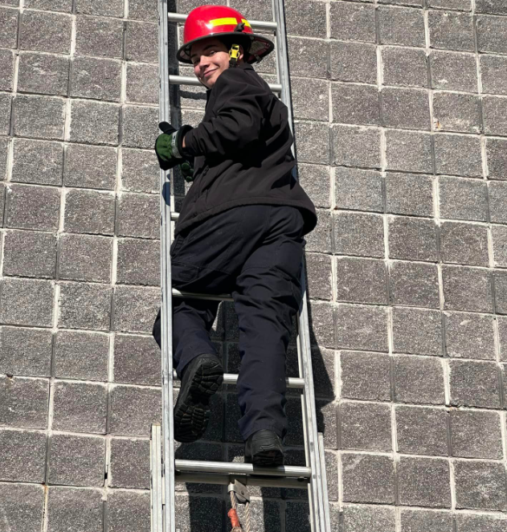
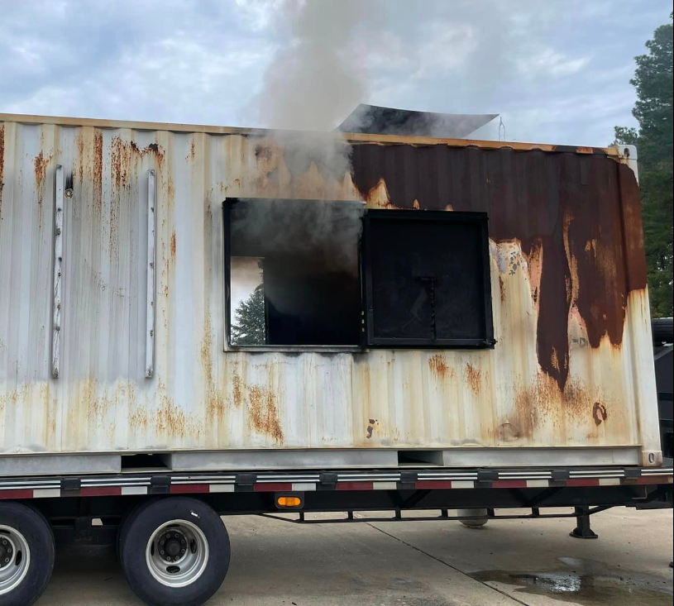
Gear Requirements
Gear needed to get started.

Slide 15
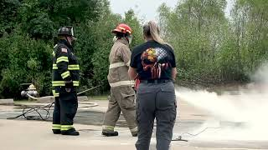
Promo Video
BPSTIL Firefighter Promo Video

Slide 16
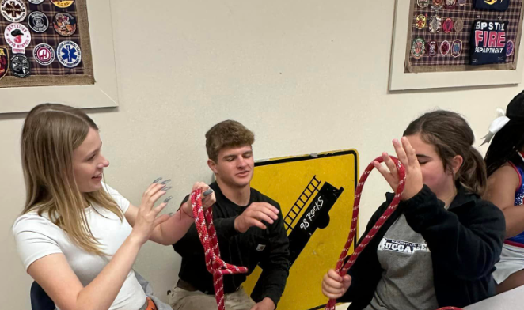
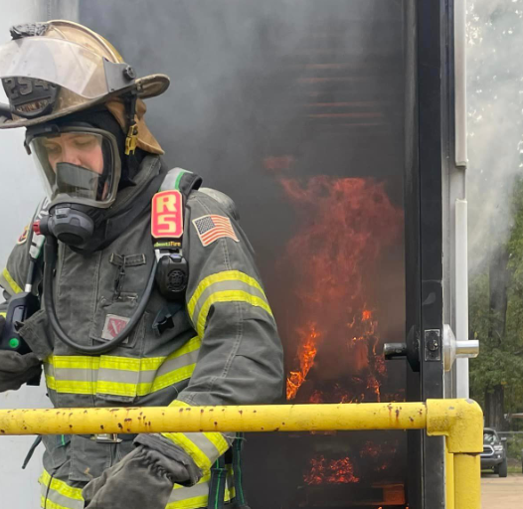
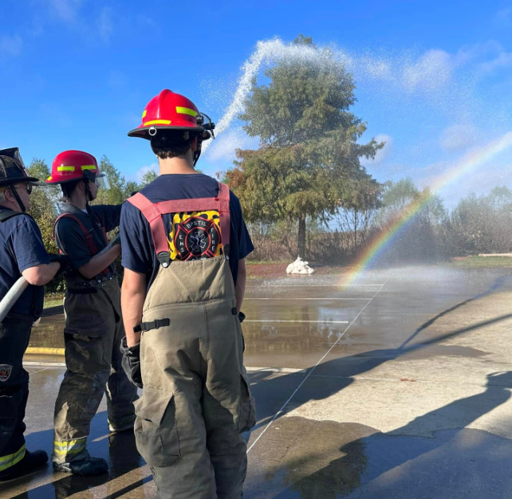
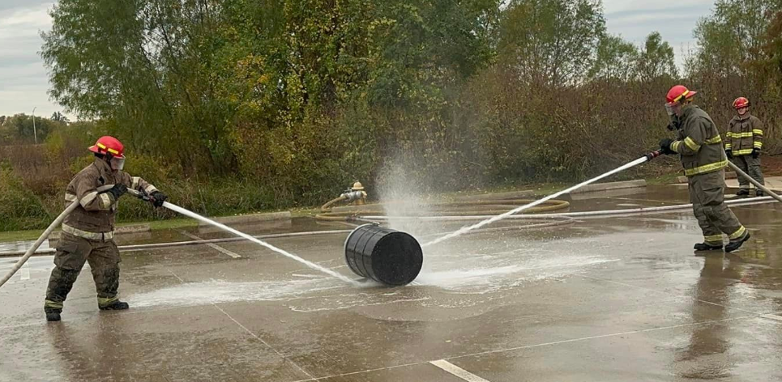
Questions?

Slide 17
Contact Information
Amy Washington - implementation and alignment questions
amy.washington@bossierschools.org
Gray Young - curriculum and instruction questions
gray.young@bossierschools.org

