Slide 1
EveryDay Labs Orientation & Dashboard Support
January 23, 2024

Slide 2
Agenda
EveryDay Labs Background
Program Overview - What to Expect
Review Self Assessment & Action Planning
Break
EveryDay Pro - Attendance Dashboard Intro
Creating High Quality Intervention Groups

Slide 3
EveryDay Labs Background
Notes:
Cindy

Slide 4
EveryDay Labs: Behavioral science is at our core
Family Communication
Attendance
Notes:
A bit about EveryDay Labs before we jump into everything today, We are an organization that was born out of the Harvard Kennedy Research Lab. Our founder, Dr. Todd Rogers is a professor of behavioral science at Harvard and is continually researching how to use behavioral science to motivate action & change people’s behavior. He became very interested in applying behavioral insights to education, and seeing if he could improve family communication, attendance and reduce chronic absenteeism. Thus, our intervention was born!
We partner with districts all across the country to provide a Tier I Universal Intervention. We send mail nudges and text nudges designed to motivate families to help their students come to school more often. We also provide access to a data platform that helps districts analyze data to find emerging attendance trends & patterns and we offer professional learning as well!
And we have been a South San Francisco partner for the last six years, sending mail nudges to your TK-2 students as a part of the Big Lift initiative. We are very excited to be expanding our partnership this year to include mail and text nudges for all eligible students in the district, access to the Pro attendance platform, and managing your truancy notices for you.

Slide 5
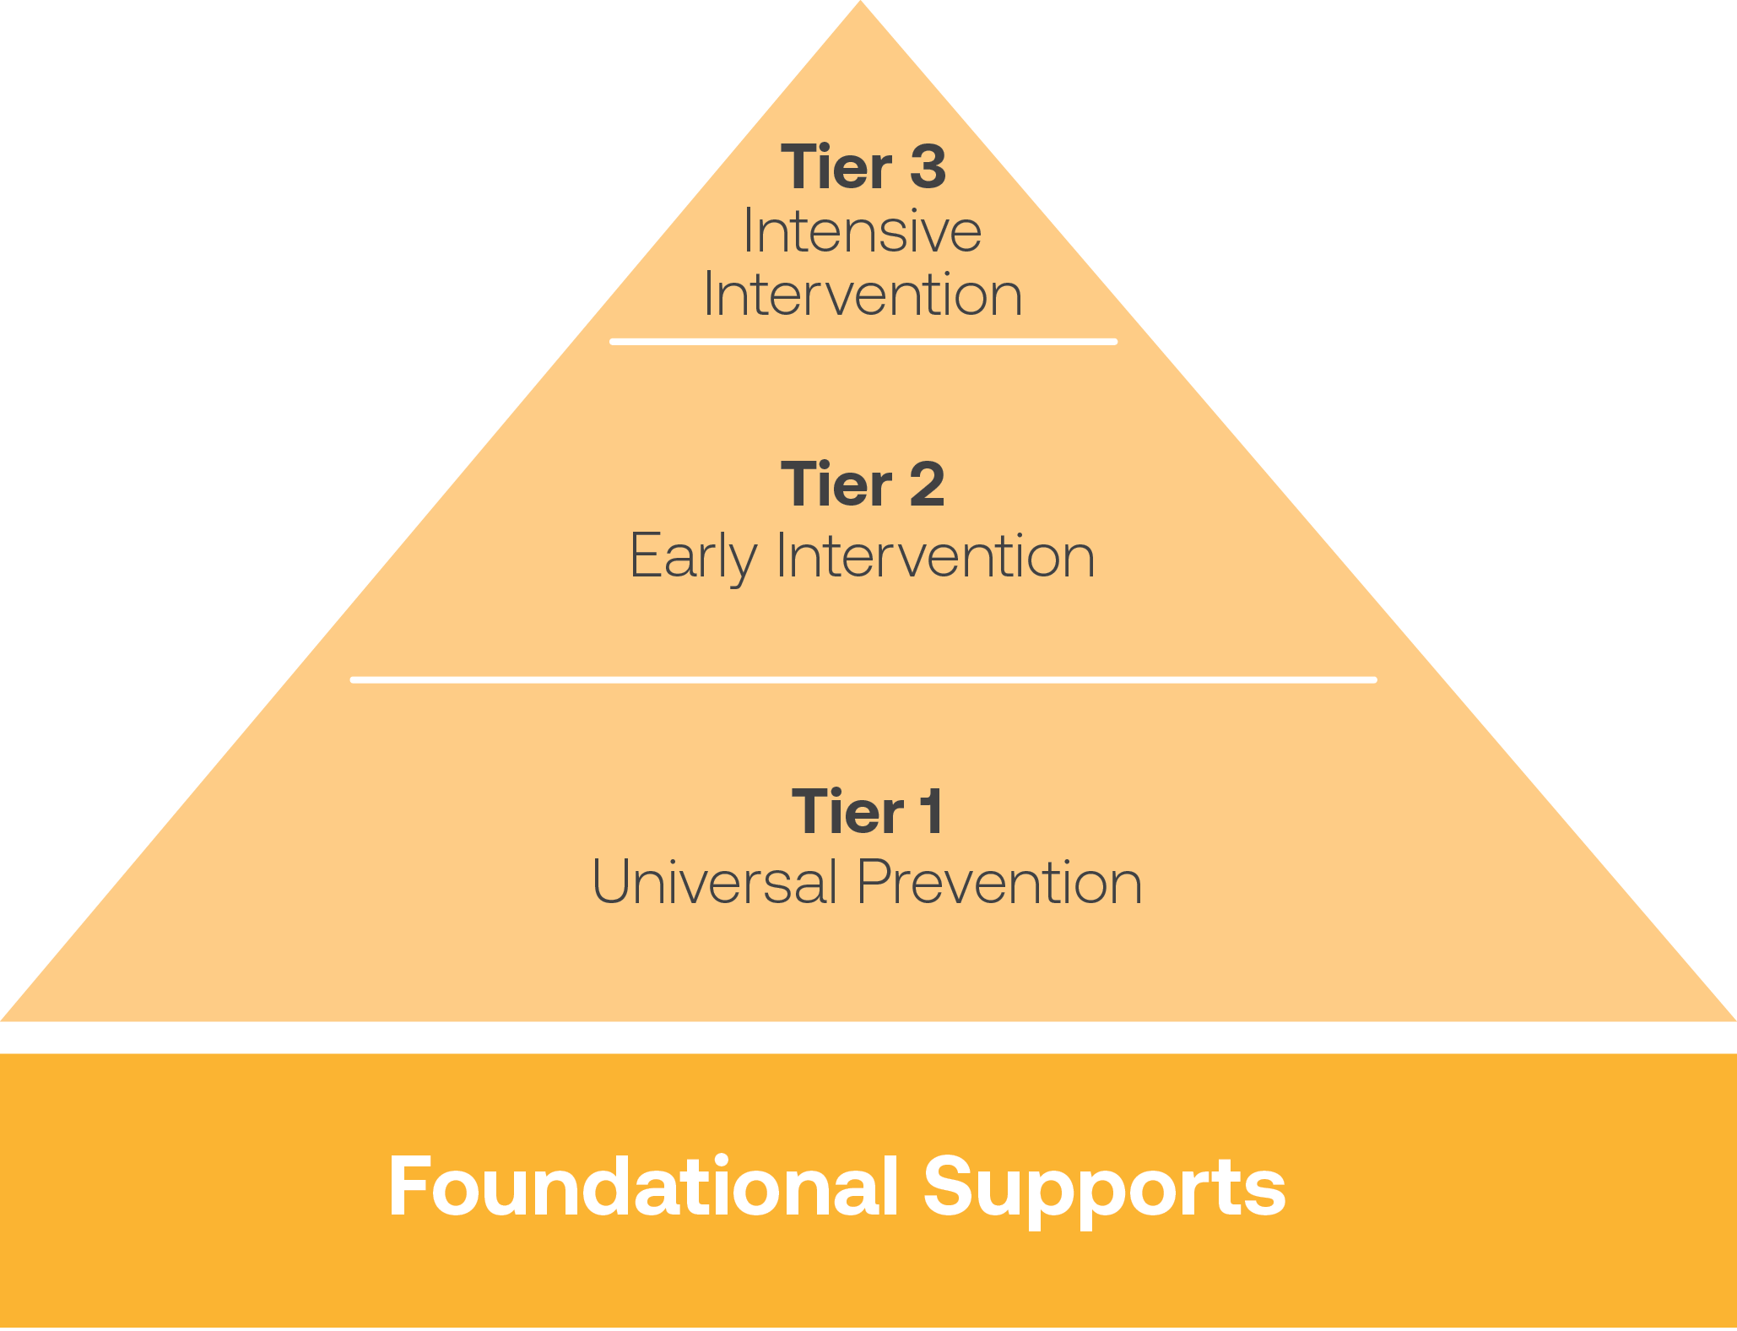
Program Overview - Collaborating with You
Our Intervention
Our intervention is part of your systemic approach to attendance and compliments your work
Notes:
Our work is part of your systemic approach to attendance: part of the system you have implemented. Where we fall—universal prevention. Meant to serve all students to prevent the number of students who slip into tier 2. Also provides early intervention for chronically absent students. and provide 3. Acknowledge challenges.
Emphasize the district-level implementation and how this program will reduce burden on local school staff – in line with new pitch deck ideas.

Slide 6
2023-2024 Program
Chronic Absence Communications: Mail and Text Nudge Intervention
4-5 rounds of letters to families of students with 5-95% absenteeism sent every 6-8 weeks
Biweekly attendance texts sent to families of students with 5-95% absenteeism
Family Support Team and 2-way Family Support Bot
Truancy Intervention
Weekly truancy notices sent to qualifying families
Student must be selected (opted in) by district staff by Friday to receive the following week
EveryDay Pro and EveryDay Learning
Attendance analytics, case management tools, and intervention tracking and coordination
4 professional learning sessions

Slide 7
What Are “Nudges”?
A nudge is a nonpunitive way to promote a healthy behavior
Concept from behavioral science leveraged across industries
Notes:
I’ve mentioned nudges and nudge theory and would like to take a moment to define what nudges are because they are the central driver of attendance improvement in EveryDay Intervention.
We send mail and text nudges to district families that help them understand their attendance.
Nudges aren’t meant to be scary or punitive, but a helpful way to promote positive behavior.
Nudges have been used to help get out the vote and reduce energy usage.
Many school leaders find that the nudges provide an opportunity to connect to disengaged families.
Families will often come to school with the mail nudges or call in to ask questions which provides schools the chance to partner around their student’s attendance challenges.

Slide 8
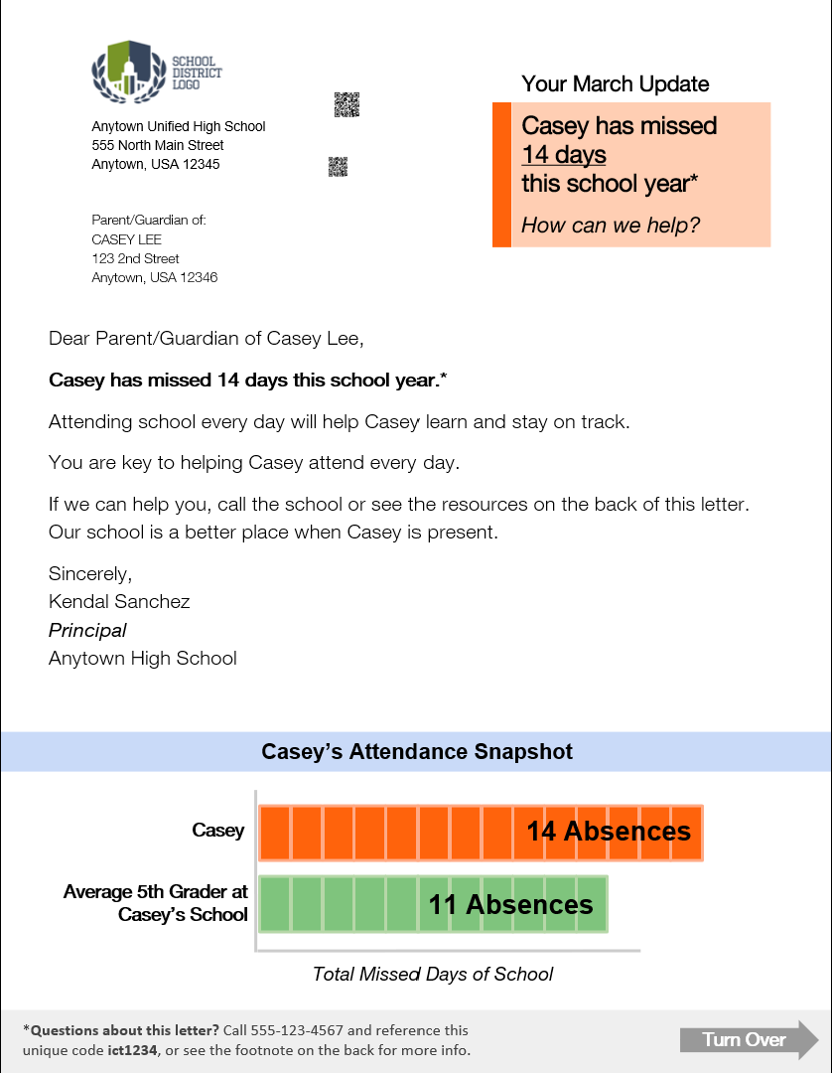
Mail Nudge
Standard Mail Nudge
Misconception #1: Families underestimate their students’ total absences by 50%
Our attendance Nudges address the three critical parent misconceptions about attendance.
Misconception #2:
Families underestimate the link between attendance and academic progress.
Designed for all families and guardians:
5th grade reading level
English & Spanish
Simple graph
Nudges include both excused and unexcused absences because all absences result in loss of instructional time.
Misconception #3:
Families believe that their students’ attendance is average or better than average.

Slide 9
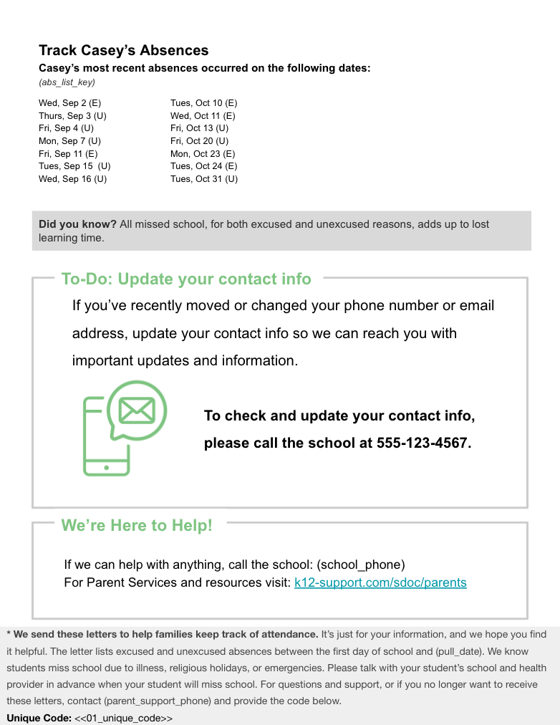
Mail Nudge
Mail nudges sent to families 6x annually
Designed for accessibility, written at 5th grade reading level
Multi-lingual
Address common misconceptions about attendance
Approach parents as partners, rather than using punitive or legal language
Employ the science of behavior change
Provide resources to families
Over 50% families report keeping nudges in their home

Slide 10
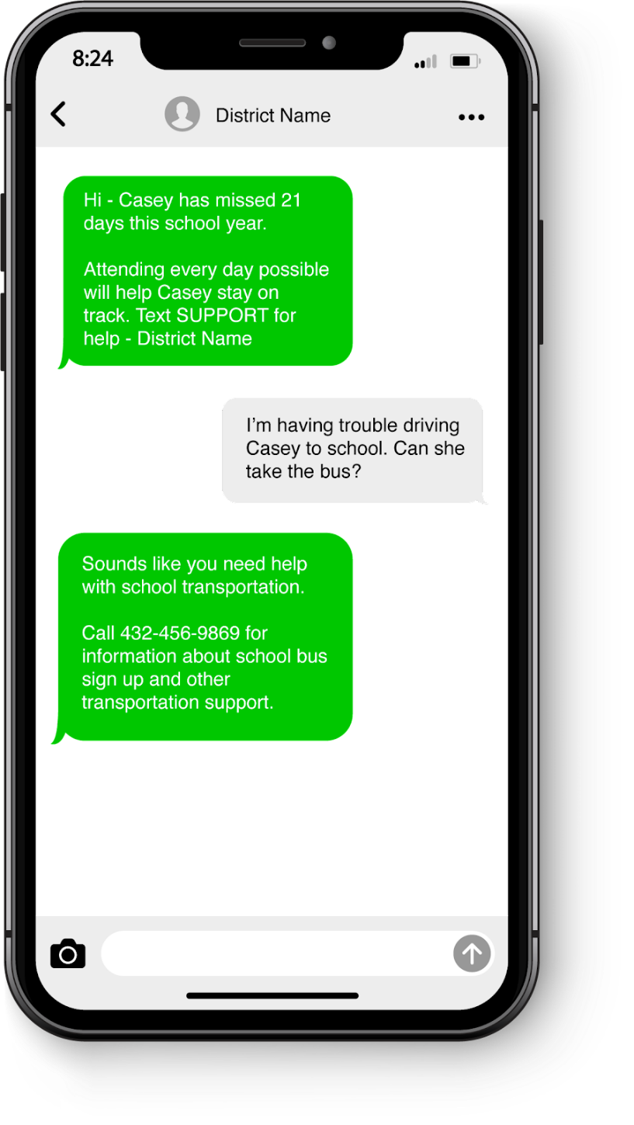
Text Nudge
Note: families will first receive an intro/opt out text
TPSS
Hi from TPSS Attendance Updates! Casey has missed 7 days this school year.
We can help with attendance, wellness, and more. and more - just text the word SUPPORT
Welcome to TPSS Attendance Updates! We may send you occasional updates about your student's progress. Msg&data rates may apply. Text STOP to stop.
Text nudges are sent bi-weekly, providing access to 24/7 support bot and phone-based family support team
Support
How can we help? You can text:
ATTENDANCE
SCHOOL for school resources (student meals, school buses, etc)
MORE for community resources (groceries, housing, etc)
OTHER for anything else
Intro/Opt Out

Slide 11
Family Support Team
Families receiving mail or text nudges will see a phone number they can call for questions. They will be in touch with our multilingual Family Support Team, who can direct them to resources.
Common Household Questions
Household Testimonials
Academic calendar dates (e.g., breaks)
Details around absences
District resource requests (e.g., food, internet connectivity)
In-person v. remote learning
School contact information
“Thank you for listening to me and for being so kind. You have no idea how much help this has been for me."
"Because of our situation, it helps to have extra tools out there. Thank you so much for doing this"

Slide 12
What can you expect?
We want (and expect) you to hear from families. The goal is to connect families back to your school sites, so that families can access what they need and build relationships with you.
Share FAQ doc with front office staff and let them know they might have more families calling in about the letters
Remind staff of ways your district can support families in overcoming barriers to attendance

Slide 13
A Systemic Approach
Notes:
Cindy

Slide 14
Supports for Students
Social Emotional Supports
Community Resources
Accelerated Learning
On Time Graduation
HealthCare Solutions
Teacher Effectiveness
Safe Environments
ATTENDANCE
Notes:
Cindy
Strong attendance improves all other outcomes
Very challenging to address your achievement gap if not addressing your attendance gap
We are all making incredible investments in academic recovery and improvement– by investing in attendance, you drastically increase your ROI for academic achievement work
Essr ending - Hold onto the things that have the highest academic ROI - attendance is one of those critical investments – its the foundation to build on

Slide 15
Three Attendance Metrics
Average Daily Attendance
Truancy
Chronic Absenteeism
Notes:
Cindy
It’s been interesting to watch over the last decade or so as more and more research has surfaced around the academic consequences of chronic absenteeism
chronic absenteeism has over time become a critical piece of data that we need to focus on because of how much we know it can impact a child’s learning

Slide 16
Average Daily Attendance (ADA):
Tracking ADA allows you to
monitor overall health of school/district attendance
set school-wide goals
reward staff/students for improvement
Notes:
Cindy
Let’s dive into Average Daily Attendance a little more.
This metric is really helpful to track because it allows you to monitor the overall health of your school’s attendance, set school-wide goals, and reward staff/students for improvement, or for reaching those goals. It’s a great metric for getting a quick snapshot into how your school is doing overall.
One of the critical pieces of a system is making sure that everyone is on the same page when it comes to thinking about ADA.
Do you track ADA right now? How important is it for your schools that you’re serving? Do your school sites know their ADA rates? Or how to find it?

Slide 17
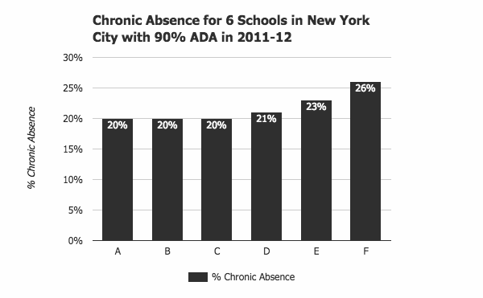
ADA Can Mask a High Chronic Absence Rate
Notes:
Cindy
While ADA is really helpful, because it tells you on average the number of students that show up on any given day, we want to make sure it’s not the only metric we are grounding ourselves in.
One reason for this, is that ADA rates can actually mask a high chronic absence rate.
Here, you’re looking at a graph of 6 schools in New York, all with a 90% ADA rate. As you can see, while their ADA rate is the same, their chronic absenteeism rate varies significantly between the 6 schools. Some are lower at 20%, some go all the way up to 26%. This is why it’s important to ensure that you have a system in place for tracking both measurements.
ADA rates support school wide data, and Chronic Absenteeism is a a bit more of an individual metric. If I have a school of 200 students with 10 missing every day, their ADA rate would be 95%.
When we consider chronic absenteeism, the question becomes: who are those 10 students that are consistently missing school? - and what can we do to help them attend more regularly?

Slide 18
Truancy
Counts only unexcused absences
Emphasizes compliance
Relies on legal & administrative solutions
Chronic Absence
Counts all absences: excused, unexcused, & suspensions
Emphasizes academic impact of missed days
Uses community-based, positive strategies
Chronic Absenteeism = Missing 10% of Enrolled Days
Notes:
Cindy
Now let’s take a closer look at chronic absenteeism and how it differs from truancy.
Again, Truancy only counts unexcused absences. When discussing truancy with families, these conversations tend to be more formal and have historically been a bit more punitive with a focus on compliance and legal solutions.
Over the last 10 years, however, many school districts have shifted their focus from truancy and more punitive attendance practices to an emphasis on monitoring and addressing chronic absenteeism. Regardless of whether a student’s absences are excused or unexcused, we know that if a student is missing more than 10% of school days, they are likely to fall behind their peers with strong attendance. As a result, when districts prioritize addressing chronic absenteeism, they are focused on using community-based and positive strategies to support students in improving their attendance, whether their absences were excused or unexcused.

Slide 19
Academic Consequences of Chronic Absenteeism
In Elementary School:
Weaker development of social skills
Less likely to read well by 3rd grade
More likely to be retained
In Middle School
Lower grades and test scores
A warning sign that students will eventually drop out
In High School
Lower grades and test scores
Lower graduation rates
Lower rates of college enrollment & completion
Notes:
Cindy
It’s been interesting to watch over the last decade or so as more and more research has surfaced around the academic consequences of chronic absenteeism
chronic absenteeism has over time become a critical piece of data that we need to focus on because of how much we know it can impact a child’s learning

Slide 20
The Impact on Student & School Success
Attendance Band | Avg. Percentile Reading | Avg. Percentile Math
95%+ (N=16,273) | 50.3 | 44.2
90-94.9% (N=2,530) | 38.8 | 32.0
85-89.9% (N=966) | 36.0 | 30.3
80-84.9% (N=486) | 33.0 | 29.7
<80% (N=580) | 31.1 | 24.9
2021 data from a large urban district & current partner
Notes:
Cindy
We examined the relationship between chronic absenteeism and achievement on MAP Tests in Grades 1–2 in a large urban district we currently partner with.
The district serves over 150,000 students that is largely made up of emergent bilingual students and students of color.
The analysis showed that even missing 1–2 additional days of school across the attendance bands had a dramatic correlation on both reading and math achievement.
What implications does this have for reading on level by third grade?
This data really brings into focus the way chronic absence snowballs, impacting achievement, and ultimately becomes the strongest predictor of a student’s risk for dropping out.
Units are percentiles of normed RIT scores
Averages are regression-adjusted means

Slide 21
The Impact on Student & School Success
Attendance Band | Avg. Percentile Reading | Avg. Percentile Math
95%+ (N=16,273) | 50.3 | 44.2
90-94.9% (N=2,530) | 38.8 | 32.0
85-89.9% (N=966) | 36.0 | 30.3
80-84.9% (N=486) | 33.0 | 29.7
<80% (N=580) | 31.1 | 24.9
2021 data from a large urban district & current partner
Notes:
Cindy
We examined the relationship between chronic absenteeism and achievement on MAP Tests in Grades 1–2 in a large urban district we currently partner with.
The district serves over 150,000 students that is largely made up of emergent bilingual students and students of color.
The analysis showed that even missing 1–2 additional days of school across the attendance bands had a dramatic correlation on both reading and math achievement.
What implications does this have for reading on level by third grade?
This data really brings into focus the way chronic absence snowballs, impacting achievement, and ultimately becomes the strongest predictor of a student’s risk for dropping out.
Units are percentiles of normed RIT scores
Averages are regression-adjusted means

Slide 22
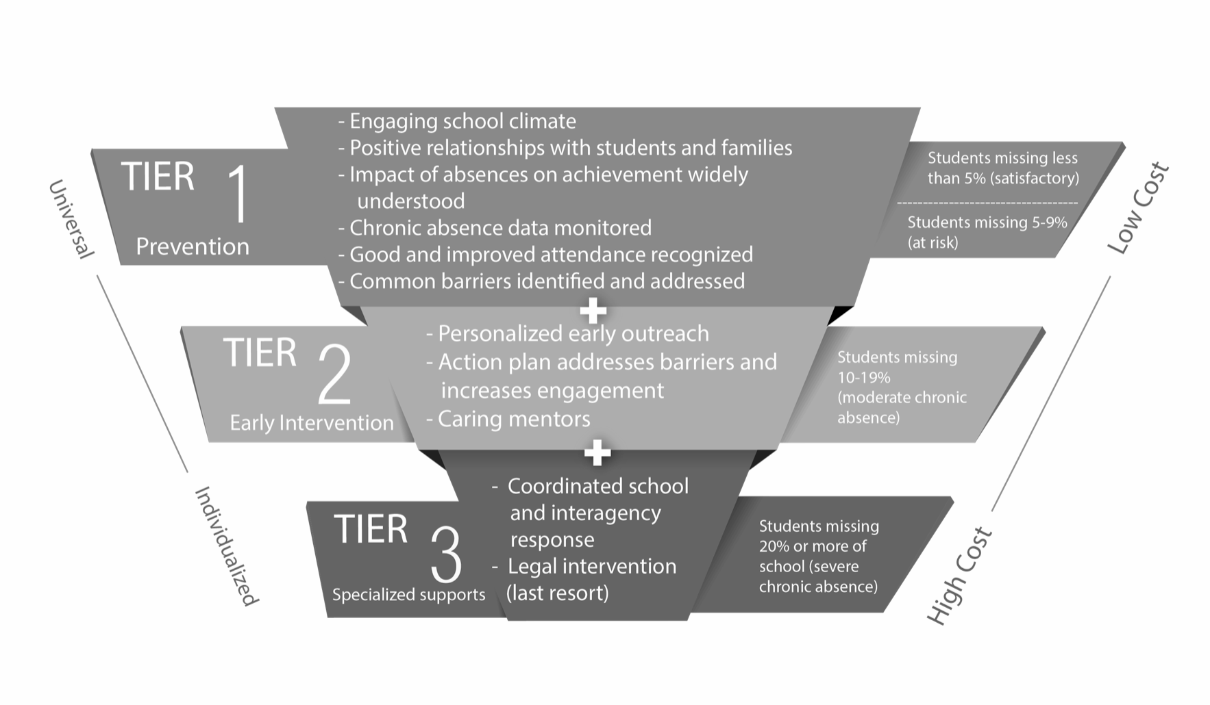
System of Support
District and School Wide Prevention &
Attendance Promotion
Small Group Interventions
Individual Supports
Notes:
Cindy
tier 1: Attendance Promotion
You may have seen something like this floating around, but this image is really going to guide a lot of the discussions that we have over the next few sessions because it is so encompassing of what the system looks like in its entirety.
Draw eyes to the right side and walk you through a couple of things that I want you to tune into. , and acknowledge that Tier I includes both students that are satisfactory attenders & at risk for becoming chronically absent
We need to have a plan for students that are falling into each tier of absenteeism - so if you look on the right, you’ll see that each Tier encompasess a subset of students ….
And we need to ensure that our resources are being utilized as strategically as possible. We know that we can’t create highly individualized plans for each and every students because of the cost, so we need to have universal preventive interventions in place, to ensure that the students who need those specialized services the most, are able to access them.
next slide

Slide 23
Reflect:
Which part of the systemic approach is widely understood at your school/district?
Which part is less understood?
Notes:
Cindy

Slide 24
Effective Attendance Teams
Notes:
Emily

Slide 25
Attendance Team Focus & Responsibilities:
Meet Regularly
Analyze data & share data across school sites and with families
Plan schoolwide approaches
Create a Tiered System of Support
Support classrooms and gather necessary materials
Provide ongoing communication on attendance data & team/school efforts with staff, students & families
Notes:
How do you know if your school site team is effective?

Slide 26
Attendance Team Members
Team should include members from across the school staff:
At least one administrator
At least one interventionist (counselor, social worker, etc.)
Several teachers (general and special education)
School resource officer or campus security
Attendance clerk
One student representative (include for parts of meeting)
One parent representative (include for parts of meeting)
Notes:
Get the right people in the room.
Research shows that broadening the group leads to more effective practices when implementing interventions & ensuring that staff buy in is there. This also helps others realize how big of a priority attendance really is.

Slide 27
Two Types of Team Meetings
Bi-Weekly Meetings
Quarterly Step Back Meetings
Analyze data
Plan interventions
Track interventions
Example: Look at recent data for a group of students with 10-15% absence rate to determine if group intervention is effective.
Analyze long-term data
Reflect on system of interventions at each tier
Create long term goals
Example: Look at daily attendance rates from last year to determine when to launch an attendance campaign around holidays.

Slide 28
Bi-Weekly Data Metrics to Track
ADA & chronic absenteeism rates by grade and/or teacher
Student lists in the following tiers:
At Risk students: 5-9% absenteeism
Moderate Chronic students: 10-19% absenteeism
Severe/Extreme Chronic students: >20% absenteeism
Individual student Data
Notes:
If you can add grade level metrics as well, that’s amazing!

Slide 29
Metrics to Analyze at Quarterly Meetings
Attendance rate by subgroups/Cohorts
Race/Ethnicity; Gender; FRPL Status; ELL status; Grade Level
Daily attendance rate for whole school
Scores on Attendance Self-Assessment
Notes:
Looking at data through various filters to identify school wide trends & systemic barriers to attendance, which is really going to inform in particular your Tier I Universal Interventions that you put in place. Trends tell us how data is changing over the year and we want to look for are increasing absenteeism & improving attendance.
When you’re looking at your data, think about what you might notice that you could use to inform interventions & policies & procedures.
If you’re noticing that over 20% of your student population is experiencing a particular barrier then that will inform what you’re going to focus on in a long-term way. It’ll help you pivot & think through what you can change for next semester, or next year.
Patterns: Absences that repeat in a recognizable way and may suggest future absences. Some questions to help identify patterns:
Which day or part of the week is most often missed? How often does the absence border a school holiday? Are absences usually single day or multiday absences? Do students in the same household have similar attendance patterns?

Slide 30
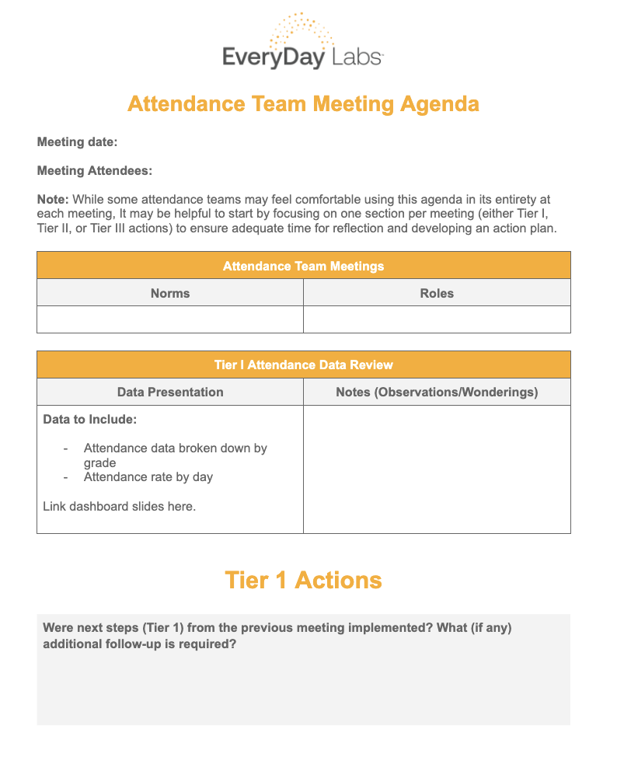
Sample Agendas for Meetings

Slide 31
Analyze the Rubric
Find the “Attendance Team” Section
What is one area that your school teams is excelling in?
Which area could your school teams use more support in?

Slide 32
Action Planning
Take a minute to review the action planning doc after analyzing the rubric.
Complete the first two sections.

Slide 33
Let’s get organized
Login to the platform and choose a school to study for the day
https://pro.everydaylabs.com
To log-in:
To log in for the first time, you will need to click on ‘forgot password’ to create a new password.
Your username is your email address
Reach out if you have any questions or need help!

Slide 34
10 Minute BREAK
Notes:
Emily

Slide 35
EveryDay Pro -
Attendance Dashboard Demo

Slide 36
Dashboard Highlights
Quick Snapshot:
School/District Overview
Useful for Attendance Team Metrics
Student Cohort
Grade Level, Race, Ethnicity, Special Ed, Homeless Metrics
Attendance Calendar
Seeing Attendance Rates Day by Day + Patterns/Trends
Student List + Student Profile
Individual Student Lists + Daily Attendance Patterns
Intervention Groups
Create intervention groups & monitor effectiveness

Slide 37
Quick Tour
Side Bar
Resource Center
Magnifying Glass
Data Updated when…
Multi-Year view
Download Button
Information Button
Chat Feature

Slide 38
Attendance Dashboard
Purpose: Find key metrics for individual schools:
Attendance Rates (monthly & Year-To-Date)
Chronic Absenteeism Rates (monthly & Year-To-Date)
Absence Rates by Tier (% & # of students)
Notes:
- What do you notice, what do you wonder?

Slide 39
Attendance Dashboard Guiding Questions
How have chronic absenteeism rates changed over time?
How has attendance changed over time?
What are our YTD metrics for chronic absenteeism and attendance?
Which months have our rates been highest? Lowest?
What percentage of students are in Tier II?
How many students are chronically absent right now?

Slide 40
Attendance Calendar
Purpose: track daily attendance rates for the district & school and locate patterns/trends + dip days (days where school attendance is significantly lower)
Are there days of the week where there is a pattern of lower attendance?
Are there significant dip days?
How can I use this information to inform my calendar next year? How can I counteract these dip days?

Slide 41
Student Cohorts
Purpose: slice data by student groups in order to see if there are patterns or trends.
grade level
FRPL (free/reduced lunch)
Race
Ethnicity
Gender
Homeless status

Slide 42
Student Cohorts
Which grade levels have higher attendance rates? Lower?
How does the attendance rate for students of one ethnicity compare to another?

Slide 43
Student Dashboard
Purpose: Identify student lists within absence tiers & analyze individual student data for patterns & trends.
Who is missing between 10-19% of school? Who is at risk for becoming chronically absent? Who is already severely absent?
Are students exhibiting the following patterns?
Vacation Extending
Day of the Week Missers
Single v. Multi-Day Missers

Slide 44
Scavenger Hunt - 8-10 minutes
Locate the following data metrics for your school:
Year-To-Date Chronic Absenteeism rate in August:
Monthly Chronic absenteeism rate in September:
% of students missing between 10-19%:
# of students missing between 4-9%:
Year-To-Date Attendance Rate for one specific grade level at your school

Slide 45
Utilizing EveryDay Pro to Create High Quality Intervention Groups
Notes:
Hello everyone! Today we’re going to talk about how to tackle the challenge of reducing chronic absenteeism by building a tiered system of interventions.

Slide 46
Our Goal
We hope that after today you will walking away knowing how to:
Tie interventions to barriers students are experiencing
Ground tiered interventions in real data
Utilize the resource center to improve and enhance tiered interventions
Create 3 intervention groups

Slide 47
Tiered Data and Interventions

Slide 48
Treating Chronic Absenteeism
It’s Chronic
Must be treated in regular intervals
One intervention may not result in long-term change
Plan for regular non-punitive interventions for families/students
Barriers to Attendance
Chronically absent students and/or their families experience an average of 9 barriers to attendance
Interventions should be: Non-Punitive
Positive
Solution Based

Slide 49
System of Support
Analyze Data
Look for patterns & trends in the data
Use barrier assessments to better understand challenges students are facing
Recommend group and/or individual interventions for students
Monitor with frequency
Notes:
This is something that not only do your attendance teams to know like the back of your hand, but this knowledge also needs to be shared with classroom teachers, those that are closest to students, so that they know what to look out for - and we have a couple of resources to share with you that we’ll show you a bit later on

Slide 50
Common Causes of Absenteeism
Physical barriers to attendance
Lack of value placed on school
Lack of understanding about the importance of attendance
Escape or avoidance
Desire to obtain or access something outside of school
Notes:
This is something that not only do your attendance teams to know like the back of your hand, but this knowledge also needs to be shared with classroom teachers, those that are closest to students, so that they know what to look out for - and we have a couple of resources to share with you that we’ll show you a bit later on

Slide 51
Notes:
animate - show screenshots

Slide 52
Expanding Your Interventions Toolbox
In the resource center, you’ll find descriptions of:
Planned Student Discussions
Home Visits
Transportation Support
Attendance Self-Monitoring
Nudge Letters
Mentoring
Check-In/Check Out
and more!
Notes:
similar to early warning comms - but intention is to move from identifying systemic to individualized barriers
we want to be able to group students based on their individual barriers that
holding teachers accountable

Slide 53
Expanding Your Interventions Toolbox
In the resource center, you’ll find descriptions of:
Planned Student Discussions
Home Visits
Transportation Support
Attendance Self-Monitoring
Nudge Letters
Mentoring
Check In/Check Out
and more!
Let’s take a look at the Check In/ Check Out (CICO Resource!)
Notes:
similar to early warning comms - but intention is to move from identifying systemic to individualized barriers
we want to be able to group students based on their individual barriers that
holding teachers accountable

Slide 54
Identify Patterns and Trends
Patterns: Is this student missing a specific day of the week?
Are they extending vacations?
Are absences single days or multiple days?
Do you imagine that this is a pattern across the household?
How often did the student miss in the first month of school?

Slide 55
Identify Patterns and Trends
Trends: How attendance data changes over the year. Trends to look for:
Increasing absenteeism
Next Step: Intervene with Barrier Assessment or Intervention
Improving attendance
Next Step: Positive Reinforcement!

Slide 56
A Note About Groups…
Grouping students in buckets vs. actual physical groups
For example:
Students who are consistently missing around the holidays
Students that miss on Fridays
Students who missed a lot at the beginning of the year that you want to keep a close eye on throughout the year
Students that come on Thursdays early for breakfast to build community

Slide 57
Quick Win Intervention Groups
Day of the Week Missers (pattern)
Nudge or Incentive based interventions
Tier II Improving Students (trend)
Positive Reinforcement!
Worsening Tier II Students (trend)
Look for other patterns
If no other patterns are present, barrier assessment

Slide 58
Day of the Week Missers
Apply 2 filters:
All “day of the week” patterns
Students in the at risk & moderate chronic absence
Determine number of students you will work with
Create intervention group
Design intervention
Example intervention: Individualized Motivational Systems or Text Nudges from school texting service (ie: Blackboard, etc.)

Slide 59
Improving Tier II Students
Change the settings to make sure you’re looking at month over month changes
Filter by students who have improving attendance
Create intervention groups that are manageable
if a large number, divide by grade levels
Identify ways to share positive reinforcement with those students
phone call home?
certificate?
Read out names on the overhead announcements?
PBIS tickets? Raffle drawing?

Slide 60
Worsening Tier II Students
Change the settings to view month over month trends
Dig into individual student profiles to see if there are other patterns
single v. multi day?
vacation extender?
Create intervention groups based on patterns
For students without a pattern, create an intervention group for those students to receive a barrier assessment

Slide 61
Time to Work
Spend the next 15 minutes working to create a minimum of 3 intervention groups
Day of the Week Missers
Worsening Tier II ++ EARLY ABSENCE
Improving Tier II

Slide 62
Group Reflection
What did you notice about your student data when you started really digging into individual students?
Anything stand out? Do you feel ready to begin work with these 3 intervention groups?

Slide 63
District Share Out of Intervention Groups
Gallery Walk

Slide 64
Next Steps
Finish creating those 3 intervention groups
Spend time in the resource center & choose one new intervention to try this year
bookmark EveryDay Pro & save your password information!
Notes:
similar to early warning comms - but intention is to move from identifying systemic to individualized barriers
we want to be able to group students based on their individual barriers that
holding teachers accountable

Slide 65
Please Share Feedback!
Please take the survey:

Slide 66
For More Information, Contact:
Cindy Welling: cindy@everydaylabs.com
Emily Orngard: emilyo@everydaylabs.com
Brad Redmond: brad@everydaylabs.com
Greg Falla: Greg@everydaylabs.com

