Slide 1
Planning for Specialized Support and Direct Services
November 2019

Slide 2
Objectives:
Participants will
Understand how the Partnerships for Success Guide can be used to support students with disabilities.
Learn how to utilize the Partnerships for Success Guide during the school system planning process.
Understand how to align support from partners to a shared vision for students with disabilities.

Slide 3
Notes:
2 minutes

Slide 4
Academic Focus
In order to ensure students do the majority of the work every day,
All teachers—including special education, English language, and reading interventionists—are fully prepared to deliver high-quality lessons.
Principals, leadership teams, content leaders and mentor teachers use classroom observation, common planning time, and one-on-one coaching to support each teacher in delivering high-quality lessons.
School systems support principals and school teams as they provide support to teachers.
The Department supports school systems as they execute their improvement plans.
Notes:
2 minutes

Slide 5
Improvements to the 2020-2021 Strategy
CIR and UIR Improvements
Professional Development Plan: School systems submit a plan that includes content module redelivery and unit unpacking for CIR schools.
Post-secondary planning partner: Schools will have at least one partner to support Individual Graduation Plans (IGPs) at CIR high schools.
District leader responsible for UIR-D schools: School systems will have a leader to coordinate support and planning for UIR-D schools.
Other Strategy Improvements
Science: School systems can apply for funds to support the purchase of science curricula and the training of teachers on this curricula.
Early Childhood: The planning process for governance, access, and quality is now included in Super App.
Special Education: Funding for professional development on specialized supports is available for schools with a UIR label for the subgroup with students with disabilities.

Slide 6
School System Planning Framework
Area of Focus
Domain
Planning Questions
Domain and Row Number
Indicators

Slide 7
Students with Diverse Needs
This session will provide information related to the School System Planning Framework area(s) below.
SDN5 | Specialized Supports + Related Services for Students with Disabilities
 | Indicator | Application Question
 | Students have specialized supports and related services that provide them with the tools they need to access high-quality curriculum. | Which partner(s) will train teachers on the use of specialized supports for students with disabilities?

Slide 8
Partnerships for Success Guide

Slide 9
Objectives:
Participants will
Understand how the Partnerships for Success Guide can be used to support students with disabilities.
Learn how to utilize the Partnerships for Success Guide in the school system planning process.
Understand how to align support from partners to a shared vision for students with disabilities.

Slide 11
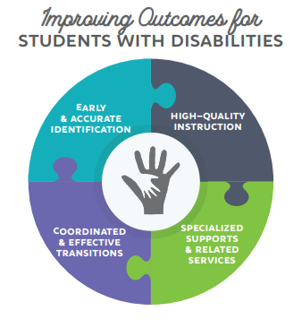
Supporting Students with Disabilities
The Super App organizes the way in which we support students with disabilities around four proven strategies:
Early & Accurate Identification
High-Quality Instruction
Specialized Supports & Related Services
Coordinated & Effective Transitions

Slide 12
Partnerships for Success Guide
To support planning for the specialized supports and related service needs of students with disabilities, the Department has developed the Partnerships for Success Guide, a vendor guide of organizations that can deliver
high-quality professional development in areas of specialized supports (communication, assistive technology, executive functioning, etc).
certified providers who can fulfill direct service requirements (speech therapy, occupational therapy, etc) as outlined in individualized education plans (IEPs).

Slide 13
Professional Development for Specialized Support
Students with disabilities, like all students, should spend the majority of their time reading, speaking, writing and solving curriculum-based tasks.
Specialized supports are strategies or tools in areas such as:
communication,
assistive technology,
functional skills,
sensory environment, and
executive functioning
that ensure students with disabilities can engage in the classroom, every day.
*For additional information see page 4 of the Partnerships for Success Guide.

Slide 14
Direct Service Providers
Students with disabilities also need direct services from a certified provider as part of their individualized education plan.
The Partnerships for Success Guide provides an informal inventory of organizations staffed with certified providers that use alternative or innovative methods to deliver direct services to students with disabilities. This includes:
speech language therapy
occupational therapy
adapted physical therapy
physical therapy
social work / counseling / psychological services
school health services

Slide 15
Partnerships for Success Guide + School System Planning

Slide 16
Objectives:
Participants will
Understand how the Partnerships for Success Guide can be used to support students with disabilities.
Learn how to utilize the Partnerships for Success Guide in the school system planning process.
Understand how to align support from partners to a shared vision for students with disabilities.

Slide 17
Students with Diverse Needs
The Super App organizes the way in which we support students with disabilities around four proven strategies:
Early & Accurate Identification
High-Quality Instruction
Specialized Supports & Related Services
Coordinated & Effective Transitions

Slide 18
Students with Diverse Needs
SDN5.1 | Specialized Supports + Related Services for Students with Disabilities
 | Indicator: | Application Question:
 | Students access specialized supports and related services that allow them to access high-quality curriculum. | Which partner(s) will train teachers on the use of specialized supports for students with disabilities?
*Note-The 2020-2021 school system planning framework does not include a planning question for the direct service needs of students with disabilities. Those needs can be addressed within a school systems IDEA budget.

Slide 19
Identifying Areas of Specialized Support
Using the areas of specialized support, described on page 4 of the Partnerships for Success Guide, consider the areas of targeted professional development in your school system for educators that might be required to ensure students with disabilities have every opportunity to build knowledge, read complex texts, express understanding, and solve complex problems.
Thoughts to consider while selecting areas of specialized support:
Specialized supports should be based on the academic and functional needs of students, not just their disability classification.
Specialized supports should increase meaningful engagement with peers across settings.
Specialized supports provide opportunities for increased access to high quality instruction, everyday.

Slide 20
Identifying Areas of Specialized Support
How can we identify the top areas of specialized support professional development educators needed, to ensure students with disabilities can meaningfully engage in high-quality instruction everyday?
Begin by identifying the most urgent needs in school(s) designated Urgent Interventiaon Required-Academics for students with disabilities.
Review these factors:
What related services are students receiving?
What educational needs are indicated across student IEP’s?
Gather feedback from educators indicating barriers that prevent students with disabilities from engaging with high-quality instruction.
Take findings from questions 1 & 2 and compare those findings across the school system.

Slide 21
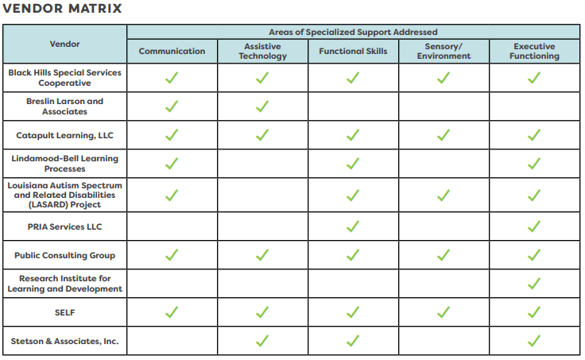
Identifying Partnerships for Specialized Support
Use the professional development provider matrix, found on page 4 of the Partnerships for Success Guide, to identify potential partner or partner that can address the areas of specialized support identified as a priority.
Reach out to potential partners to discuss the specific needs of educators who support students with disabilities in your school system.

Slide 22
Budgeting Partnerships for Specialized Support
Rank up to three areas of specialized support professional development educators need (one being the highest), to ensure students with disabilities can meaningfully engage in high-quality instruction everyday
Indicate the state and/or IDEA funds budgeted to support this work.

Slide 23
Budgeting Partnerships for Specialized Support
Example 1:
This is a sample budget that would provide two days of professional development in communication, one day of sensory/environment, and one day of training for the implementation of assistive technology for up to 30 educators by the same vendor. The majority of this cost would be paid for under the diverse needs tab IDEA budget.

Slide 24
Budgeting Partnerships for Specialized Support
Example 2:
This is a sample budget utilizing three different vendors providing two days of professional development for executive functioning, one day of leadership training for the implementation of assistive technology, and one day of training to support the communication needs of students with disabilities. This cost is completely budgeted for under under the diverse needs tab IDEA budget.

Slide 25
Competitive Funding Requests for Specialized Support
School systems with at least one school identified as UIR in the students with disabilities subgroup may request competitive funding to subsidize professional development from vendors in the Partnerships for Success Guide.
This funding is not exclusive to UIR school sites, but can rather support professional development for educators across the school system.

Slide 26
Competitive Funding Requests for Specialized Support
Funding Eligibility
Qualifier | Maximum funding request
School system with one school designated as UIR for students with disabilities. | Up to $5,000
School systems with two or more schools designated as UIR for students with disabilities. | Up to $10,000

Slide 27
Budgeting Partnerships for Specialized Support
This is a sample budget that would provide two days of professional development in communication, one day of sensory/environment, and one day of training for the implementation of assistive technology for up to 30 educators by the same vendor.
This school system had only one school labeled as UIR for students with disabilities, meaning they could request up to $5,000 to subsidize funding for training educators across the school system with the specialized supports required to support students with disabilities.

Slide 28
Competitive Funding Requests for Specialized Support
Looking at this second example budget, this school system utilizes three different vendors providing two days of professional development for executive functioning, one day of leadership training for the implementation of assistive technology, and one day of training to support the communication needs of students with disabilities.
This school system had more than two schools labeled as UIR for students with disabilities, meaning they could request up to $10,000 to subsidize funding for training educators across the school system with the specialized supports required to support students with disabilities.

Slide 29
Vision for Aligned Support

Slide 30
Objectives:
Participants will
Understand how the Partnerships for Success Guide can be used to support students with disabilities.
Learn how to utilize the Partnerships for Success Guide in the school system planning process.
Understand how to align support from partners to a shared vision for students with disabilities.

Slide 32
Expectations from Vendors
Specialized supports and direct services should always increase opportunities for students with disabilities to build knowledge, read complex text, express understanding, and solve complex problems. Vendors in the Partnerships for Success Guide are expected to:
Understand the Louisiana’s strategy for supporting and students with disabilities.
Ensure all training, support, and direct services are aligned to our vision for students with disabilities.
Utilize Department tools and structures to assist school systems in ensuring students with disabilities are able to meaningfully engage in the most complex components of lessons.

Slide 33
Resources

Slide 34
Additional Resources
Partnerships for Success Guide
Strategies for Success: A Guidebook for Supporting Students with Disabilities
Louisiana Believes Students with Disabilities Resource Library
Louisiana PD Vendor Guide
School System Support Toolbox

Slide 35
Super App Support
Support for completing the Super App will be provided through
School Improvement Library
LDOE Weekly Newsletters
School System Planning and Superintendent Calls
Network Teams
Office Hours on scheduled Mondays at 11:00 AM (details via LDOE Weekly Newsletter)
Send all questions related to school system planning and Super App to LDOE.GrantsHelpDesk@la.gov and include “Super App” in the subject line.

