Slide 1
Coordinating School System Professional Development Opportunities
November 2019

Slide 2
Objectives
Participants will:
Understand the requirements in Super App for Professional Development plans
Understand the components required in Professional Development Plans
Be able to access and use planning resources provided by the LDOE

Slide 3
Agenda
Components of strong professional development plans
Professional development planning template
Getting started

Slide 4
Notes:
2 minutes

Slide 5
Academic Focus
In order to ensure students do the majority of the work every day,
All teachers—including special education, English language, and reading interventionists—are fully prepared to deliver high-quality lessons.
Principals, leadership teams, content leaders and mentor teachers use classroom observation, common planning time, and one-on-one coaching to support each teacher in delivering high-quality lessons.
School systems support principals and school teams as they provide support to teachers.
The Department supports school systems as they execute their improvement plans.
Notes:
2 minutes

Slide 6
Improvements to the 2020-2021 Strategy
CIR and UIR Improvements
Professional Development Plan: School systems submit a plan that includes content module redelivery and unit unpacking for CIR schools.
Post-secondary planning partner: Schools will have at least one partner to support Individual Graduation Plans (IGPs) at CIR high schools.
District leader responsible for UIR-D schools: School systems will have a leader to coordinate support and planning for UIR-D schools.
Other Strategy Improvements
Science: School systems can apply for funds to support the purchase of science curricula and the training of teachers on this curricula.
Early Childhood: The planning process for governance, access, and quality is now included in Super App.
Special Education: Funding for professional development on specialized supports is available for schools with a UIR label for the subgroup with students with disabilities.

Slide 7
School System Planning Framework
Area of Focus
Domain
Planning Questions
Domain and Row Number
Indicators

Slide 8
Core Academics
This session will provide information related to the School System Planning Framework area(s) below.
CA 2.3 | High Quality Teacher Professional Development
 | Indicator | Application Question
 | Teachers in all grade levels and core content areas receive orientation to the curriculum, content module redelivery, opportunities to prepare for units and lessons, and ongoing support. | Please upload the completed Professional Development Planning template as a Word document.

Slide 9
Current Progress to Goal
Goal:
All Teachers—including special education, English language, and reading interventionists—are fully prepared to deliver high quality lessons.
Current state:
Based on LEAP 2025 scores and classroom observation curriculum implementation is improving, but teachers are not yet experts on the curriculum.
Teachers who attend redelivery of content modules express a deeper understanding of the curriculum and deliver more effective instruction. However, not all teachers have the opportunity to attend content module redelivery.
Next Steps:
Support school systems to create effective Professional Development plans that prioritize content module redelivery and unit and lesson preparation.
Notes:
2 minutes

Slide 10
Components of Strong Professional Development Plans

Slide 11
Professional Development Plans
In order for all students to achieve grade level standards, all teachers—including special education, English language, and reading interventionists—must deliver high quality lessons.
Each year, school systems build a plan to ensure that all teachers receive training and ongoing support. Plans should include:
Content module redelivery
Unit and lesson preparation
The Professional Development Planning Guidance will help schools and school systems to complete the Professional Development Planning Template required for CIR schools in Super App.

Slide 12
Professional Development Plans
3 minutes: Review the Professional Development Planning Guidance
As you review consider the following questions:
What stands out to you as important?
What information is new or surprising?
What information will be most helpful?
Where do you have questions?
5 minutes: Group Discussion
Notes:
15 mimutes

Slide 13
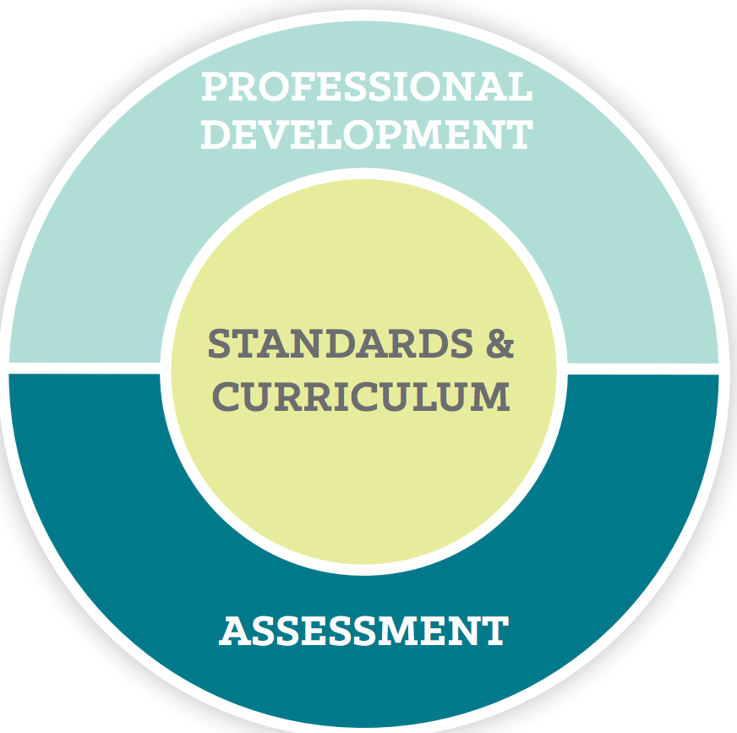
Distinction Between Content Leader Roles
ELA and Math Content Leaders
Provide content- and curriculum-specific professional development to teachers in their school and school system using turnkey session materials
Lead professional learning communities in schools
Lead content module re-delivery at school and school system professional development days
Intervention Content Leaders
Ensure all students can access a high quality curriculum
Train teachers to use core instruction and intervention time effectively
Support general education teachers in lesson preparation
Ensure all teachers in the school use effective intervention strategies and that staffing and scheduling decisions support collaboration and lesson preparation
Do not re-deliver content modules

Slide 14
Redelivery of Content Modules
Redelivery of content can begin at any time throughout the school year and can have an immediate impact on teacher practice.
The modules (36 hours total) are flexible to fit school/district needs and can be delivered in chunks from ranging from one to six hours.
All modules include facilitator notes, handouts, and a recommended facilitation time.
ELA content modules are best delivered in grade bands (3-5, 6-8, 9-10); teachers spend time digging into the texts in each unit of the Guidebook.
Math content modules are best delivered in grade bands (K-5, 6-9) because of the emphasis on understanding the vertical progression of the standards.
Science content modules are currently in development and will require three days for redelivery.
The first several sessions are focused on studying content and training. Content Leaders are generally ready to redeliver training content at day nine of training.

Slide 15
ELA Content Modules
Module | Title
1 | Unpacking the Guidebooks
2 | Building Knowledge to Support Understanding
3 | Close Reading to Build Understanding
4 | Supporting All Students
5 | Developing Writing and Language Skills
6 | Supporting All Students

Slide 16
Math K-5 Content Modules
Module | Title
1 | Setting the foundation for implementing the curriculum
2 | Operations and Algebraic Thinking: Addition and Subtraction of Whole Numbers and Problem Types
3 | Operations and Algebraic Thinking: Multiplication and Division of Whole Numbers and Problem Types
4 | Numbers and Base Ten: Place Value and Fluency
5 | Numbers and Operations—Fractions: Understanding Fractions
6 | Number and Operations—Fractions: Operations With Fractions

Slide 17
Components of Professional Development Plans
Content Leader redelivery of Content Modules
*There may be exceptions when qualified Content Leaders are not available.
Should | Should Not
effectively train teachers to develop a deeper understanding of curriculum design, connection to the standards, and key instructional practices within the curriculum that lead to student comprehension should be re-delivered as intended happen at the beginning of the school year use vendors to redeliver when qualified Content Leaders are unavailable | be replaced by a general vendor professional development* only redeliver part of modules be redelivered by an ineffective Content Leader

Slide 18
Components of Professional Development Plans
Unit preparation
Should | Should not
align to actions in the Common Planning Tool happen ongoing throughout the school, during common planning. Teachers should have time set aside prior to each unit for unit unpacking. | happen during 30 minute conference periods simply be a quick skimming of the unit consist of reviewing the problems instead of working the problems in the unit

Slide 19
Professional Development Planning Template and Resources

Slide 20
Professional Development Plans
3 minutes: Review the Professional Development Planning Template
As you review consider the following questions:
What stands out to you as important?
What information is new or surprising?
What questions are confusing?
Where will your school system struggle to determine answers?
10 minutes: Q&A
Notes:
15 mimutes

Slide 21
Additional Resources
The Professional Development Planning Guidance will help schools and school systems to complete the Professional Development Planning Template required in Super App.
These additional resources may be helpful to school systems when creating their professional development plan:
Mentor Teacher and Content Leader Participation List
Mentor Teacher/Content Leader Vendor Guide
Science Content Leader one page summary
Content Leader Webpage
Instructional Support Guide
Sample Calendar

Slide 22
Getting Started

Slide 23
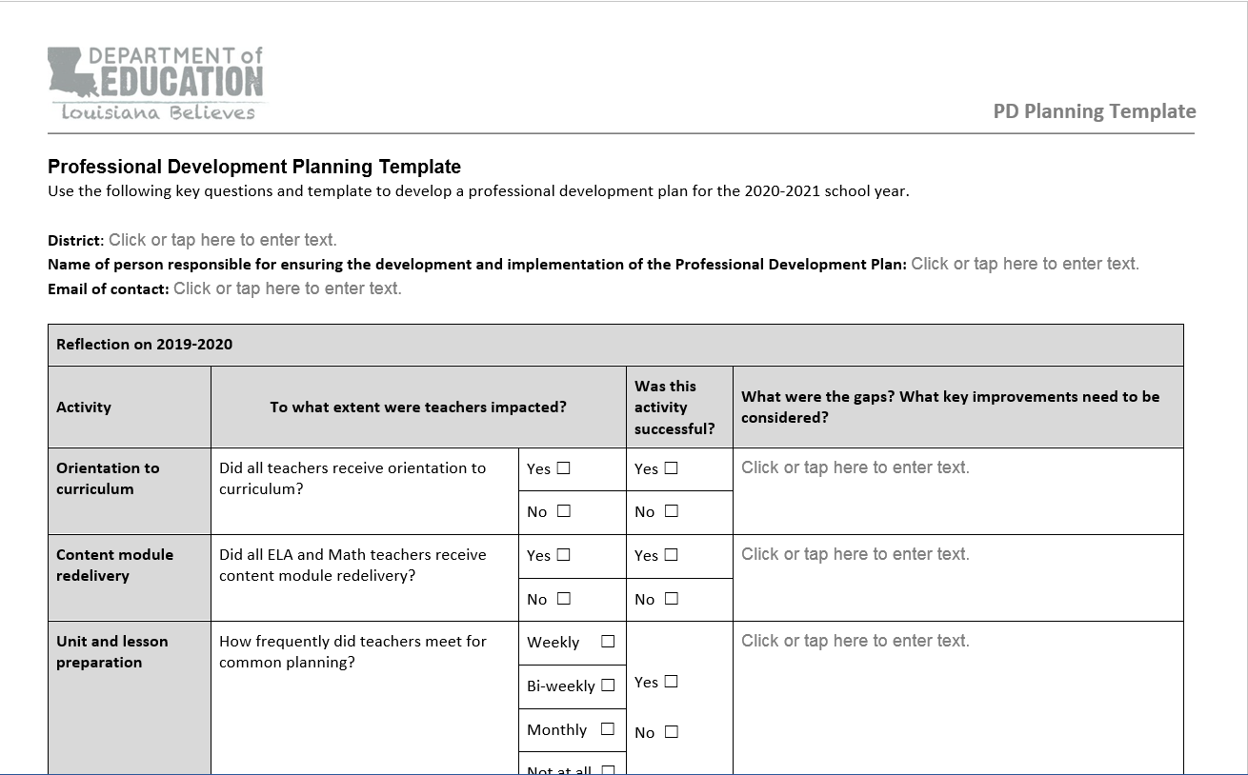
Professional Development Plans:
Getting Started!

Slide 24
Professional Development Plans:
Getting Started!
10 minutes: Begin to complete the reflection questions on page one.
As you complete the reflection consider the following questions:
Who in the school system will be responsible for completing the Professional Development plan?
What data do you need in order to answer the questions effectively?
What decisions need to be made? Who should be involved in those decisions?

Slide 25
Professional Development Planning: Network Support
Below are the following steps school systems should take to create a professional development plan:
Review the Professional Development Planning Guidance to better understand the components of Professional Development and how they interact.
Have a reflective conversation about your 2019-2020 professional development activities. During this conversation complete the top section of the Professional Development Planning Template.
Discuss your Professional Development plans for the 2020-2021 school year by answering the questions in the Professional Development Planning Template.
Reach out to your network contact if you need support drafting your plan.

Slide 26
Closing

Slide 27
Professional Development Plans: Timeline
Dates | Actions
November-February | School systems draft Professional Development plans using the planning template and guidance resources
February | School Systems submit Professional Development plans via Super App
February- March | LDOE reviews plans and provides feedback
April- May | School systems revise and finalize Professional Development plans
June | Revised plans due

Slide 28
Next Steps
Identify who will be responsible for creating the plan and who will need to be involved in the creation of the plan.
Ensure you have the information you need to effectively reflect on the previous year and plan for the upcoming year.
Reach out to your network contact if you need support drafting your plan.
Submit your plan with Super App on February 7.

Slide 29
Super App Support
Support for completing the Super App will be provided through
School Improvement Library
LDOE Weekly Newsletters
School System Planning and Superintendent Calls
Network Teams
Office Hours on scheduled Mondays at 11:00 AM (details via LDOE Weekly Newsletter)
Send all questions related to school system planning and Super App to LDOE.GrantsHelpDesk@la.gov and include “Super App” in the subject line.

