Slide 1
Zoom Meeting Preparation
Please make sure your phone or computer is muted to minimize background noise.
To do this, hover over the bottom left-hand side of your screen and click “Mute.”
Please make sure you have turned off your camera to save bandwidth and prevent any connectivity issues.
To do this, hover over the bottom left-hand side of your screen and click “Stop Video.”
Please submit questions during the presentation in the “Chat” function located on the bottom of your screen.
NOTICE: In accordance with the Americans with Disabilities Act, if you need special assistance at this meeting please contact ldoecommunications@la.gov.

Slide 2
AAA: Assessment and Accountability Monthly Call
September 26, 2023

Slide 3
Agenda Items
LEAP 2025
ELPS/ELPT
ACT
K-3
V. Innovative Assessment
VI. Accountability

Slide 4
LEAP 2025

Slide 5
LEAP Enrollment Verification
The enrollment window in LEAP DRC INSIGHT will open on September 29 and will close on October 27.
PLEASE NOTE THAT DTCs are required to complete enrollments at two levels on the DRC INSIGHT Portal Enrollment functionality this year: at District level and at school level.
At District Level: This is new for 2023-2024: DTCs must select a shipping window for Manuals, and CBT/PBT shipment; Selection is at District level, because materials are only shipped to the district.
Select Administration>District >Show Enrollments>Select options that work for the district.>Save>Complete

Slide 6
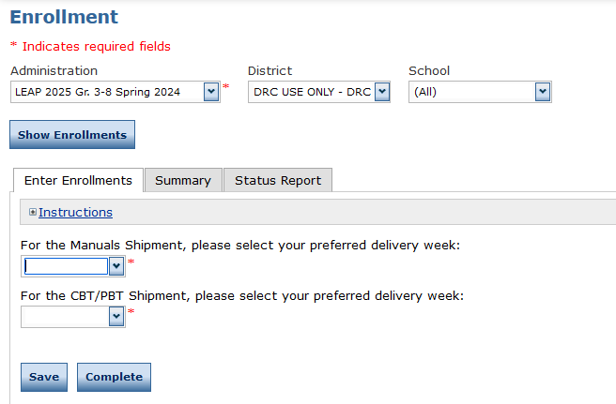
NEW: District Level Enrollment Data in DRC INSIGHT

Slide 7
School Enrollment Data and Paper Testing
As in previous years, DTCs will need to provide information on:
Test Mode
Materials Quantities
Select Administration>District >School>Show Enrollments>Select options that work for the school(s).>Save>Complete
School systems that are planning to administer paper testing for grade 3 must complete their selection no later than October 27. All schools and systems that do not make this selection in DRC INSIGHT will be assigned to online testing.

Slide 8
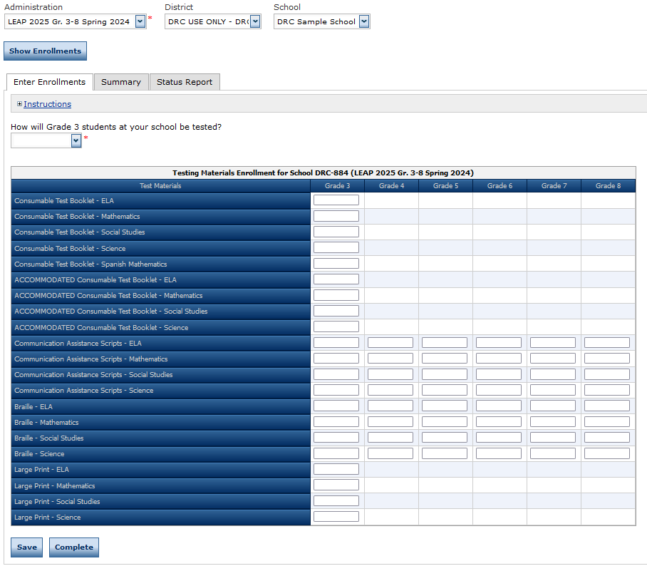
School Level Enrollment Data

Slide 9
Unique Accommodations Request Form
The Unique Accommodations Request Form will now only be used for students and teachers who need paper copies of the assessment. The form will not be approved by department staff.
The form continues to require an explanation of the need for the request.
Assurance that the accommodation is being used routinely in the classroom.
Assurance that the school has reviewed the requirements in the LEAP Accommodations and Accessibility Features User Guide.
Teachers who are providing human reader must have a copy of the test. They cannot read from the student’s screen.

Slide 10
ELPT/ELPS

Slide 11
ELPT Connect
ELPT Connect scale score ranges and achievement levels will be recommended to BESE for approval in October. With approval, student and school reports will be released. The ELPT Connect will include 4 achievement levels.
The department will begin work on adding ELPT Connect performance levels to accountability for inclusion in ELPT progress in 2024.

Slide 12
ACT/WorkKeys

Slide 13
ACT MOUs
ACT MOUs are now due. If a school system plans to test students for WorkKeys and ACT who are not eligible to be tested under the state contract, there must be an MOU on file.
Students who are eligible to test under state contract include:
All students in grade 11
Grade 12 students who do not have an ACT on file with the department from a prior administration
Grade 11 students who are on the Jump Start diploma pathway AND who have never taken a WorkKeys assessment.

Slide 14
K-3

Slide 15
K-3 Screening Updates
Please note that all students in K-3 must be screened within the first 30 school days. There has been some confusion about the deadline for reporting results. The deadline is before October 13.
Data managers should reach out to System Support for questions about uploading their files.

Slide 16
Innovative Assessment

Slide 17
IAP Fall Administration Window
Students will be loaded into ADAM prior to administration. Their inclusion will be determined by the data that was submitted to EdLink by September 22.
Please be reminded that students who do not test must be accountability coded each window. Students with unexcused absences in testing from any window will not be eligible for LEAP. The Fall 2022 administration webinar was very clear that students had to be coded, as well as instructions for absences that were included in the test administration manual.

Slide 18
Accountability

Slide 19
Progress Rosters in Assessment Data Certifications
As soon as VAM determinations can be applied to progress rosters, they will be loaded into La Data Review. Schools systems will have one week to review and submit changes before assessment data certification closes for new submissions. Please note that there will be no additional extensions once the system closes since any additional delay will affect the release of school performance scores.

Slide 20
Updated Graduation Student Rosters
The cohort graduation student level rosters for the 2022 graduation cohort were updated to correct the flag for students with disabilities and an updated roster has been placed on the ftp. The file names are:
LEA Code_LEA Name_2022_Cohort_Graduation_Student_Roster_updated
LEA Code_LEA Name_Cohort_56Years_Student_Roster_updated

Slide 21
Interests and Opportunities
The Jotform survey for Interests and Opportunities will open on 8/21/2023 and will close on 11/3/2023. Final validations are due on 11/8/2023. The 2023-2024 Menu can be found in the Accountability Library.
Office Hours for I&O will be held on the following dates at 10:00 a.m.
Thursday, August 31st
Thursday, September 28th
Thursday, October 19th
Wednesday, November 1st
Please contact accountability@la.gov with questions.

Slide 22
Call Summary
Month | Key Deadlines | Support and Resources
September | Open: Assessment Data Certification Due Now: ACT MOUs | Assessment Library DTC Resources Page 2023-2024 Assessment Calendar K-3 Literacy Screener
October | Enrollment/Selection of Paper Testing for Grade 3 opens in DRC INSIGHT October 6: IAP Test Schedules Due October 23-November 3: IAP Testing October 13: Snapshot for K-3 literacy screening results | Office Hours Tuesdays at 3:45: October 3, 10, 24, 31 Monthly Call: October 17

