Slide 1
Zoom Meeting Preparation
Please make sure your phone or computer is muted to minimize background noise.
To do this, hover over the bottom left-hand side of your screen and click “Mute.”
Please make sure you have turned off your camera to save bandwidth and prevent any connectivity issues.
To do this, hover over the bottom left-hand side of your screen and click “Stop Video.”
Please submit questions during the presentation in the “Chat” function located on the bottom of your screen.
NOTICE: In accordance with the Americans with Disabilities Act, if you need special assistance at this meeting please contact ldoecommunications@la.gov.

Slide 2
AAA: Assessment and Accountability Monthly Call
October 17, 2023

Slide 3
Agenda Items
LEAP 2025
ELPS/ELPT
ACT
K-3
V. Innovative Assessment
VI. Accountability

Slide 4
LEAP 2025

Slide 5
LEAP 2025 Fall High School Window
BESE policy requires that all IEPs and accommodations be finalized for a testing window at least 30 days prior to the state’s opening. For the fall high school testing window that opens on November 27, all accommodations should be final no later than October 27.
October 23: DRC INSIGHT will open for test setup and assignment of TA numbers.
November 6: Additional materials window opens

Slide 6
LEAP Enrollment Verification
The enrollment window in LEAP DRC INSIGHT will open on September 29 and will close on October 27.
PLEASE NOTE THAT DTCs are required to complete enrollments at two levels on the DRC INSIGHT Portal Enrollment functionality this year: at District level and at school level.
At District Level: This is new for 2023-2024: DTCs must select a shipping window for Manuals, and CBT/PBT shipment; Selection is at District level, because materials are only shipped to the district.
Select Administration>District >Show Enrollments>Select options that work for the district.>Save>Complete

Slide 7
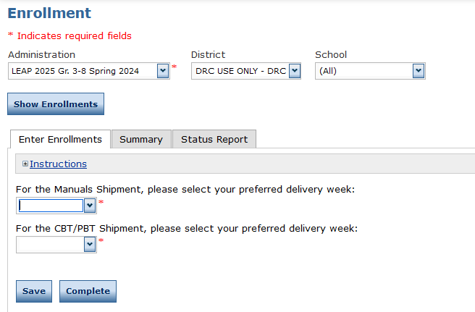
NEW: District Level Enrollment Data in DRC INSIGHT

Slide 8
School Enrollment Data and Paper Testing
As in previous years, DTCs will need to provide information on:
Test Mode
Materials Quantities
Select Administration>District >School>Show Enrollments>Select options that work for the school(s).>Save>Complete
School systems that are planning to administer paper testing for grade 3 must complete their selection no later than October 27. All schools and systems that do not make this selection in DRC INSIGHT will be assigned to online testing.

Slide 9
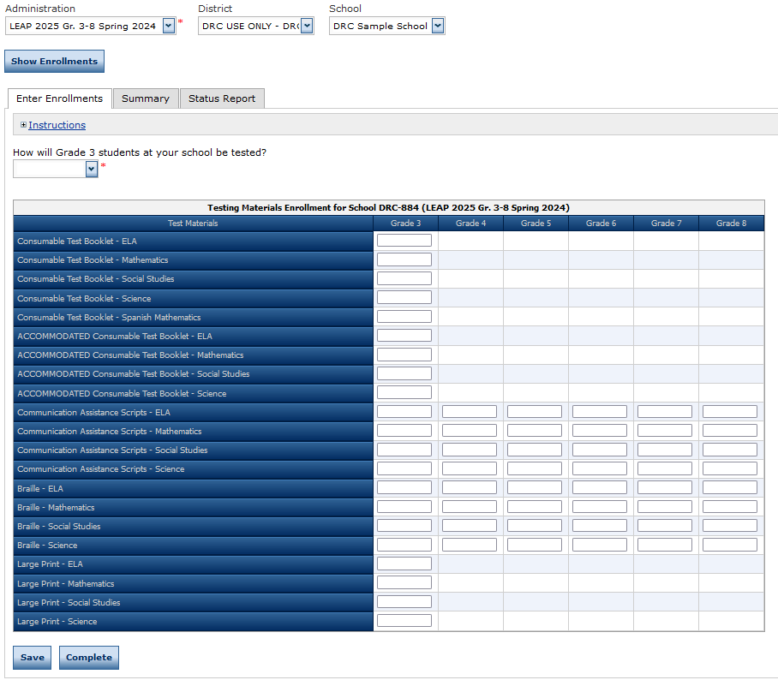
School Level Enrollment Data

Slide 10
Assessment Committee Applications
The Division of Assessment Content is preparing to convene educator committees in January for the following assessments:
LEAP 2025 Science Grades 4-7 and Biology Stimuli Reviews
LEAP Connect Item Reviews
Interested educators can access the Assessment Content Educator Review Committees document for committee details and links to apply. The deadline to complete the applications is November 5.
Please email michelle.mcadams@la.gov with questions.

Slide 11
Unique Accommodations Request Form
The Unique Accommodations Request Form will now only be used for students and teachers who need paper copies of the assessment. The form will not be approved by department staff.
The form continues to require an explanation of the need for the request.
Assurance that the accommodation is being used routinely in the classroom.
Assurance that the school has reviewed the requirements in the LEAP Accommodations and Accessibility Features User Guide.
Teachers who are providing human reader must have a copy of the test. They cannot read from the student’s screen.

Slide 12
ELPT/ELPS

Slide 13
ELPT Connect
ELPT Connect scale score ranges were approved by BESE at the October meeting. Individual student reports will be issued prior to the Thanksgiving break.
The department will begin work on adding ELPT Connect performance levels to accountability for inclusion in ELPT progress in 2024. Unlike the ELPT which has five levels, ELPT Connect has only four levels.

Slide 14
ACT/WorkKeys

Slide 15
ACT MOUs
ACT MOUs are now due. If a school system plans to test students for WorkKeys and ACT who are not eligible to be tested under the state contract, there must be an MOU on file.
Students who are eligible to test under state contract include:
All students in grade 11
Grade 12 students who do not have an ACT on file with the department from a prior administration
Grade 11 students who are on the Jump Start diploma pathway AND who have never taken a WorkKeys assessment.

Slide 16
K-3

Slide 17
K-3 Screening Updates
The department is working with Amplify to finalize the state contract, and to prepare to have the platform available for the December screening. As soon as the department can share additional information, it will be provided. Our team will be hosting a webinar for training on the new system and all of its functions as soon as we are cleared to do so.
The department is also working on a data sharing agreement for Amplify. Student information cannot be shared with the vendor without them in place. This will be a quick turnaround, and details are coming soon.
There will be some field testing done during the mid-year administration. This is necessary for the development of the new secure form that will be used in the spring. Details coming soon. Thanks for your patience.

Slide 18
KEA and K-3 Submissions
Thanks so much to all of you for your diligent work to get submissions completed for the new K-3 literacy screening and the traditional KEA screening. There are still some districts who have not reported all of their students.
Prior to the mid year administration, please be reminded that ALL students must be screened. There is no exception for students who are alternate assessment, EL or other designation.

Slide 19
Innovative Assessment

Slide 20
IAP Fall Administration Window
Please be reminded that students who do not test must be accountability coded each window. Students with unexcused absences or voids from any window will not be eligible for LEAP to be used in accountability. The LEAP can be administered to the student for informational purposes only.
Students in grade 8 who are taking English I must take both the LEAP grade 8 ELA assessment and the LEAP high school English I assessment.

Slide 21
Spanish Forms for Innovative Math
For schools and systems participating in the innovative math testlets, please let us know as soon as possible if you will need a Spanish form of the testlets, and indicate grade level. Emails were sent on Monday, October 16 with this request along with the manuals.

Slide 22
Accountability

Slide 23
Interests and Opportunities
The Jotform survey for Interests and Opportunities opened on 8/21/2023 and will close on 11/3/2023. Final validations are due on 11/8/2023. The 2023-2024 Menu can be found in the Accountability Library.
Office Hours for I&O will be held on the following dates at 10:00 a.m.
Thursday, October 19th
Wednesday, November 1st
Please contact accountability@la.gov with questions.
The link is: https://ldoe.zoom.us/j/99815735110
Passcode: 202324

Slide 24
Data Certification
Please submit any documentation for submissions that are still under review and a reviewer has asked for additional information as soon as possible. All responses this week will include a deadline.
There has been no final date set for release of school performance scores. CIR and UIR determinations will be released at the same time. Final rosters for DCAI, ACT, Assessment and ELPT will be posted to the ftp with the SPS release.

Slide 25
Call Summary
Month | Key Deadlines | Support and Resources
October | October 23: DRC INSIGHT opens for test setup October 23-November 3: Innovative assessment window for ELA and mathematics. Voids due by end of the window By October 27: Finalize enrollment, grade 3 paper selection and delivery dates for DRC in INSIGHT By October 27: Finalize IEPs, IAPs and EL checklist accommodations for fall high school window | Assessment Library DTC Resources Page 2023-2024 Assessment Calendar K-3 Literacy Screener
November | Office Hours cancelled November 21 High school administration window opens November 27 | Office Hours Tuesdays at 3:45: October 24, 31, November 7, 28 Monthly Call: November 14 Office Hours cancelled on November 21.

