Slide 1
Zoom Meeting Preparation
Please make sure your phone or computer is muted to minimize background noise.
To do this, hover over the bottom left-hand side of your screen and click “Mute.”
Please make sure you have turned off your camera to save bandwidth and prevent any connectivity issues.
To do this, hover over the bottom left-hand side of your screen and click “Stop Video.”
Please submit questions during the presentation in the “Chat” function located on the bottom of your screen.
NOTICE: In accordance with the Americans with Disabilities Act, if you need special assistance at this meeting please contact ldoecommunications@la.gov.

Slide 2
AAA: Assessment and Accountability Monthly Call
July 15, 2023

Slide 3
Agenda Items
LEAP 2025
ELPS/ELPT
ACT
K-3
V. Innovative Assessment
VI. Accountability

Slide 4
LEAP 2025

Slide 5
LEAP grades 3-8 Score Release
In late July, schools will receive school rosters and individual student reports for grades 3-8 spring testing. School systems will be notified of the official release date by the end of this week.
The department also is working to release grades 6-8 Innovative Assessment end-of-year reports by late July.
Embargo
There is no embargo on individual student reports. When they are released, they should be distributed to parents. An embargo of LEAP scores applies to district release of any summary results prior to the department’s official release.

Slide 6
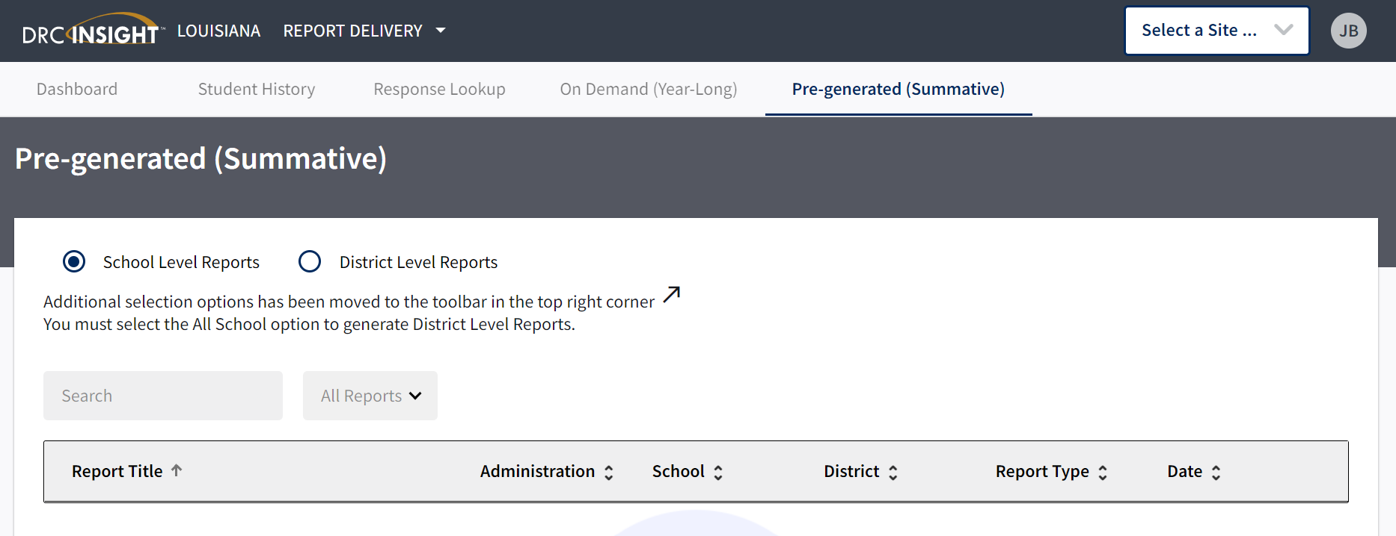
LEAP Scores in DRC INSIGHT
When scores are released, they can be found in DRC INSIGHT using the following steps:
Go to My Applications
Select Report Delivery
Select Pre-Generated (Summative)
In the upper right hand corner, users can select site and test administration: LEAP 2025 Grades 3-8 Spring 2022

Slide 7
LEAP 2025 High School Summer Administration
July 27: Last day to request summer rescore
Initial test scores from the summer administration will not be in the 2023 fall SPS and cannot be used to remove a zero for a student who failed to test after completing a course in spring.

Slide 8
Graduation Waiver
At the June BESE meeting, a graduation waiver was proposed and approved for students who did not meet assessment graduation requirements. This proposal is now out for notice of intent, as is the case for all BESE approvals. The intent process allows for additional input. Guidance will be provided to schools once the process closes.

Slide 9
Growth-to-Mastery Rosters
On August 1, the department will release the Grades 3-8 growth-to-mastery rosters that include new targets for spring 2024. The rosters released on August 1 will be posted in DRC INSIGHT and NOT posted to the ftp.
The rosters will include students who tested with the school. The rosters will be updated to include all students enrolled in the school on October 1 once the collection in EdLink closes.
The rosters for high schools will be released after the October 1 collection closes. This allows for grade 8 students in middle schools to be migrated over to their new high school site.

Slide 10
ELPT/ELPS

Slide 11
Access to TIDE for Screening
The TIDE platform will be unavailable from July 24 through August 1. Returning TIDE users will be required to reset their passwords upon initial log in.
Please contact the Louisiana ELPT Help Desk with assistance or questions.

Slide 12
ACT

Slide 13
ACT Online Testing
This coming year online testers have 9 days for each window, instead of 6. Testing can take place on weekdays only. These dates are reflected in the current assessment calendar.

Slide 14
ACT/WorkKeys
ACT/WorkKeys invoices have been emailed to district superintendents, finance contacts, and DTCs. Any prepayment, MFP deduction, or overpayment is reflected on the invoice. The State will refund any overpayment (if applicable) to the district by July 30, 2023. For any balance due, please make the check payable to LDOE and remit full payment by July 15, 2023 to:
Louisiana Department of Education
Division of Appropriation Control
PO Box 94064
Baton Rouge, LA 70804-9064
A student roster that confirms students for whom the district was billed for is on the ftp.

Slide 15
K-3

Slide 16
K-3 Screening Updates
The process for fall administration of K-3 literacy screening will be released by the end of the week.
All students must participate in the statewide K-3 literacy screener or approved alternate assessment for students who qualify.

Slide 17
Innovative Assessment

Slide 18
2023-2024 Participation
Any school system that is interested in participating in the Innovative Assessments for English language arts or the math testlets pilot should notify assessment@la.gov or ruth.caillouet@la.gov as soon as possible.
Grade 5-8 ELA operational Innovative Assessments are included in accountability assessment index in lieu of LEAP ELA. They may or may not be used for the progress index, depending on VAM results.
All grade level math testlets are optional and cannot be used in lieu of LEAP mathematics.

Slide 19
Accountability

Slide 20
August Data Certification
In early August, school system accountability contacts will receive an email notifying them of the opening of La Data Review for the purpose of reviewing data included in the ACT, DCAI, assessment and progress indices. The tentative schedule is below:
Week of August 7: Release of ACT and DCAI rosters
Week of August 21: Release of assessment rosters (additional rosters will be provided for progress index and ELPT progress index)
The only accounts that are created for La Data Review are for the official accountability contacts. If there are changes to these important roles, please complete the document at this link and return it to assessment@la.gov. Changes will not be made through an email exchange.
https://www.louisianabelieves.com/docs/default-source/assessment/dtc-and-accountability-contact-update-form.pdf?sfvrsn=36c28f1f_18

Slide 21
August Data Certification Webinar
A webinar for district accountability contacts has been scheduled for July 26 at 2 p.m. to:
Explain the process for reviewing data that will be included in the school performance score (SPS)
Provide directions for requesting changes in La Data Review that are/can be documented
Review accountability policies that affect what and how data are used in the SPS
Join Zoom Meeting
One tap mobile: | US: +14702509358,,98093302235# or +14703812552,,98093302235#
Meeting URL: | https://ldoe.zoom.us/j/98093302235
Meeting ID: | 980 9330 2235

Slide 22
Interests and Opportunities
The Jotform survey for Interests and Opportunities will open on 8/21/2023 and will close on 11/3/2023. Final validations are due on 11/8/2023. The 2023-2024 Menu can be found in the Accountability Library.
Office Hours for I&O will be held on the following dates at 10:00 a.m.
Thursday, August 31st
Thursday, September 28th
Thursday, October 19th
Wednesday, November 1st
Please contact accountability@la.gov with questions.

Slide 23
Call Summary
Month | Key Deadlines | Support and Resources
July | July 26: Webinar for Data Certification July 27: All rescore requests due for high school summer administration Late July, grades 3-8 individual score reports and school roster reports available in DRC INISGHT | 2022-2023 Assessment Calendar Assessment Library DTC Resources Page
August | August 1: Grades 3-8 growth-to-mastery rosters posted to DRC INSIGHT First 30 days of school, all schools administer the single statewide screener to students in grades K-3 unless student qualifies and participates in state-approved alternate screener Week of August 7: Notification of data certification opening for DCAI and ACT August 21: Interests and Opportunities survey opens in JotForms | Office Hours Tuesdays at 3:45: July 25, August 1, 8, 22, 29 Monthly Call: August 15

