Slide 1
School Performance Score Early Release
February 4, 2020

Slide 2
Agenda
Early Release Timeline Overview
Review of Indices
How are data collected for the index?
How can data be validated throughout the year?
Will there be data certification for the index?
Pre and Post Data Certification SPS File

Slide 3
Early Release Timeline Overview

Slide 4
2019-2020 Fall Release Timeline
The Department is committed to sharing school and center results to support school system planning and to provide parents and other stakeholders with accurate and timely information.
In an effort to time the school and center performance score release with back-to-school communications, 2019-2020 results will be published no later than September 2020.
In order to accomplish this, the Department has been working with school systems to:
Speed up the release of student growth results from October 30 in 2017 to August 16 in 2018 and August 9 in 2019.
When applicable, validate reported data during open collection periods to minimize corrections required during accountability data certification. In 2020, some corrections will be made after the release and some correction periods will be moved to early dates.

Slide 5
Most Significant Changes after Data Certification
Based on analysis of preliminary and post-data certification school performance scores, the most significant changes are seen with the DCAI and ACT rosters.
DCAI: Some school systems have not updated the transcripts of 9th grade students when the data are downloaded in July. In addition, students who are flagged as current year dropouts have not been exited as transferring out of state or to nonpublic schools. This is especially problematic for charter and scholarship schools.
ACT: Matching many WorkKeys subtest scores across administrations within and across years remains a challenge to identification of students who are eligible for WorkKeys certificates.

Slide 6
Review of Indices
Cohort Graduation

Slide 7
Cohort Graduation Data: Collection
How are cohort graduation data collected?
Cohort Graduation Data Element | Collection Method
Graduation Status | Exit code 04 in SIS and graduation date on transcript in STS
Legitimate Leavers removed from cohort | Exit codes in SIS (7, 10, 14, 16, 20)
Jump Start Credentials | Student transcripts in STS
HiSET | Exit code 05 in SIS
Diploma plus TOPS Core-Aligned Dual Enrollment | Course code on transcript in STS
Advanced Placement/IB | Test score AP 3-5; IB 4-6; From vendor Test score AP 1-2, IB 1-3: From vendor and course on transcript
CLEP | From College Board

Slide 8
Cohort Graduation Data: Validation
How can cohort graduation data be validated throughout the year?
SIS and STS have on-demand reports which provide enrollment and exit data.
Exit codes that result in dropouts or incorrect non-graduates can be corrected through the SIS cleanup period.
Cohort tracking reports will be provided to assist schools with monitoring progress of potential cohort members.

Slide 9
Cohort Graduation Data: Data Certification
Will cohort graduation data be reviewed prior to release?
Data certification for cohort graduation data will be conducted as usual with the exception of the elimination of an override of SIS data that can no longer be corrected. School systems will be provided with preliminary student-level cohort rosters that include:
Graduation status
Credential attainment (IBC, AP, IB, CLEP, DE)
HiSET earnings
School systems will continue to be able to make requests for updates to transcripts in STS regarding graduation and credential earnings.
Exit code reviews will be conducted for exit code 10 (out of state transfer) and code 14 (nonpublic school transfer). Students who are exited as home study, code 16, will be selected for review if there is no application on file or if application does not include contact information for the parent.

Slide 10
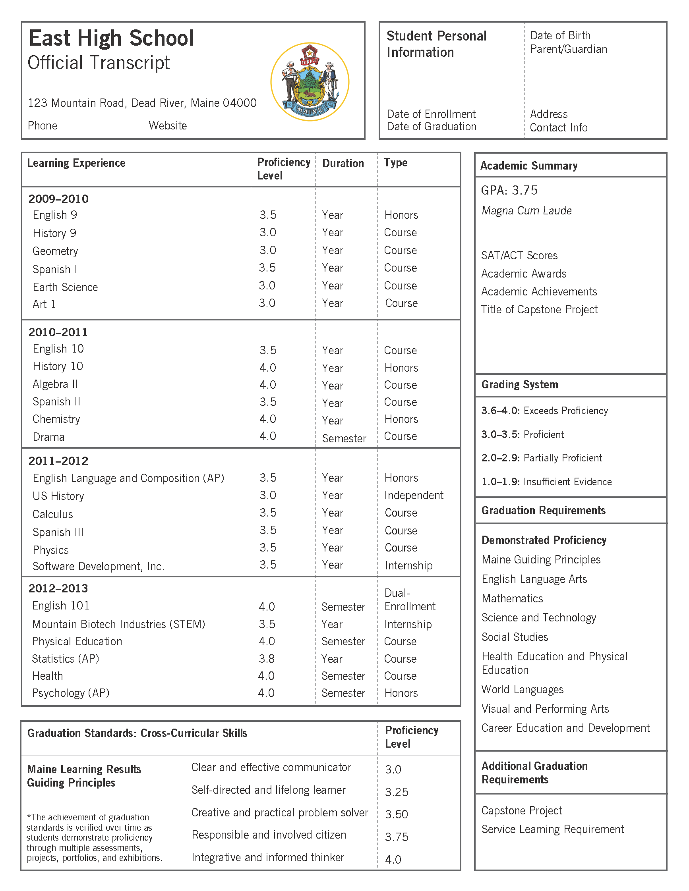
Review of Indices
Dropout Credit Accumulation Index (DCAI)

Slide 11
DCAI: Collection
How are data for the DCAI collected?
There are three important data elements used for the dropout/credit accumulation index (DCAI).
Full Academic Year (FAY) students are identified as meeting full academic year requirements in the prior year and the current year based on SIS files. Full academic year status determines if a student will be included in accountability calculations.
The number of Carnegie credits earned by a student by the end of their first year enrolled in high school, as indicated on the official transcript in STS, determines the index point award. Carnegie credit reports are available on demand in the current system.
Students are identified as dropouts in the prior year or the current year based on official records in SIS. Schools and systems are provided with multiple opportunities to correct dropouts through the SIS cleanup period.

Slide 12
DCAI: Validation
How can DCAI data be validated throughout the year?
Dropout and Full Academic Year
During each collection period, the SIS SER validation reports are dropped on the data management ftp. The reports include counts and rosters of submitted data along with guidance about how to verify and or correct reported information.
SIS provides a months-long dropout corrections opportunity after October 1 of each year.
Carnegie credits
There are a number of on-demand reports that are available in STS that provide users with Carnegie credits and course types earned by students. (STSQ7, STSQ12, STSQ13)
In 2020-2021, additional validation reports will be designed to replace data certification rosters.

Slide 13
DCAI: Data Certification
Will there be data certification for the DCAI prior to release?
In 2020, DCAI will be reviewed for one last cycle in La Data Review prior to SPS release beginning the third week of July. However, any requests made after the published deadline will not be applied to the SPS until after release.
As in the past:
The prior year dropout flag cannot be changed. The current year dropout flag can be changed with documentation and if it can be changed in SIS.
Carnegie units are not reviewed in data certification. Updates must be made in STS.
In 2020-2021, the Department will discontinue review of DCAI data elements in La Data Review prior to release. A new credit attainment validation report will be provided through SIS processes to verify credits. School systems will be given 30 days after release to submit any requests for changes to current year dropout data or full academic year status.

Slide 14
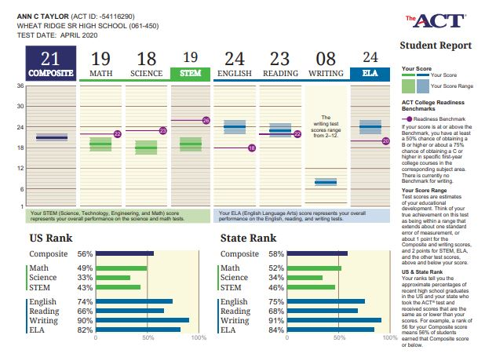
Review of Indices
ACT/WorkKeys

Slide 15
ACT/WorkKeys: Data Collection
How are data collected for the ACT/WorkKeys index?
The Department receives files directly from ACT and WorkKeys for state-sponsored administrations.
The Department also receives ACT national test site data, if students grant permission to share their scores.
WorkKeys scores from non-LDOE realms are only shared with the department if there is a data sharing agreement in place.
Accountability codes, which excuse students from testing, must be provided by school systems in the testing window. This includes coding for students who participated in LEAP Connect and are not required to take ACT.
Full academic year status, which determines which students are included for accountability, is determined by enrollment in SIS.

Slide 16
ACT/WorkKeys
How can ACT/WorkKeys data be validated throughout the year?
In February 2020, the Department will work with ACT to initiate a new ACT reporting platform that will make ACT test scores for students much more accessible in a user-friendly online reporting format.
School systems currently receive ACT/WorkKeys score reports directly from ACT and they will continue to receive them.
The Department provides ACT Match/No Match lists two times a year. These lists identify the highest scores on record with the Department for each student who was enrolled on October 1. The lists are also used to identify students who have no score and will need to test or be accountability coded.
Students who are no longer enrolled in school at the time of testing, based on SIS records, do not need to be coded out since they will not meet the FAY requirement.

Slide 17
ACT/WorkKeys: Data Certification
Will there be data certification for ACT/WorkKeys prior to release?
The department will continue to conduct ACT data certification through LA Data Review.
In order to complete reviews for an early release, ACT data certification will begin the third week of July.
Any submissions made after the LDOE published deadline may not be applied to the SPS until after release.

Slide 18
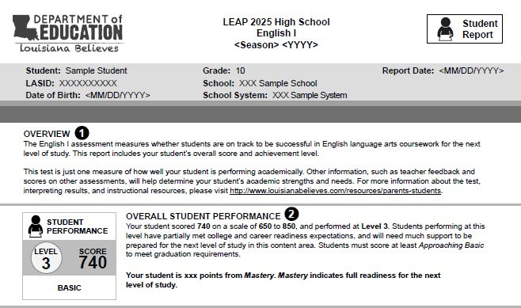
Review of Indices
Assessment

Slide 19
Assessments
How are data collected for the assessment and progress indices?
Scores from state assessments, including LEAP 2025 grades 3-8 and high school, LEAP Connect, and ELPT are received by the Department and school systems directly from the vendors.
Accountability codes that are applied either during the testing window or during June DRC Student Corrections System cleanup, scheduled for the week of June 8, 2020, are received by the Department directly from the vendors.
Full academic year status, which determines which students are included for accountability, is determined by official enrollment in SIS.

Slide 20
Assessments: Validation
How can assessment data be validated throughout the year?
School systems receive test score reports directly from vendors by June 30th. The reports include csv data files that contain demographic data and a breakdown of performance by subcategories.
Schools can summarize data by subgroups and subcategories.
Schools can identify areas of strength and areas that are challenging for students.
Files include scale scores that are used to set growth targets.
Files include a flag for students who require remediation.
ELPT reports determine the progress that students make toward English proficiency.
In June, the DRC student corrections system provides an opportunity for schools to correct student demographic data and impending zeros for students who did not test and non-matching documents.

Slide 21
Assessment Data Certification
Will there be data certification for assessments and progress prior to release?
There will be an assessment data certification, but it will not be completed prior to SPS release. There are opportunities to reduce errors that affect SPS prior to release.
Apply accountability codes to all students who are expected to test but do not. There are two opportunities to apply codes: in-window and DRC June online cleanup Make corrections in the DRC June online cleanup. Failure to apply accountability codes during the testing window or through DRC INSIGHT online cleanup accounts for a large percentage of high school data certification requests.
Do not remove records of students in DRC INSIGHT in place of appropriate exit codes.
For paper-based tests, hand-coded data should match state records in SIS. Hand-coded errors account for a large percentage of data certification requests.
Identify students eligible for LEAP Connect as early in the year as possible. Policy requires identification 30 days prior to the opening of the testing window.

Slide 22
Pre and Post Data Certification SPS File

Slide 23
Summary of Changes in 2019 SPS
The tables below provide statewide changes pre and post data certification in 2019.
Letter Grade Changes Pre/Post
Letter Grade Pre Data Cert | A Post | B Post | C Post | D Post | F Post | T Post | Total
B | 5 | 0 | 1 | 0 | 0 | 0 | 6
C | 0 | 10 | 0 | 2 | 0 | 0 | 12
D | 0 | 0 | 4 | 0 | 3 | 2 | 9
F | 0 | 0 | 0 | 4 | 0 | 0 | 4
Total | 5 | 10 | 5 | 6 | 3 | 2 | 31
SPS Changes | K8 | Combination | High | Total
decrease 0.1 and more | 40 | 18 | 10 | 68
0.1-1.0 | 165 | 61 | 67 | 293
1.1 to 2.0 | 24 | 20 | 14 | 58
2.1-3.0 | 13 | 14 | 10 | 37
3.1-4.0 | 6 | 4 | 3 | 13
4.1-5.0 | 3 | 2 | 3 | 8
5.1-6.0 | 2 | 1 | 1 | 4
6.1-7.0 | 1 | 2 | 0 | 3
7.1-8.0 | 2 | 0 | 0 | 2
9.1-10 | 0 | 1 | 0 | 1
Total | 256 | 123 | 108 | 487

Slide 24
Pre and Post Data Certification SPS File
The Department has placed a pre and post data certification file on the secure ftp with file name 001_LEA Name_Preliminary vs Final SPS Summary that provides the changes in SPS that were made after data certification in 2019.
As systems review these files and discuss the changes proposed for early release, questions and feedback should be sent to assessment@la.gov or Jennifer.Baird@la.gov.

