Slide 1
Staffing and Scheduling
Best Practices for Addressing Unfinished Learning and Meeting the Needs of Diverse Learners Review of Guidance and Opportunities for Additional Support March 31st, 2021

Slide 2
Agenda
Introduction to LDOE and DMGroup Partnership
Overview of Best Practices Guidance Document
Selected Best Practices and Examples
Opportunities for Additional Support
Conclusion

Slide 3
LDOE Partnership with District Management Group
The Louisiana Department of Education has partnered with District Management Group, a Boston-based public education consulting firm.
There are two main elements to the partnership:
Comprehensive Guidance Document
Best Practices for Addressing Unfinished Learning and Meeting the Needs of Diverse Learners
Supports for LEAs in Implementing Best Practices (Spring – Fall 2021)
Live webinars, resource sharing sessions, and question & answer sessions
Opt-in intensive regional technical support and district specific coaching

Slide 4
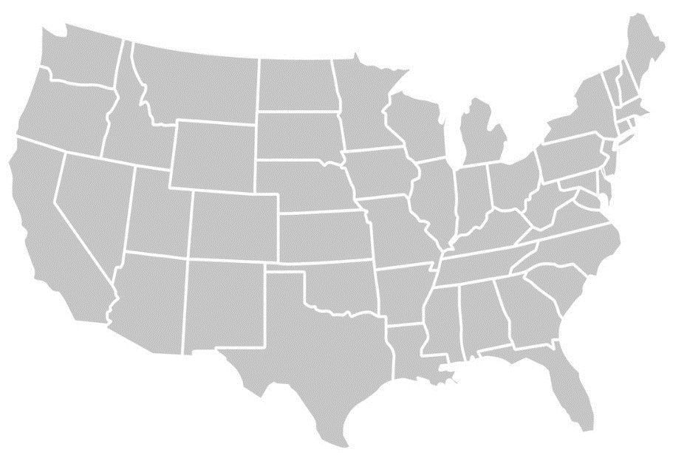
DMGroup brings experiences from hundreds of districts and agencies of all sizes and types from across the US, including many from Louisiana.
700+ 40+ 10+ million Districts States Students Supported

Slide 5
Agenda
Introduction to LDOE and DMGroup Partnership
Overview of Best Practices Guidance Document
Selected Best Practices and Examples
Opportunities for Additional Support
Conclusion

Slide 6
Guidance Document
The document is organized into 3 main sections:
General Overview of 6 best practices
Staffing Implications for each of the best practices
Scheduling Implications for each of the best practices
Each section includes specific:
Recommendations and Examples
Tips, Cautions, Common Misperceptions, and Strategies to Avoid
Image of Coverpage of Document
Image of Coverpage of Document
Image of Coverpage of Document
Best Practices for Addressing Unfinished Learning and Meeting the Needs of Diverse Learners
Guidance Document
March 2021

Slide 7
Overview of Best Practices
High-Quality Core and Literacy Instruction
1. High-quality core instruction is the foundation.
2. Effective literacy instruction is central to student success.
3. Students with unfinished learning and diverse learners need extra instructional time to catch up.
4. Both core instruction and acceleration must be provided by content strong staff.
Extra Instructional Time from Content Strong Staff
5. Meeting the social, emotional, and behavioral needs of students supports academic achievement.
6. Equity should be at the forefront of all these strategies.
Social & Emotional Needs and Equity Matter Greatly

Slide 8
High-Quality Core and Literacy Instruction
High-quality core instruction is the foundation.
No amount of acceleration, intervention, or special education services will make a difference in student achievement without high-quality core instruction.
Effective literacy instruction is central to student success.
Within core instruction, literacy is paramount—learning how to read unlocks a students’ ability to learn all other content.

Slide 9
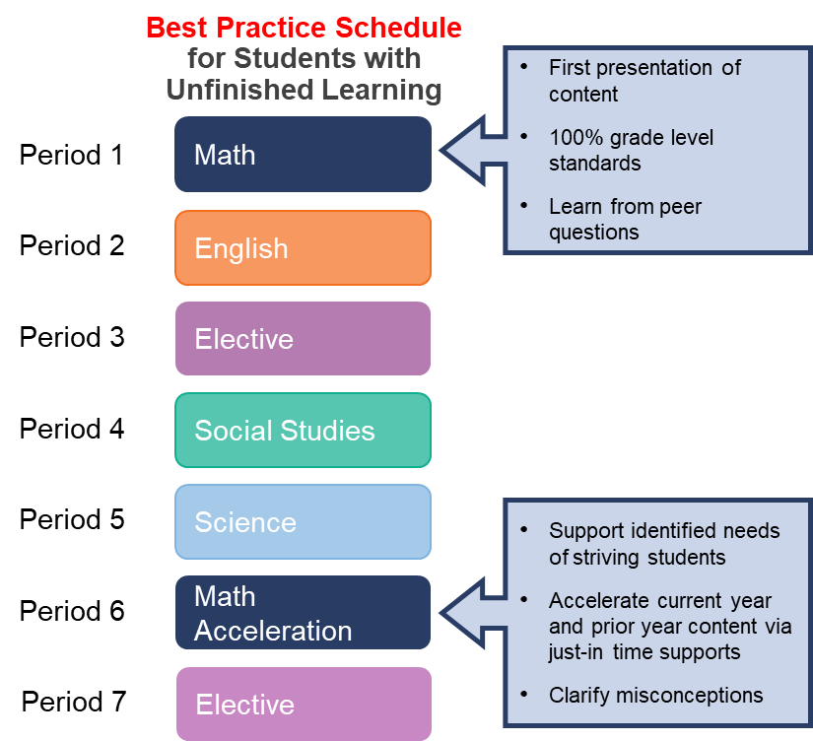
Extra Instructional Time from Content Strong Staff
Students with unfinished learning and diverse learners need extra instructional time to catch up.
Just-in-time acceleration must be in addition to core instructional time.
Both core instruction and acceleration must be provided by content strong staff.
The abilities and expertise of staff matters as much as the amount of time a student spends in core instruction and acceleration.
Acceleration should occur during the
school day, not before or after.

Slide 10
Social & Emotional Needs and Equity Matter Greatly
Meeting the social, emotional, and behavioral needs of students supports academic achievement.
Schools cannot improve academic outcomes without also addressing students’ social, emotional and behavioral needs.
Equity should be at the forefront of all these strategies.
Students from marginalized and underserved communities must be supported so that they can develop to their full academic and social potential.

Slide 11
Agenda
Introduction to LDOE and DMGroup Partnership
Overview of Best Practices Guidance Document
Selected Best Practices and Examples
Opportunities for Additional Support
Conclusion

Slide 12
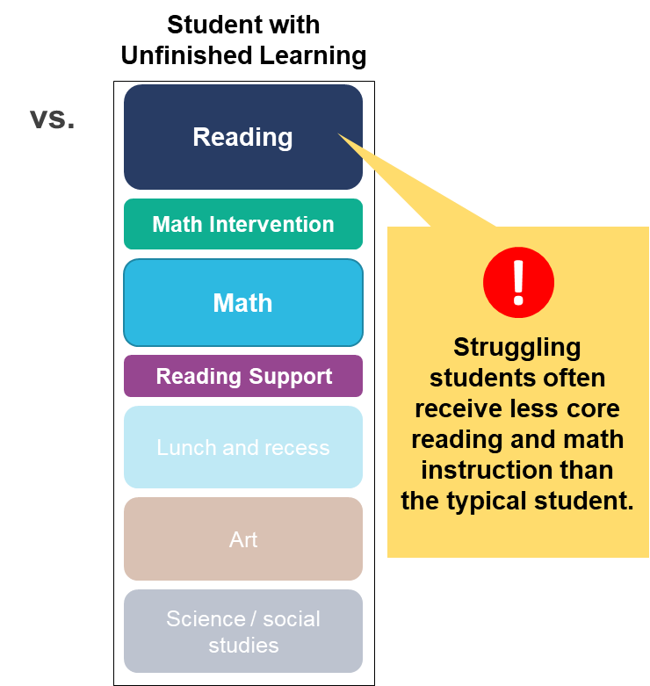
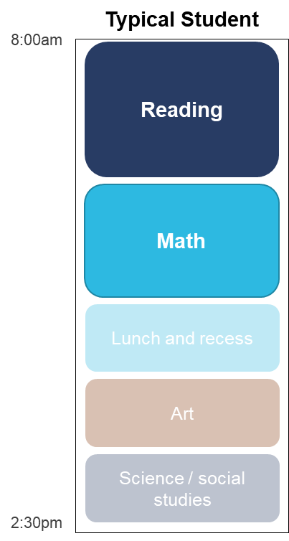
More time on a subject increases learning—it is crucial that students not be pulled out of core reading, math, or ELA for other services.

Slide 13
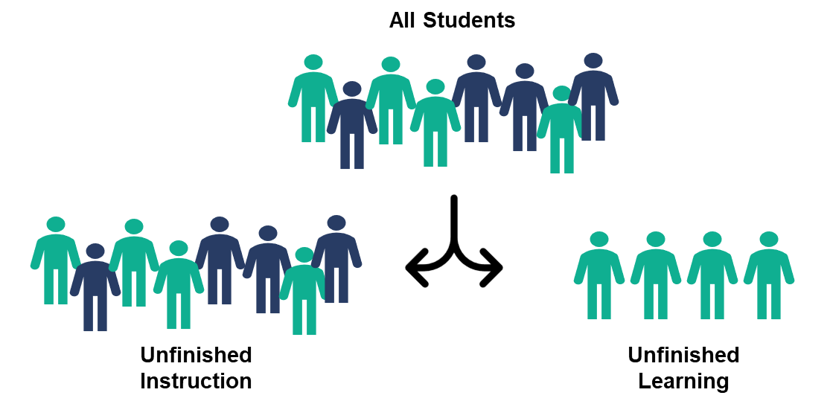
There are 2 types of acceleration in the aftermath of the pandemic: unfinished instruction and unfinished learning.

Slide 14
Time matters more than group size, and time with content strong staff matters most of all.
Acceleration should be provided 3 -5x per week with group sizes between:
3-5 students at elementary
15 students at secondary
Students should be:
Grouped by similar areas of need, and
Taught by a content strong teacher.
Consider two groups of elementary readers:
Needs of Group A | Needs of Group B
1. Fluency | 1. Fluency
2. Comprehension | 2. Fluency
3. Vocabulary | 3. Fluency
 | 4. Fluency
 | 5. Fluency

Slide 15
Prioritize acceleration during freshman and sophomore years by delaying subjects that don’t require 4 credits for graduation.
TOPS University
College Diploma Course Requirements
Subject | Required # of Units for Graduation | Suggested Grade-Level
 |  | 9 | 10 | 11 | 12
English | 4 | ✔ | ✔ | ✔ | ✔
Math | 4 | ✔ | ✔ | ✔ | ✔
Science | 4 | ✔ | ✔ | ✔ | ✔
Social Studies | 4 | ✔ | ✔ | ✔ | ✔
Foreign Language | 2 |  | ✔ | ✔
Art | 1 |  |  | ✔
Health/PE | 2 |  |  | ✔ | ✔
Electives | 3 |  | ✔ | ✔ | ✔
Option for Scheduling:
Delay courses such as foreign language, art, health/PE, and electives to make room for acceleration.

Slide 16
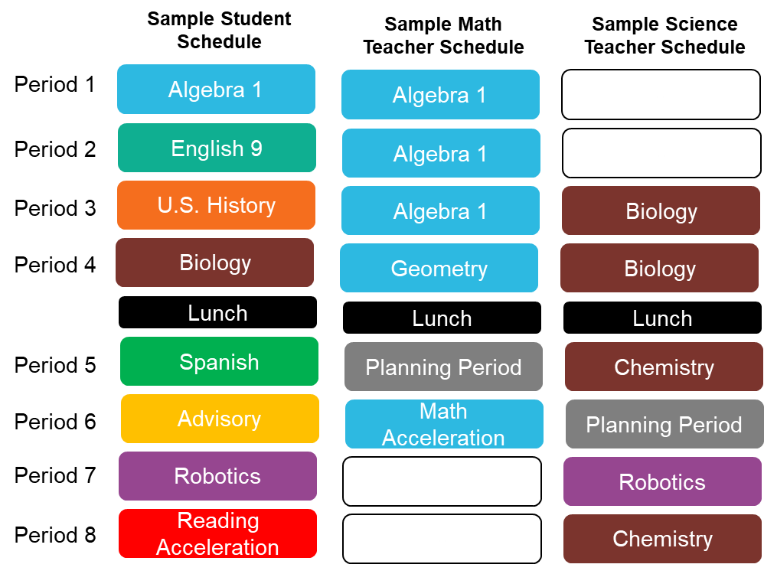
Consider structuring longer days for students, with staggered start and end times for teachers to allow for more instruction without extending the day for all staff.
Sample Staggered Schedule: Students attend 8, 55-minute periods, while teachers are scheduled to teach for only 5 periods of the day.
Teachers do not have a longer day, as they come or leave at a different time from students.

Slide 17
Finding the highly skilled staff needed to implement the best practice guidance can be difficult, but creative strategies exist.
Four additional options for hiring can include:
1
3
Retired Teachers After consulting with TRSL
Recent College Graduates with math, science, and writing related majors
for high-dose tutoring
2
4
Teachers Who Left to care for children or parents
Current College Students with math, science, and writing related majors

Slide 18
Some historically common practices are not likely to be impactful.
Cautions:
The use of paraprofessionals for academic support or reading instruction seldom accelerates learning.
Co-teaching is hard to scale and often crowds out extra time alternatives.
Push-in support during core instruction is not a substitute for extra time intervention from content strong staff.
Typical short dose, “sit and git” professional development is not as impactful as instructional coaching or sustained 50 hour/ year efforts.
1
2
3
4

Slide 19
Agenda
Introduction to LDOE and DMGroup Partnership
Overview of Best Practices Guidance Document
Selected Best Practices and Examples
Opportunities for Additional Support
Conclusion

Slide 20
LDOE and DMGroup will provide live technical training and support sessions to LEAs.
As part of the release of the Staffing and Scheduling Best Practices initiative, school systems will be offered a variety of implementation supports this spring, summer, and fall at no cost. A detailed list of supports is located in the guidance document.
Best Practice Webinars
Practical tips for implementing LDOE’s best practice guidance.
Virtual Job Alike Sharing Sessions
District Academic Leadership
School Leadership
Diverse Learners Leadership
Counselors and Counselor Leadership
Targeted Question & Answer Sessions
Virtual Q&A sessions to go deep into best practices related to effectively addressing unfinished student learning.

Slide 21
May Webinars
System leaders and school leaders that oversee academics, human resources, diverse learners, principal support, and counseling should attend these upcoming trainings. Participants must register using the links below.
Date and Time | Webinar Title and Registration Link
May 5 at 1 p.m. | Staffing and Scheduling Best Practices Webinar
May 11 at 11 a.m. | Job Alike Session: District Academic Leadership
May 11 at 1 p.m. | Job Alike Session: Diverse Learners Leadership
May 12 at 11 a.m. | Job Alike Session: Counselors and Counselor Leadership
May 12 at 1 p.m. | Job Alike Session: School Leadership

Slide 22
LEAs can opt into additional supports with DMGroup for targeted and more personalized technical assistance for a small fee.
Regional Technical Support Series
Three regional technical support sessions for LEAs to receive in-depth training and guidance on best practices from DMGroup experts.
“Phone a Friend” Coaching Support
Individualized “just-in-time” coaching sessions for LEAs with DMGroup experts to discuss LEA-specific questions and challenges.
Pricing:
$2,500 per district/system – Covers Regional Technical Support Series and Coaching Support. Note: This support is subsidized by LDOE and qualifies for CARES Act Funding.
Bring a team of up to 8 leaders
Link to Learn More

Slide 23
Additional Staffing and Scheduling TA
Session 1
May 17 1:00-4:00 PM | Spring Regional Technical Support Series: New Orleans (Virtual)
May 18 1:00-4:00 PM | Spring Regional Technical Support Series: Baton Rouge (Virtual)
May 19 1:00-4:00 PM | Spring Regional Technical Support Series: Northern LA (Virtual)
Session 2
July 26 8:00 AM -12:00 PM | Summer Regional Technical Support Series: New Orleans (in person)
July 27 8:00 AM -12:00 PM | Summer Regional Technical Support Series: Baton Rouge (in person)
July 28 8:00 AM -12:00 PM | Summer Regional Technical Support Series: Northern LA (in person)
Session 3
September 20 8:00 AM -12:00 PM | Fall Regional Technical Support Series: New Orleans (in person)
September 21 8:00 AM -12:00 PM | Fall Regional Technical Support Series: Baton Rouge (in person)
September 22 8:00 AM -12:00 PM | Fall Regional Technical Support Series: Northern LA (in person)
School systems may choose to purchase more strategic implementation support for $2500. This support includes participation for up to 8 individuals to attend three regional technical support sessions and receive three individual coaching calls. Systems interested should register by May 4.

Slide 24
Agenda
Introduction to LDOE and DMGroup Partnership
Overview of Best Practices Guidance Document
Selected Best Practices and Examples
Opportunities for Additional Support
Conclusion

Slide 25
Conclusion
Access the Staffing and Scheduling Best Practices Guidance
Begin meeting with your team to plan for implementation
Register for upcoming events
Email questions to em.cooper@la.gov.

