Slide 1
The April Dunn Act Understanding the Self-Assessment Guide Section Two

Slide 2
Objectives
Provide an overview of
The April Dunn Act Self-Assessment Guide
Introduction
Components
Planning and Preparation
Understanding the Review
Maintaining Results on File
Self-Assessment Team Checklist

Slide 3
Objectives
Provide an overview of
Section Two: Data Review
Self-Assessment Results Summary Form
Section Two: Data Review Documentation

Slide 4
The Self-Assessment Guide Introduction

Slide 5
Self Assessment Guide: Introduction
The Louisiana Department of Education (LDOE) supports engagement in self-assessment as a method of analyzing the implementation of the April Dunn Act for students with disabilities.
To support the effective implementation of the April Dunn Act, the LDOE has provided guidance on Louisiana Believes website in the Students with Disabilities Library.

Slide 6
Self Assessment Guide: Introduction
The guide offers a comprehensive analysis of various aspects of the implementation process local education agencies (LEAs) should have in place including the review of procedures and data to determine valid and systemic conclusions.
The primary goal of the self-assessment is
identification of areas where implementation is lacking or not in line with best practices, and
technical assistance needs for those who participate in the implementation of the April Dunn Act.

Slide 7
Self Assessment Guide: Introduction
The Self-Assessment should also reveal the strengths and weaknesses of your local special education program by evaluating its impact on student achievement.
When completed with fidelity, we expect this activity will be helpful in identifying any root causes of performance and implementation issues in your LEA.
The Self-Assessment Guide only addresses the implementation of the April Dunn Act graduation criteria.

Slide 8
The Self-Assessment Guide Components

Slide 9
Self-Assessment Guide: Components
There are two sections in this portion of the Self Assessment Guide
Section One: Procedures Review
Section Two: Data Review
This training module addresses Section Two: Data Review of the April Dunn Act: Self-Assessment Guide.

Slide 10
Self-Assessment Guide: Components
Section Two contains a bank of scenarios, referred to as Data Review, that should be used to analyze data related to the implementation of the April Dunn Act in your district.
The results of this self-assessment will assist Special Education Leaders and LEAs in
identifying systemic challenges with implementation,
determining how student performance has been impacted, and
developing a plan for intervention.

Slide 11
The Self-Assessment Guide Planning and Preparation

Slide 12
Self-Assessment Guide: Planning and Preparation
The LEA should identify key staff to serve on the self-assessment team.
The team member selection is at the discretion of the LEA; however, LDOE recommends including knowledgeable and experienced individuals such as
the Special Education Leader,
IEP facilitators,
Special Education Teachers, and
any other staff responsible for implementing or collecting data related to the April Dunn Act.

Slide 13
Understanding the Self-Assessment Review

Slide 14
Understanding the Self-Assessment Review
Documentation and Evidence:
For each of the components of the self-assessment tool, information is provided which includes
a specific list of documentation (information to examine) and,
evidence (information to look for) that should be considered during the review.
Additionally, LDOE guidance related to the effective implementation of the April Dunn Act is provided under the Resources tab at the end of the Self-Assessment document.

Slide 15
Understanding the Self-Assessment Review
Recording findings:
In Section Two: Data Review, click on the data box under the “Results of Review” tab and enter data related to the topic in the “Data Review” column.

Slide 16
Maintaining Results on File

Slide 17
Maintaining Results on File
The results of the self-assessment along with the Self-Assessments Results Summary form should be stored onsite in the LEAs self-assessment files.
LDOE recommends that self-assessments be conducted annually, no later than the last business day in February.

Slide 18
Maintaining Results on File
Self-Assessment Audits:
The LDOE may conduct spot checks, or audits, in LEAs to ensure the self-assessment results, along with the Self-Assessment Results Summary form, accurately represent best practices in the implementation of the April Dunn Act.
The integrity of the self-assessment relies on the validity of the process and the humility of the educators involved in the review of the policy and procedures and data.

Slide 19
Self-Assessment Team Checklist

Slide 20
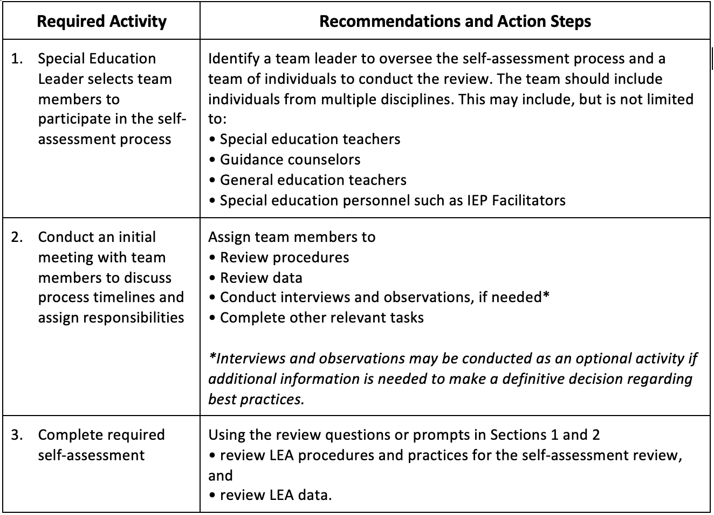
Self-Assessment Team Checklist

Slide 21
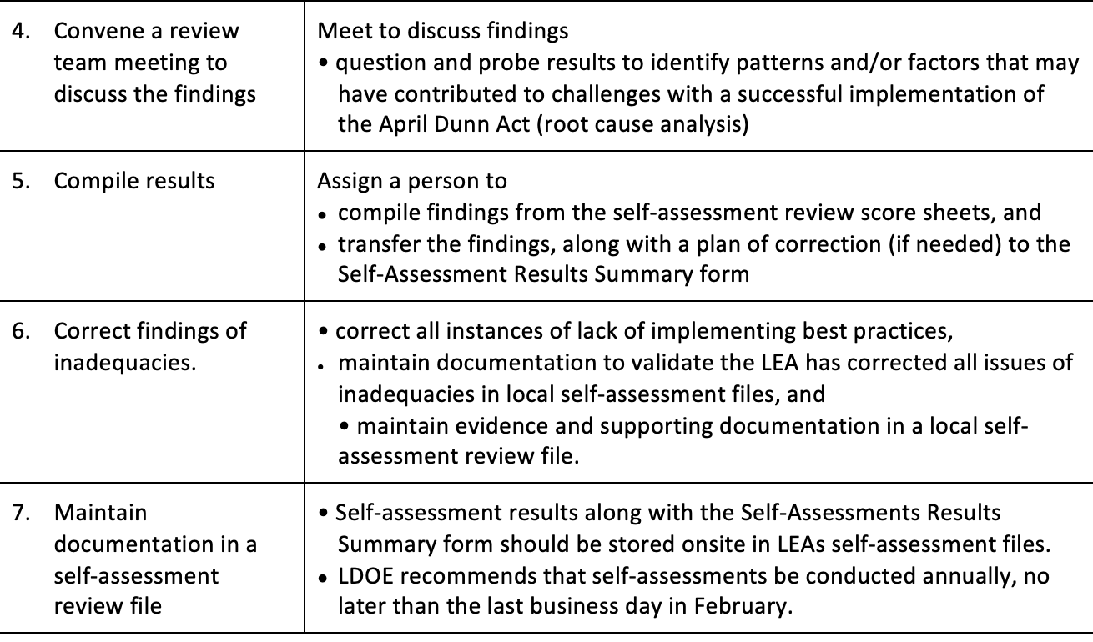
Self-Assessment Team Checklist

Slide 22
The Self-Assessment Guide Section Two: Data Review

Slide 23
Section Two: Data Review
Items contained in Section Two ask LEAs to examine data related to the implementation of the April Dunn Act.
Reviewers completing Section Two will pull information from sources such as the
Special Education Reporting System (SER)
Student Information System (SIS)
School Transcript System (STS)
LEAP 2025 Data file (remediation flag indicates students that did not meet benchmark for assessment/grade)
Prior test history from EdLink
Post Data Certification Cohort Graduation data file

Slide 24
Section Two: Data Review
Section Two follows the format of presenting a “Data Review” scenario. The scenario request April Dunn Act data for a particular situation. Additionally, the reviewer is asked to look at data across several years.

Slide 25
Section Two: Data Review
Once compiled, the data is then recorded in the appropriate box in the “Results of Review” column.
Note: Diplomas earned by students on the LEAP Connect Alternate Assessment Pathway to a Diploma and
participating in the LEAP Connect Alternate Assessment should not be included in this data review.

Slide 26
Section Two: Data Review
“Data Review” scenarios found in Section Two include:
DR1: Using data pulled from SER, list the total number of students eligible for the April Dunn Act in the following school years
1a: 2020-2021
1b: 2021-2022
1c: 2022-2023
DR2: Using data pulled from SER, list the total number of students with Individual Performance Criteria applied to their high school experiences in the following school years (April Dunn Act Applied)
2a: 2020-2021
2b: 2021-2022
2c: 2022-2023

Slide 27
Section Two: Data Review
DR3: Using data pulled from SER, list the total number of students eligible for the April Dunn Act in the 2020-2021 school year by grade level.
3a: 9th
3b: 10th
3c: 11th
3d: 12th
DR4: Using data pulled from SER, list the total number of students eligible for the April Dunn Act in the 2021-2022 school year by grade level.
4a: 9th
4b: 10th
4c: 11th
4d: 12th

Slide 28
Section Two: Data Review
DR5: Using data pulled from SER, list the total number of students eligible for the April Dunn Act in the 2022-2023 school year by grade level.
5a: 9th
5b: 10th
5c: 11th
5d: 12th
DR6: Using the LEAP 2025 data file or test history in EdLink, list the total number of students eligible for the April Dunn Act in the 2020-2021 school year by grade level.
6a: 9th
6b: 10th
6c: 11th
6d: 12th

Slide 29
Section Two: Data Review
DR7: Using data pulled from the LEAP 2025 data file or test history in EdLink, list the total number of students eligible for the April Dunn Act in the 2021-2022 school year by grade level.
7a: 9th
7b: 10th
7c: 11th
7d: 12th
DR8: Using data pulled from the LEAP 2025 data file or test history in EdLink, list the total number of students eligible for the April Dunn Act in the 2022-2023 school year by grade level.
8a: 9th
8b: 10th
8c: 11th
8d: 12th

Slide 30
Section Two: Data Review
DR9: Using data pulled from the Post Data Certification Cohort Graduation data file, list the total number of diplomas earned by students in the two previous school years. (Use the blanks to indicate years being recorded)
9a: 20_ _ - 20_ _
9b: 20_ _ - 20_ _
DR10: Using data pulled from the Post Data Certification Cohort Graduation data file, list the total number of diplomas earned by students with disabilities in the two previous school years. (Use the blanks to indicate years being recorded)
10a: 20_ _ - 20_ _
10b: 20_ _ - 20_ _

Slide 31
Section Two: Data Review
DR11: Using data pulled from the Post Data Certification Cohort Graduation data file, list the total number of diplomas earned by students with disabilities eligible for the April Dunn Act in the two previous school years. (Use the blanks to indicate years being recorded)
11a: 20_ _ - 20_ _
11b: 20_ _ - 20_ _
DR12: When compared to all diplomas earned, what is the percentage of diplomas earned by students with disabilities eligible for the April Dunn Act in the two previous school years? (Use the blanks to indicate years being recorded)
12a: 20_ _ - 20_ _
12b: 20_ _ - 20_ _

Slide 32
Section Two: Data Review
DR13: When compared to all diplomas earned by students with disabilities, what is the
percentage of diplomas earned by students with disabilities eligible for the April Dunn Act
in the two previous school years?
13a: 20_ _ - 20_ _
13b: 20_ _ - 20_ _

Slide 33
Self-Assessment Results Summary Form

Slide 34
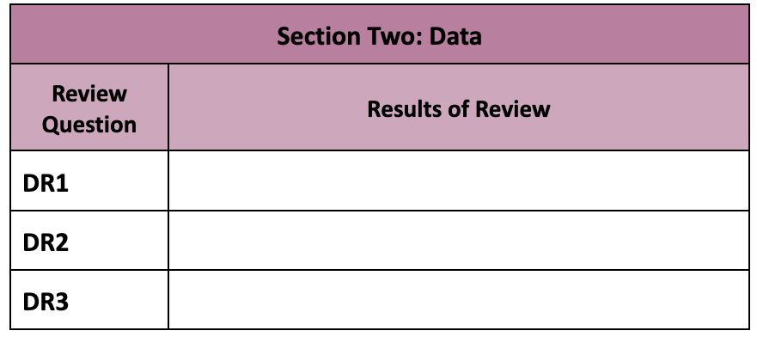
Self-Assessment Results Summary Form
The Self-Assessment Results Summary Form should be used by the self-assessment team to compile information recorded on the self-assessment score sheets.
In Section Two: Data Review, reviewers will simply enter data in the
“Results of Review” column.

Slide 35
Questions, comments, or concerns?
Contact: SpecialEducation@la.gov

