Slide 1
A Story of Units
Grade 1 – Module 1
Notes:
WELCOME AND AND POLL PARTICIPANTS
This full-day session is intended to support successful implementation of this module. Using this module as a platform for understanding our instructional approach and lesson structure, you will have the tools needed to tackle the remaining modules of the year.
Welcome participants and introduce presentation team.
Fist to Five:
- How familiar are you with Eureka Math and A Story of Units?
Poll the participants:
Are you using the lessons on a daily basis? Or to supplement your instruction?
Are you a classroom teacher? For this grade? A different grade?
Are you a math coach? Coordinator? Resource teacher?
Are you a school-level administrator? District-level administrator?
Quickly orient participants to the day’s materials:
Full module – provided by Wiley; additional modules are available for purchase through our website, commoncore.org
Handout packet – describe the nature and purpose of both the stapled packet and the loose handouts
Materials – any announcements needed regarding materials on the tables?
TIME ALLOTTED FOR THIS SLIDE:
6 minutes
MATERIALS NEEDED:
X

Slide 2
This PowerPoint presentation is provided to individuals who participated in a live training by professional developers certified by, or affiliated with, the copyright holder, Common Core, Inc. It may not be altered in any way. The presentation may be shared for non-commercial purposes only. However, Common Core makes no representations or warranties about the effectiveness of training provided by non-certified/non-affiliated presenters of the material. Any commercial use of this presentation is illegal and violates the copyrights of Common Core, Inc.
Notes:
Review copyright slide.

Slide 3
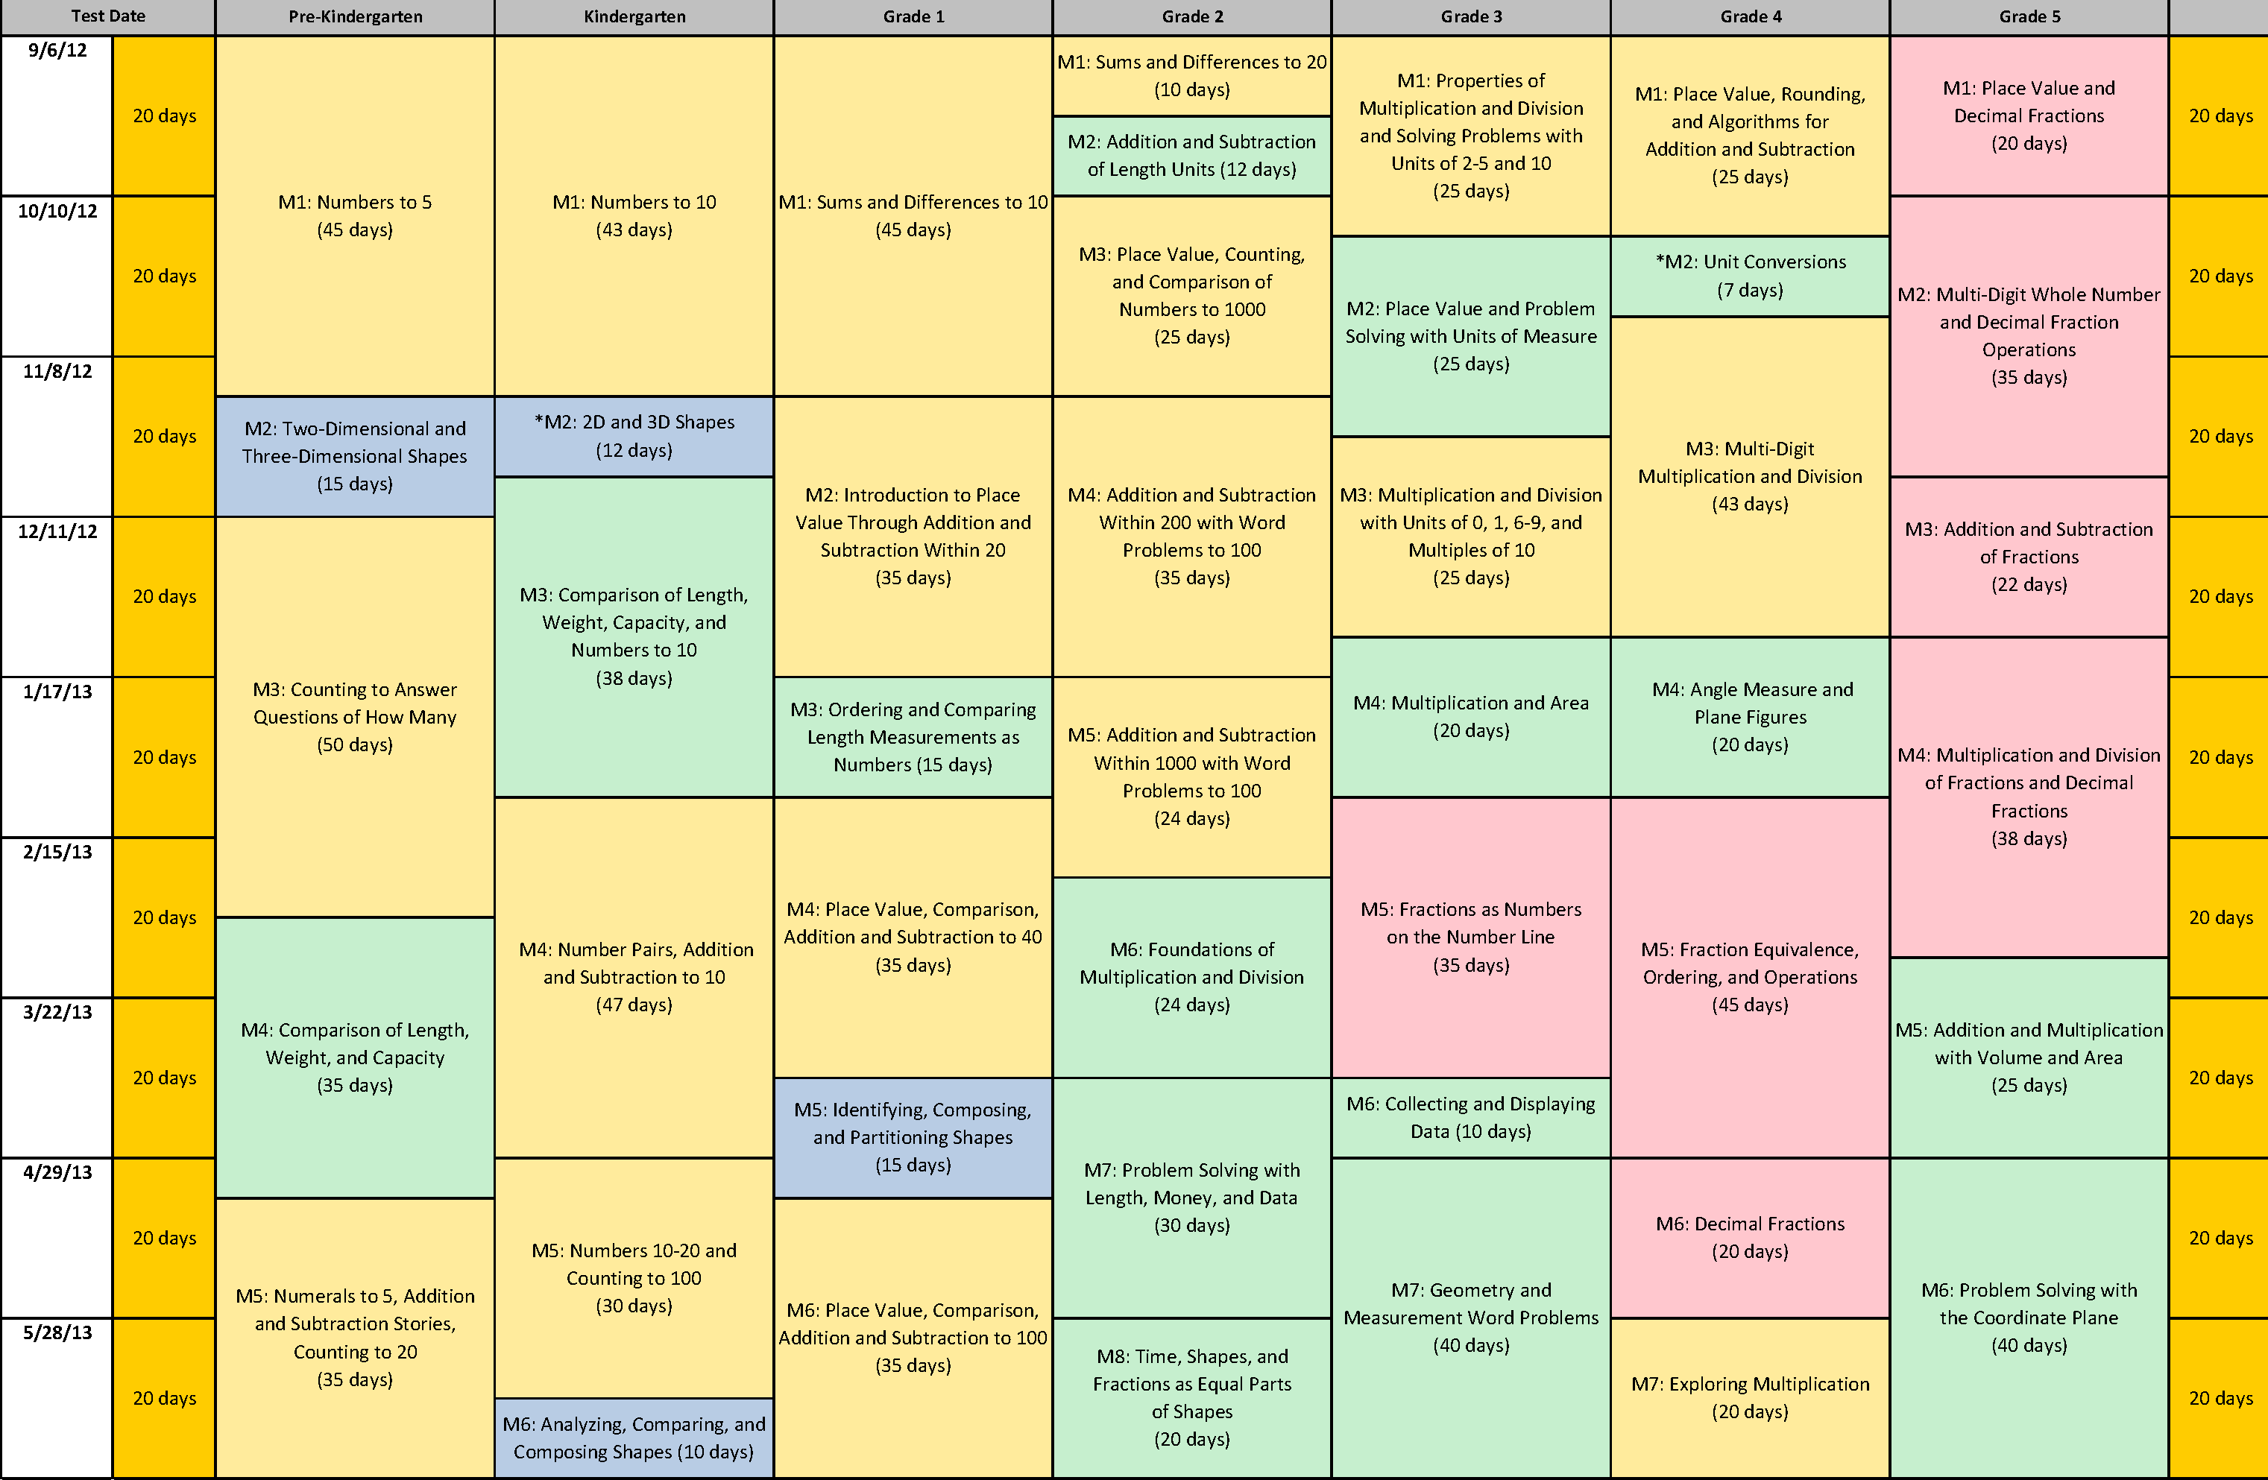
Curriculum Overview of A Story of Units
Notes:
BRIEFLY SUMMARIZE MODULE 1: SUMS AND DIFFERENCES TO 10
The first module in Grade 1 is Sums and Differences to 10. The module includes 39 lessons and is allotted 45 instructional days, in which students make significant progress towards the grade’s core fluency goal of addition and subtraction within 10. Students are presented with opportunities intended to advance them from counting all to counting on and have many experiences with composing and decomposing numbers. This initial module builds on students’ work in Kindergarten, where where they achieved fluency with sums and differences to 5.
TIME ALLOTTED FOR THIS SLIDE:
3 minutes
MATERIALS NEEDED:
X

Slide 4
Session Objectives
Examine the sequence of concepts across the module.
Study mathematical models and instructional strategies from A Story of Units.
Prepare to implement this and subsequent modules of A Story of Units.
Notes:
REVIEW SESSION OBJECTIVES
Our objectives for this session are to:
Examine the sequence of concepts across the module.
Study mathematical models and instructional strategies from A Story of Units.
Prepare to implement this and subsequent modules of A Story of Units.
TIME ALLOTTED FOR THIS SLIDE:
1 minute
MATERIALS NEEDED:
X

Slide 5
Agenda
Lesson Structure
Instructional Sequence
Module Review
Preparation for Implementation
Notes:
INTRODUCE LESSON STRUCTURE SECTION
We will begin by exploring the lesson structure and how it is fundamental to supporting rigorous instruction. Then we will dig in to the math of the module, examining the intentional instructional sequence that leads students toward mastery of the focus standards. Afterwards, we’ll take a look back at the module, reflecting on all the parts as one cohesive whole. Finally, we’ll talk about strategies for implementation in preparation for the beginning of the school year.
Let’s get started with the lesson structure. We’ll use Lesson 1 as our context for doing so.
Facilitator notes
This is a 6 hour session that breaks down as follows.
Lesson Structure: approx. 90 minutes
Instructional Sequence: approx. 165 minutes
Module Review: approx. 60 minutes
Preparation for Implementation: approx. 45 minutes
TIME ALLOTTED FOR THIS SLIDE:
1 minute
MATERIALS NEEDED:
X

Slide 6
Introduction to the Lesson Structure
Math Fingers Flash
Lesson 1, Fluency Practice
Notes:
There are typically 4 parts to each Lesson: Fluency, Application, Concept Development, and Debrief. As we explore each lesson component. I’ll play the role as the teacher and I’ll ask you to play the role as the students, to help paint a picture of what this lesson might look like in a classroom. We’ll start with the first fluency activity in Grade 1.
MODEL MATH FINGERS FLASH
Flash numbers within 5.
T: I’m going to hold up some fingers the Math Way and then hide them. Look carefully and say the number you saw when I snap.
T: (Flash 3 fingers for 2–3 seconds and then hide them). Ready (snap).
S: 3!
Repeat process for numbers within 5.
Flash 6-10 and count on from 5.
T: (Flash 7 fingers.) Ready (snap). S: 7!
T: (Hold up 5 fingers on the right hand.) How many fingers are on this hand?
S: 5.
T: 5 (hold up the five hand, then hold up the other fingers, one at a time) 6, 7.
Repeat the process for other numbers 6–10, inviting students to count on from 5 with you.
Note to Facilitator: In Pre-K and Kindergarten, students had extensive practice with counting the Math Way, where they see the number of fingers increase as they count from 1 to 10, moving from their left pinky to their right pinky without interruption. This provides a foundation for understanding the number path and number line, on which numbers also increase from left to right. Internalization of the number line develops multiple areas of number sense and will facilitate future work in operations.
TIME ALLOTTED FOR THIS SLIDE:
3 minutes
MATERIALS NEEDED:
X

Slide 7
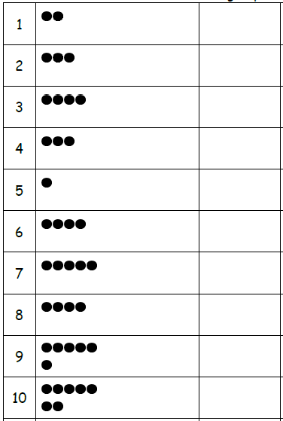
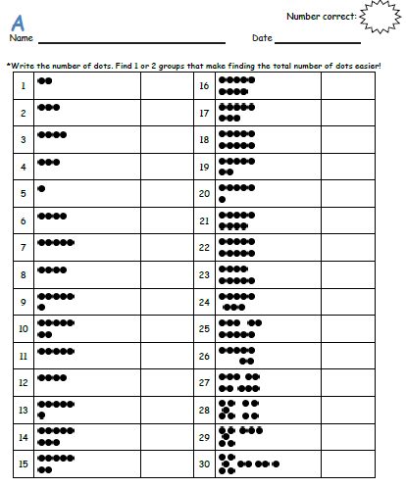
Introduction to the Lesson Structure
SPRINT: Count Dots
Lesson 1, Fluency Practice
Notes:
MODEL LESSON 1 SPRINT
If the participants have not been introduced to a Sprint before this, give the background to Sprints, similar to the directions included at the start of Module 1 in each grade level. (Included for reference on subsequent notes pages of this PPT.)
The first Sprint for Grade 1 focuses on students ability to subitize, or SEE the number of dots presented, without having to count them.
Administer the Sprint to the participants.
After participants complete the Sprint procedure, fold a Sprint into fourths to show the quadrant breakdown. Allow participants to make observations about the each of the four quadrants in this Sprint.
1st Quadrant: Very easy (Every student in the class should be able to do these problems).
2nd Quadrant: Somewhat easy
3rd Quadrant: Moderate
4th Quadrant: Challenging
Note to Facilitator: This slide may take longer depending on participants’ prior knowledge and/or experiences of Sprints.
TIME ALLOTTED FOR THIS SLIDE:
15 minutes
MATERIALS NEEDED:
Stopwatch
Sprint A and B for each participant (G1-M1-L1 Sprint)

Slide 8
Introduction to the Lesson Structure
SPRINT: Count Dots
Lesson 1, Fluency Practice
Notes:
Reference for facilitator: Directions for Administration of Sprints (from G1-M1-Module Overview)
Sprints are designed to develop fluency. They should be fun, adrenaline-rich activities that intentionally build energy and excitement. A fast pace is essential. During Sprint administration, teachers assume the role of athletic coaches. A rousing routine fuels students’ motivation to do their personal best. Student recognition of increasing success is critical, and so every improvement is celebrated.
One Sprint has two parts with closely related problems on each. Students complete the two parts of the Sprint in quick succession with the goal of improving on the second part, even if only by one more.
With practice, the following routine takes about 9 minutes.
Sprint A
Pass Sprint A out quickly, face down on student desks with instructions to not look at the problems until the signal is given. (Some Sprints include words. If necessary, prior to starting the Sprint, quickly review the words so that reading difficulty does not slow students down.)
T: You will have 60 seconds to do as many problems as you can. I do not expect you to finish all of them. Just do as many as you can, your personal best. (If some students are likely to finish before time is up, assign a number to count by on the back.)
T: Take your mark! Get set! THINK!
Students immediately turn papers over and work furiously to finish as many problems as they can in 60 seconds. Time precisely.
T: Stop! Circle the last problem you did. I will read just the answers. If you got it right, call out “Yes!” If you made a mistake, circle it. Ready?
T: (Energetically, rapid-fire call the first answer.)
S: Yes!
T: (Energetically, rapid-fire call the second answer.)
S: Yes!
Repeat to the end of Sprint A or until no student has a correct answer. If needed, read the count-by answers in the same way you read Sprint answers. Each number counted-by on the back is considered a correct answer.
T: Fantastic! Now, write the number you got correct at the top of your page. This is your personal goal for Sprint B.
T: How many of you got one right? (All hands should go up.)
T: Keep your hand up until I say the number that is one more than the number you got correct. So, if you got 14 correct, when I say 15, your hand goes down. Ready?
T: (Continue quickly.) How many got two correct? Three? Four? Five? (Continue until all hands are down.)
If the class needs more practice with Sprint A, continue with the optional routine presented below.
T: I’ll give you one minute to do more problems on this half of the Sprint. If you finish, stand behind your chair.
As students work, the student who scored highest on Sprint A might pass out Sprint B.
T: Stop! I will read just the answers. If you got it right, call out “Yes!” If you made a mistake, circle it. Ready? (Read the answers to the first half again as students stand.)
Movement
To keep the energy and fun going, always do a stretch or a movement game in between Sprints A and B. For example, the class might do jumping jacks while skip-counting by 5 for about 1 minute. Feeling invigorated, students take their seats for Sprint B, ready to make every effort to complete more problems this time.
Sprint B
Pass Sprint B out quickly, face down on student desks with instructions to not look at the problems until the signal is given. (Repeat the procedure for Sprint A up through the show of hands for how many right.)
T: Stand up if you got more correct on the second Sprint than on the first.
S: (Stand.)
T: Keep standing until I say the number that tells how many more you got right on Sprint B. If you got three more right on Sprint B than you did on Sprint A, when I say three, you sit down. Ready? (Call out numbers starting with one. Students sit as the number by which they improved is called. Celebrate the students who improved most with a cheer.)
T: Well done! Now, take a moment to go back and correct your mistakes. Think about what patterns you noticed in today’s Sprint.
T: How did the patterns help you get better at solving the problems?
T: Rally Robin your thinking with your partner for 1 minute. Go!
Rally Robin is a style of sharing in which partners trade information back and forth, one statement at a time per person, for about 1 minute. This is an especially valuable part of the routine for students who benefit from their friends’ support to identify patterns and try new strategies.
Students may take Sprints home.

Slide 9
The Role of Fluency
Maintenance staying sharp on previously learned skills
Preparation targeted practice for the current lesson
Anticipation skills that ensure that students will be ready for the in-depth work of upcoming lessons
Notes:
SHARE FLUENCY OVERVIEW
Review the 3 functions of fluency. Note that the information on this slide can be found as a text box in the fluency section of the revised version of G1-M1-L1.
Point out about fluency in SOU in general, regardless of the activity’s function:
Fluency is designed to promote automaticity.
Just about every lesson has a fluency component to it.
Most lessons start with fluency to immediately engage students in the math in an exciting and fast-paced way.
Activities are meant to be fast-paced, accessible, and exciting, and almost never include completely new learning in order to make that possible.
This is a high-energy point in the lesson in which students celebrate improvement and recognize patterns and connections between material.
Most lessons have more than 1 fluency choice per day. (Talk about how teachers might use these depending on student needs. E.g., choose one, some, all, write your own.)
Stress the importance of including fluency with each lesson to maintain a balance of components that achieves the rigor specified by the shifts.
Let’s move on to the next component of the lesson.
TIME ALLOTTED FOR THIS SLIDE:
X minutes
MATERIALS NEEDED:
X

Slide 10
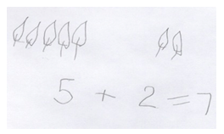
Introduction to the Lesson Structure
Dora found 5 leaves that blew in through the window. Then, she found 2 more leaves that blew in.
Draw a picture and use numbers to show
how many leaves Dora found in all.
Lesson 1, Application Problem
Notes:
SOLVE APPLICATION PROBLEM
Read the problem aloud together.
Participants Solve: Ask participants to use their personal white boards to solve the application problem with a drawing and numbers, as a first grader might do on the first day of school.
Share: Select 2-3 participants with diverse strategies or recording methods to share.
Ask participants to think about how the work being shared is similar to their own work. How is is different?
Point out that sharing different strategies allows students to learn from their peers.
Remind participants that this is the first day of school. As teachers look at student work, they are getting a sense of how students solve problems. They are not looking to correct students or instruct them on “the proper way” to solve problems in this part of the lesson. Use the participants’ work to examine the types of information a teacher might gather from students’ work (e.g., Is the student drawing realistic pictures or math pictures? How is the picture arranged? Did the student label with numbers or write a number sentence? Etc.).
TIME ALLOTTED FOR THIS SLIDE:
5 minutes
MATERIALS NEEDED:
Document camera
Personal white board per participant

Slide 11
Application Problems
Real world problem solving
Placement in lesson depends on function
Opportunity for informal assessment
Problem-solving process:
Read the problem
Draw and label a model to represent the problem
Write an equation and a complete word sentence
Notes:
SHARE OVERVIEW OF APPLICATION PROBLEMS
We just solved the word problem that makes up the Application Problem component of G1-M1-L1.
WHAT ARE THEY?
Point out/discuss the following about Application Problems:
(Click to advance animation.) These are often word problems, but occasionally take other forms. They typically offer real world applications (like the example).
The number of Application Problems may vary from lesson to lesson (usually 0 if the CD is a problem solving lesson, and 1 or more for a more typical lesson).
(Click to advance animation.) Placement in the lesson depends on function.
FUNCTION
Point out/discuss the following about the function of APs:
Those that come before the CD often:
Make an application of the new learning from the day before.
Relate to the CD by providing context or point of comparison for a later problem, or by having students solve a problem that they’ll use again in some way in the CD.
Those that come after the CD often:
Provide an immediate application of new learning before the Problem Set, (or at the end of the lesson if the PS is used during the CD).
Provide a quick opportunity for informal assessment of new learning before independent practice in the PS.
Usually, Application Problems don’t specify a model to use or way of solving. The reason is to encourage students to think quantitatively and creatively, and to give them practice with understanding how to choose and apply the correct mathematics concept to solve real world problems.
TIME ALLOTTED FOR THIS SLIDE:
3 minutes
MATERIALS NEEDED:
X

Slide 12
Application Problems – HIDDEN SLIDE (p.2 of notes)
Real world problem solving
Placement in lesson depends on function
Opportunity for informal assessment
Problem-solving process:
Read the problem
Draw and label a model to represent the problem
Write an equation and a complete word sentence
Notes:
(Click to advance animation.) Because of this, APs present a good opportunity for informal assessment. Noticing how students represent problems using models and equations will provide you with lots of information about their level of comfort with recently taught material, as well as how they’re thinking through solution paths.
RDW EXPLANATION
Think back on the problem-solving process we just went through.
What was our first step? (Read.) (Click 1x to advance animation.)
What came next? (Draw.) (Click 1x to advance animation.)
And then? (Write an equation/word sentence.) (Click 1x to advance animation.)
Throughout SOU we refer to these steps as the RDW process. (Click 1x to advance animation.)
Point out/discuss the following about the RDW process:
Usually this is the process that students use to solve word problems in SOU, including Application Problems.
We hope students internalize the process with practice over time so that it becomes a tool for problem solving.
Don’t let RDW become the focus of problem solving, but rather teach RDW as a tool for approaching problem solving.

Slide 13
Application Problems – HIDDEN SLIDE (p.3 of notes)
Real world problem solving
Placement in lesson depends on function
Opportunity for informal assessment
Problem-solving process:
Read the problem
Draw and label a model to represent the problem
Write an equation and a complete word sentence
Notes:
SUGGESTIONS FOR IMPLEMENTATION
Discuss/Point out the following tips for implementation:
If students need encouragement to draw: Provide just the stem of the problem at first. (This removes the temptation to ‘just solve’.)
Ask them to share their drawing with a neighbor.
You might present your own model to help students distinguish between a drawing and a math drawing (for example, in the G3 AP problem we’d rather not see detailed pictures of 159 boys and girls).
Once students have drawn and before they’ve seen the question, ask, “What questions could we ask based on the information we’ve been given?”
This emphasis on the drawing encourages students to use it as a tool for solving rather than as an afterthought.

Slide 14
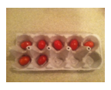
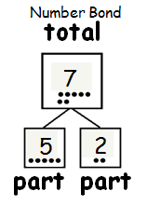
Introduction to the Lesson Structure
Egg carton with two slots cut off.
Lesson 1, Concept Development
Notes:
MODEL LESSON 1’S CONCEPT DEVELOPMENT
Presenter should play the role of the teacher and invite participants to respond as the students would.
MODEL PART 1: REVIEW NUMBER BONDS FOR 5 (core fluency for Kindergarten)
T: Count the slots. Raise your hand when you know how many slots there are. Wait for the signal to tell me. (Pause. When all are ready, give the signal.)
S: 10!
T: How many slots are in the top row? (Signal)
S: 5.
T: How many slots are in the bottom row? (Signal)
S: 5!
T: (Place 5 beads into the top row from left to right.) How many beads are in the top row? (Signal.)
S: 5!
T: 5 is our total, or whole. I’ll make a number bond, like you did in kindergarten. (Make a number bond with 5 as the whole.)
T: Now let’s be number detectives. What other numbers do you see hiding inside 5? Talk to your partner.
T: I heard someone say 2. That’s a part. (Write the 2 in the number bond.)
T: Let’s cover those 2 beads. What is the other part? (Signal.)
S: 3!
T: I’ll write that in the other part of the number bond. (Write 3.)
T: What 2 parts did we find make 5, detectives?
S: 2 and 3!
T: Let’s see if we can find different numbers inside of 5. (Write 5 in the total box inside a new number bond. Continue to find the other numbers inside of 5 and generate the corresponding number bonds using the same process.)
TIME ALLOTTED FOR THIS SLIDE:
3 minutes
MATERIALS NEEDED:
Document camera
Egg carton with 10 slots (cut off 2 slots
10 linking cubes or counters
Personal white board

Slide 15
Introduction to the Lesson Structure – HIDDEN SLIDE (p.2 of notes)
Egg carton with two slots cut off.
Lesson 1, Concept Development
Notes:
MODEL PART 2: NUMBER BONDS 6-10 (focusing on embedded 5)
T: (Add 2 beads to the bottom row, as pictured on the slide.) Look at the beads in this carton. How many bead are there? (Signal.)
S: 7.
T: Turn and talk to your partner about what numbers you see inside 7.
S: (Share their observations as you circulate.) T: I heard a student say that she saw 5 beads. Are there 5 beads?
S: Yes!
T: Let’s draw 5 dots as a part in our number bond instead of the number 5.
T: Where did you see the 5?
S: In the top row.
T: Let’s cover the 5. What is the other part to make 7? (Signal.)
S: 2!
T: Let’s draw in 2 dots as the other part in the number bond.
T: Let’s count on from 5 to find our total. Count with me. Let’s start with 5. (Point to the fifth dot.)
T/S: Fiiiiiive, 6, 7.
T: (Point to each of the dots as you count them. Draw 7 dots in the total box the 5-group way.)
T: Let’s now represent this number bond with numbers instead of dots. (Lead the students to make the number bond numerically on their personal white boards.)
Change the number of beads (or cubes) in the carton to have 6 cubes, 8, cubes, and 9 cubes. Each time, find five and its partner. (Students explore other combinations in Lesson 2.)
TIME ALLOTTED FOR THIS SLIDE:
3 minutes
MATERIALS NEEDED:
Document camera
Egg carton with 10 slots (cut off 2 slots
10 linking cubes or counters
Personal white board

Slide 16
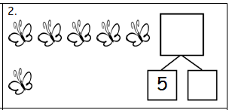
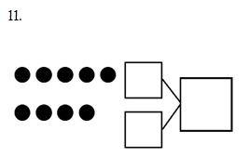
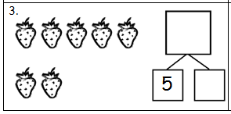
Introduction to the Lesson Structure
Lesson 1, Concept Development
Notes:
DISCUSS PROBLEM SET
After working with the whole class on embedded numbers within the egg carton, students work on the Problem Set, looking for embedded numbers within pictures organized in 5-group formations.
Ask participants to talk to a neighbor about the sample problems on the slide. How is the sequence of problems scaffolded?
Problems 2-3: The embedded 5 is provided, the numbers are lower and the pictures are more tangible.
Problem 11: The number bond is blank, there are more dots and the pictorial representation is more abstract.
Note to facilitator: You may wish to Invite participants to turn to the Problem Set page in Module, if you’d like to have participants reflect on simple to complex progression in CD and PS on next slide.
TIME ALLOTTED FOR THIS SLIDE:
3 minutes
MATERIALS NEEDED:
Lesson 1 PS (optional)

Slide 17
Concept Development
New material
Timing includes 10 minutes for Problem Set
Moves from simple to complex
Problem Set
Time frame rather than task frame
Closely related to the other lesson components
A good place to begin lesson planning
Notes:
SHARE CONCEPT DEVELOPMENT OVERVIEW
The Concept Development is the part of the lesson where new material is taught. It almost always ends with a Problem Set, which offers immediate practice with the new learning.
Discuss/ask participants the following questions about the work they just did:
What do you notice about the relationship between the CD and PS?
How did the CD prepare you for the PS?/Was anything on the PS surprising?
In a moment we’ll spend some time talking just about the PS, and how you might make adjustments for different students and also for lesson pacing.
Point out/discuss the following about CDs in SOU:
Is generally the component allotted the most time within the hour long lesson.
(Click 1x to advance animation.) The time allotment for the CD includes 10 minutes for the PS.
Very few lessons don’t have any CD at all. (Might be a lesson focused on fluency, for example.)
Some CDs use the PS, which makes the 10 minutes for it at the end unnecessary.
(Click 1x to advance animation.) The CD moves from simple to complex, usually mirroring that same development on the PS.
CDs take different formats. For example: teacher directed, stations, problem solving, group work, etc.
The vignettes throughout the lesson are meant to sample what the instruction looks, sounds, and feels like. They’re definitely not meant to be followed verbatim.
TIME ALLOTTED FOR THIS SLIDE:
X minutes
MATERIALS NEEDED:
X

Slide 18
Concept Development – HIDDEN SLIDE (p. 2 of notes)
New material
Timing includes 10 minutes for Problem Set
Moves from simple to complex
Problem Set
Time frame rather than task frame
Closely related to the other lesson components
A good place to begin lesson planning
Notes:
SHARE PROBLEM SET OVERVIEW
Point out/discuss the following about Problem Sets: (Click 1x to advance animation.)
Simple to complex sequence.
Draw attention to the Problem Set directions in the lesson.
PS is meant to be done as a time frame rather than a task frame. (Click 1x to advance animation.)
Every student may not be assigned every problem (but ensure they get a balance of word problems and other types)
Suggestion for implementation: Take 8 minutes to get as far as possible on PS, last 2 minutes all work on a particular problem. (Ensures everyone’s done at least 1 ‘meaty’ problem to discuss in the Debrief.)
Discuss the relationship between PS and HW and PS and Exit ticket. (Click 1x to advance animation.)
Problems mirror development in CD
May want to talk about how writers wrote PS first, then CD. Suggestion for planning: start with the PS and plan the path that will get your students there. (Click 1x to advance animation.)
TIME ALLOTTED FOR THIS SLIDE:
X minutes
MATERIALS NEEDED:
X

Slide 19
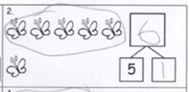
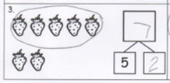
Introduction to the Lesson Structure
Look at Problems 2 and 3. Are there 5 butterflies? Where? What about strawberries?
Can you show me five fingers? Can you show me 5 fingers on 2 hands?
Look at your Application Problem. What were the 2 parts in our story problem?
Lesson 1, Student Debrief
Notes:
MODEL DEBRIEF
Ask participants the questions presented on the slide. You may wish to choose some of the other Debrief questions from Lesson 1, as well (listed below).
Are there 5 butterflies? Where? What about strawberries? (We want students to see that there are 5 soccer balls, etc., embedded within the larger numbers. There are 6 butterflies in all. Have them identify the other part once they have seen the five within the number.)
Look at the soccer balls and the pencils. What is the same about them? What is different about them? (Guide students to see that both 8 and 9 have 5 embedded in them. If they notice the other embedded numbers such as 1 to 8, that is great!)
Can you show me five fingers? Show me five with two hands (i.e., 4 and 1, or 3 and 2). Now show me five with one hand.
Can you show me 6 the Math Way with your fingers? (5 fingers on the left hand and thumb on the right hand.) Can you show me the 5 inside 6? Continue with 7, 8, 9, and 10.
(Show examples of student work from the application problem.) What were the 2 parts in our story problem? What does that have in common with today’s lesson?
TIME ALLOTTED FOR THIS SLIDE:
5 minutes
MATERIALS NEEDED:
Lesson 1 PS (optional)

Slide 20
Introduction to the Lesson Structure – HIDDEN SLIDE (p. 2 of Notes)
Look at Problems 2 and 3. Are there 5 butterflies? Where? What about strawberries?
Can you show me five fingers? Can you show me 5 fingers on 2 hands?
Look at your Application Problem. What were the 2 parts in our story problem?
Lesson 1, Student Debrief
Notes:
After discussing the answers, ask participants, “How would this kind of conversation help the students in your class?”
Reponses may include:
Students can verbalize their understanding.
Students make connections among their various activities throughout math class.
Students learn from listening to their peers and from reflecting on their own work.
SHARE DEBRIEF OVERVIEW:
These questions are suggestions about what may be discussed in Student Debrief portion of the lesson. Teachers may choose any combination of the suggested questions.
Rather than stating the objective of the lesson at its beginning, we wait until the dynamic action of the lesson has taken place.
The student debrief is an important time that takes place as the last 10 or 12 minutes of an hour math block.
This is when students bring together all of their learning experiences and articulate what they have learned.
Optional: Ask participants to develop a debrief question about the Problem Set and share.
TIME ALLOTTED FOR THIS SLIDE:
5 minutes
MATERIALS NEEDED:
Lesson 1 Problem Set (optional)

Slide 21
Student Debrief
Class conversation to reflect on the day’s learning
Make connections between parts of the lesson, concepts, strategies, and tools
Students ultimately articulate the learning objective
Exit Ticket
Daily formative assessment to drive instruction
Time frame rather than task frame
Tool for lesson planning
Notes:
SHARE DEBRIEF PROCEDURE:
Discuss/Point out about Student Debrief in SOU:
Students bring PS to the carpet and gather around for a conversation about the lesson.
Check PS with a partner/correct as a class.
Invite students to share work.
Students see and hear multiple perspectives from classmates.
Students reflect back on the lesson to analyze the learning that occurred. (Lesson doesn’t start by naming objective.)
(Click 1x to advance animation.) Students make connections between parts of the lesson, concepts, strategies and tools. The student debrief is not to be missed!
(Click 1x to advance animation.) Students ultimately articulate the objective/day’s learning.
Teacher reviews key vocabulary and help students name the learning they describe.
(Click 1x to advance animation.) The time allotment for the Debrief includes 3 minutes for the Exit Ticket.
Tip for implementation:
If initially your students need help learning how to have these conversations (or accountable partner talk): They can share work, but also, you might present 1-2 different solutions and have them practice explaining the model, labels, equation and solution path to their partner.
TIME ALLOTTED FOR THIS SLIDE:
X minutes
MATERIALS NEEDED:
X

Slide 22
Student Debrief – HIDDEN SLIDE (p.2 of notes)
Class conversation to reflect on the day’s learning
Make connections between parts of the lesson, concepts, strategies, and tools
Students ultimately articulate the learning objective
Exit Ticket
Daily formative assessment to drive instruction
Time frame rather than task frame
Tool for lesson planning
Notes:
SHARE EXIT TICKET OVERVIEW
Discuss/Point out the following about the Exit Ticket:
(Click 1x to advance animation.) Daily formative assessment to drive daily instruction (use it to plan!)
Use it to close the lesson, or some people use as morning work the next day (teachers use it in lots of ways: the point is that it be useful for planning your instruction.)
(Click 1x to advance animation.) Time frame, not task frame
(Click 1x to advance animation.) Can be a tool for lesson planning because it’s a glimpse of the student outcome for each day.
TIME ALLOTTED FOR THIS SLIDE:
X minutes
MATERIALS NEEDED:
X

Slide 23
Agenda
Lesson Structure
Instructional Sequence
Module Review
Preparation for Implementation
Notes:
INTRODUCE INSTRUCTIONAL SEQUENCE SECTION
As you’ve seen, each lesson component has a very different purpose. Consequently, each lesson component has a different pace, so the experience feels different for students. It is important to honor each component in order to do justice both to the mathematical practices and to the balance of rigor that is expected.
Moving forward, we’ll explore the instructional sequence. In doing this, we’ll lead you through the module, modeling instruction for each objective. Along the way, we’ll also revisit the other lesson components and experience how they function in collaboration with the concept development.
TIME ALLOTTED FOR THIS SLIDE:
1 minute
MATERIALS NEEDED:
X

Slide 24
Instructional Sequence
Notes:
EXPLAIN TOPIC BREAKDOWN
Lesson 1 is a part of our first topic in Module 1: Embedded Numbers and Decompositions.
There are 10 topics in Module 1. Each of the ten topics are sequenced to support student understanding of the strategies for adding and subtracting as well as the connection between the two operations.
TIME ALLOTTED FOR THIS SLIDE:
1 minute
MATERIALS NEEDED:
X

Slide 25
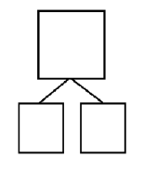
Embedded Numbers
Finding Embedded Partners within a Group
Lesson 2
Notes:
INTRODUCE TOPIC A: EMBEDDED NUMBERS AND DECOMPOSITIONS
In Lesson 1, we directed students to particularly notice 5 embedded within each number. As students move into Lesson 2, they look at other combinations of embedded numbers.
FIND PARTS AND WHOLE AND RECORD IN NUMBER BOND
Ask participants what smaller part can they find in the configuration. (Click to animate circling 2 parts.)
Once circled, what are the two parts?
How much in the whole configuration?
How would we show these parts and the total with a number bond? (Click to animate number bond parts and whole.)
After sharing, explain the importance of embedded numbers:
foundation of decompositions of a total
key to why “counting on” can be used as a strategy. (In counting on, we start with one embedded number and “count on” the second part to reach the total.)
TIME ALLOTTED FOR THIS SLIDE:
3 minutes
MATERIALS NEEDED:
X

Slide 26
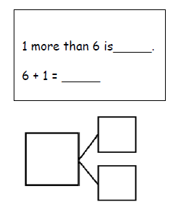
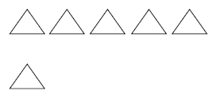
Embedded Numbers
Identifying “1 more”
Lesson 3
Notes:
IDENTIFY 1 MORE
The concept of embedded numbers can help students consider “1 more” as it connects with a group of objects that is already counted.
In this example, students are asked to draw 1 more in the 5-group drawing and write the numbers to describe the new picture.
T: Raise you hand if you know how many triangles there are? (Signal.)
S: 6.
T: (Click to advance animation.) How many now?
S: 7.
T: (Point to the sentence stems.) 1 more than 6 is?
S: 7.
T: 6 + 1 = ?
S: 7.
T: (Click to advance animation. Then point to the number bond.) Say the parts, starting with the biggest number.
S: 6 and 1,
T: Say the whole.
S: 7.
T: (Click to advance animation).
Students connect the concept of embedded numbers with their knowledge of the counting sequence to tell “1 more” without needing to physically count the items again. This is also foundational for students to be ready for moving to counting on as a strategy for adding.
TIME ALLOTTED FOR THIS SLIDE:
2 minutes
MATERIALS NEEDED:
X

Slide 27
Counting On
Lesson 4
Notes:
INTRODUCE TOPIC B: COUNTING ON FROM EMBEDDED NUMBERS
Topic B includes Lessons 4 through 8 focuses on using embedded numbers to help us count on. Lesson 4 focuses on compositions with a total of 6. Lesson 5 focuses on compositions of 7, and so on until we get to Lesson 8, which focuses on compositions of 10.
FIND PARTNERS OF 6 WITHIN IMAGE; WRITE CORRESPONDING EXPRESSIONS AND NUMBER BONDS
If participants have their Module 1 with them, they can turn to the last page of Lesson 4 to find the picture shown on the slide. They will use the counters on the table for this group activity.
T: How many apples do we have?
S: 6.
T: How many of the apples have a stem? Let’s put a red counter on each and count as we do.
S: 1, 2, 3, 4.
T: How many apples do NOT have a stem? Let’s put a yellow counter on each of these and count.
S: 1, 2.
T: On your personal white board, write the expression that shows our two parts. (4 + 2.) Complete the number bond to show that our two parts, 4 and 2, make a total of 6.
T: With the person next to you, find other ways to put the apples in 2 parts, and write the expression and the number bond on your personal white board.
(Note to facilitator: Students in class would be able to record their expressions and number bonds on a special recording chart. While the recording chart for students allows them to recognize that 4 + 2 and 2 + 4 use the same number bond, the commutative property is not emphasized in the lesson.)
TIME ALLOTTED FOR THIS SLIDE:
4 minutes
MATERIALS NEEDED:
6 double-sided counters per pair
Personal white board per participant
Picture of Apples from M1 Lesson 4 per participant

Slide 28
Counting On
Lesson 5
Notes:
USE 7 VOLUNTEERS AS ACTORS
Invite 7 participants to the front of the room to show how student actors are used to identify combinations as well. In Lesson 5, the focus is on combinations of 7. When choosing 7 participants, start with at least 1 characteristic that you can see comes in 2 parts, such as long hair and short hair, or long sleeves and short sleeves.
MAKE NUMBER BOND WITH LABELED PARTS AND SHOW PARTS WITH 5-GROUP CARDS
T: Today we will use 5-group cards to keep track of our two parts.
T: How many people do we have here?
S: 7!
T: Write 7 in the total box of your number bond. What does this 7 represent? (People.)
T: (Label the total, or whole, with ‘People’.)
T: Part of these 7 people have long hair. How many people have long hair?
S: 1! (or appropriate number.)
T: Let’s write 1 as one part of our number bond. This 1 represents the part of our group that has long hair. (Label with “long hair”)
T: Show 1 with your 5-group cards using the dot side.
T: There is 1 person with long hair. How many people have short hair?
S: 6!
T: How should I label this part?
S: Short hair.
T: Now show 6 with your 5-group card using the dot side, right next to your first card.
TIME ALLOTTED FOR THIS SLIDE:
4 minutes
MATERIALS NEEDED:
Document camera
Personal white boards per participant
5-group cards per participant

Slide 29
Counting On – HIDDEN SLIDE (p. 2 of Notes)
Lesson 5
Notes:
COUNT ON WITH CARDS AND WRITE ALL NUMBER SENTENCES
T: What strategy can I use to find out how many students there are altogether?
S: (Responses may vary.) Count on!
T: Point with me to keep track as we count on from our 1 long haired friend. (Gesture around the group of 1, and then touch the 6 students on the head as you count on with the class; have them sit down as you count them.)
T: Now it’s your turn to count on. Flip over your 1 dot card to show the number 1. Then count on from 1. Be sure to touch and count!
S: (Count on from 1 to 7, pointing to each dot.)
T: What are the 2 parts that make 7?
S: 1 and 6.
T: Say the number sentence that makes 7. (Point to each box as students respond.)
S: 1 + 6 = 7.
T: (Record this on the chart beneath the number bond.)
T: Say the number sentence starting with the students with short hair.
S: 6 + 1 = 7.
T: Say the number sentence starting with the total.
S: 7 = 1 + 6.
T: Say the number sentence starting with the total but flip the parts this time.
S: 7 = 6 + 1.
Continue this process with the other decompositions of 7. Keep the same actors but rearrange them to show different
decompositions of 7 (e.g., 2 sitting, 5 standing; 3 smiling, 4 frowning). Review zero if necessary.
TIME ALLOTTED FOR THIS SLIDE:
4 minutes
MATERIALS NEEDED:
Document camera
5-group cards per participant

Slide 30
Counting On
Lesson 6
Notes:
FIND PARTNERS OF 8 WITHIN IMAGE
Look at the picture. Talk with a partner about the different parts you see.
SHARE OUT AN EXAMPLE
(use 5-group cards. Record with number bond and number sentence)
Invite participants to:
Name parts.
Show parts with 5-group cards.
Put parts in front of them:
1st part: number side
2nd part: dot side
Practice counting on: starting with the first numeral and then touch each dot on the second card as you count on to find the total.
Write the parts and the total on the number bond template as well as the number sentence.
SHARE MORE EXAMPLES:
Invite 1 or 2 more participants to share different compositions so that the group can practice finding the parts, using 5-group cards to count on, and then recording the parts and totals in number bonds and as number sentences.
TIME ALLOTTED FOR THIS SLIDE:
3 minutes
MATERIALS NEEDED:
Document camera
5-group cards per participant
Personal white board

Slide 31
Counting On
Lesson 8
Notes:
MAKE REKENREK BRACELETS
After working with compositions of 6, 7, 8, and 9, we come to Lesson 8 where the focus will be on compositions of 10.
Students will have spent some time in kindergarten focusing on these partners of 10 in various ways.
As you can see from our 5-group cards and our Finger Flash work from Lesson 1, work with partners of 10 is embedded in a great deal of the representations and tools used.
In Lesson 8, we introduce students to Rekenrek bracelets: a pipe cleaner that has 5 white pony beads and 5 red pony beads. These bracelets mimic the configuration of one row on a 20-bead or 100-bead Rekenrek (show Rekenrek).
Starting with the 5 red beads, have participants create their own Rekenrek bracelet, as shown on the slide.
TIME ALLOTTED FOR THIS SLIDE:
5 minutes
MATERIALS NEEDED:
5 red and 5 white pony beads and a pipe cleaner per participant
Rekenrek

Slide 32
Counting On
Lesson 8
Notes:
FIND PARTNERS FOR 10 WITHIN IMAGE AND SAY COMMUTATIVE EXPRESSIONS
T: Talk with your partner about different parts you see in this picture.
Participants share out; Facilitator records on chart paper entitled “Partners of 10”.
Identify Parts: Invite a participant to share one example aloud for the group. (Write the corresponding number bond on the chart.)
Use bracelets: Ask all participants to show the on the bracelet by separating the 10 beads to show the two parts.
Say expressions: Ask participants to tell the expression starting with the smaller part. Then tell the expression starting with the bigger part. (Add the corresponding expressions to the chart.)
Continue with more examples.
COMPLETE PROBLEM SET
Give the participants two minutes to complete the Problem Set with a partner by finding all the ways to show partners of 10 on their Rekenrek bracelets and recording each way on the Problem Set.
TIME ALLOTTED FOR THIS SLIDE:
5 minutes
MATERIALS NEEDED:
Chart paper
Rekenrek bracelet per participant (created in previous slide)
Lesson 8 Problem Set per participant

Slide 33
Addition Word Problems
Add To with Result Unknown
Put Together with Total Unknown
Lesson 9 and 10
Notes:
INTRODUCE TOPIC C: ADDITION WORD PROBLEMS
Add To – Result Unknown
There are many different Addition Word Problem Types that first graders will learn this year. In Topic C, students will work with problems where objects are added to other objects and the total, or result, is unknown. This is called “Add To with Result Unknown.” These problems are are action-oriented; they show changes from an initial state to a final state.
Put Together – Total Unknown
Students will also work with problems where two parts are given and the total is unknown. There is not necessarily an action in these problems. Both parts are simply “there.” Think of boys and girls, or red apples and green apples. These problems are called “Put Together with Total Unknown.”
TIME ALLOTTED FOR THIS SLIDE:
1 minute
MATERIALS NEEDED:
X

Slide 34
Addition Word Problems
Add To with Result Unknown or Put Together with Total Unknown?
There are 4 inch-worms on a giant leaf.
3 more inch-worms crawled onto the leaf.
How many inch-worms are there now?
Lesson 9
Notes:
USE 7 PARTICIPANTS TO MODEL STORY PROBLEM
In Lesson 9, students solve together by counting the actors involved and recording with a drawing, writing a number sentence, and sharing statements about their numbers. (This is a precursor to RDW process.)
T: I will tell you a story and you draw.
T: There are 4 inchworms on a giant leaf.
S: (Draw 4 worms on a leaf.)
T: Three more inchworms crawled onto the leaf.
S: (Draw 3 more worms.)
T: Does your drawing show the two parts of our story clearly? Tell your partner how.
T: Write a number sentence to show what happened in your picture and find the total.
S: (Write 4 + 3 = 7.)
T: Turn and talk to your partner about what each number tells about the story.
S: (Share with their partners.)
T: Write the rest of the number sentences that go with your story.
IDENTIFY PROBLEM-TYPE
T: Is this an Add To or Put Together problem? Raise your hand when you know the answer. (Pause, signal.)
S: Add to.
T: Yes. This is an add to problem because a change occurred. In this problem, the result of the change is the unknown.
TIME ALLOTTED FOR THIS SLIDE:
3 minutes
MATERIALS NEEDED:
Document camera
7 participants

Slide 35
Addition Word Problems
Add To with Result Unknown or Put Together with Total Unknown?
There are 3 students sitting at recess.
There are 7 students standing at recess.
How many students are at recess?
Lesson 10
Notes:
INVITE PARTICIPANTS TO USE 5-GROUP CARDS TO THE MODEL STORY PROBLEM
In Lesson 10, students use 5-group cards to solve and continue to practice recording a drawing, a number sentence, and the teacher and/or students write a statement. (Precursor to RDW process.)
Take out your 5-group cards. I’ll make up a math story and you’ll use your cards to match the story.
There are 3 students sitting at recess. (Show numeral side.)
There are 7 students standing at recess. (Show dot side.)
Count on with me to find how many students are at recess. Ready? (Touch numeral and dots to count.)
Write number sentence. Identify what the numbers represent in relation to the story.
Share statement.
IDENTIFY PROBLEM-TYPE
T: Is this an Add To or Put Together problem? Raise your hand when you know the answer. (Pause, signal.)
S: Put together.
T: Yes. This is a put together problem because there was no change. In this problem, the total number of students is the unknown.
TIME ALLOTTED FOR THIS SLIDE:
3 minutes
MATERIALS NEEDED:
Document camera
Personal white boards per participant
5-grou p cards per participant

Slide 36
Addition Word Problems
Add To with Change Unknown
Once upon a time, 3 little bears
went to play tag in the forest.
Then, some more bears came over.
In the end, there were 5 little bears playing
tag in the woods altogether.
How many bears came over to play?
Lesson 11
Notes:
USE THE MYSTERY BOX TO INTRODUCE CHANGE UNKNOWN PROBLEMS
Use a document camera to demonstrate using bears and a mystery box.
T: Once upon a time, 3 little bears went to play tag in the forest. (Place 3 bear counters on the template on the floor.) Then, some more bears came over. (Place the box with the question mark next to the bears.) In the end, there were 5 little bears playing tag in the woods altogether.
T: How many bears do you think came to play (point to the box)? Turn and talk to a partner. (Circulate and listen to student discussions.)
T: (Have students share ideas.) What strategy did you use to decide? (Ask a few students to share varying ideas.) Let’s use counting on to test our ideas.
S/T: (Gestures over the 3.) Threeeee, (taps the box while drawing dots below the box for each count) 4, 5!
T: How many more bears came to play?
S: 2 bears!
T: Let’s find out if we were right. (Open up the box and reveal 2 bears.) You were right! There were 2 more bears that came to play tag. (Close the box and place the 2 bears on top of the box.)
T: Write the number sentence and number bond for the story. (Circulate.)
S: (Write the number sentence and number bond.)
T: Let’s replace our bears with numbers to see our number sentence. (Replace the 3 bears with the number 3 and the 2 bears with the number 2. Add the number 5 after the equal sign as the total.)
Analyze the referents.
By introducing students to addition problems where the change is unknown, they use their knowledge of counting on and their confidence with addition to determine the missing part, or unknown addend. A natural connection is developed that will help students understand the relationship between addition and subtraction.
TIME ALLOTTED FOR THIS SLIDE:
4 minutes
MATERIALS NEEDED:
Document camera
Personal White Board
3 counting bears
Mystery box (or cup) with 2 more bears placed inside)

Slide 37
Addition Word Problems
Add To with Change Unknown
Lesson 12
Notes:
USE THE MYSTERY BOX AND INVITE PARTICIPANTS TO USE 5-GROUP CARDS
Continuing to use the bears and the mystery box, students connect their work with 5-group cards.
(Discretely place 3 bears in the mystery box.)
Use the number side of your 5-group cards to help me solve a story:
“Once upon a time, 5 little bears came out of hibernation.”
T – Place 5 bears under document camera.
S – Place numeral card on work mat.
“Then, some more bears came out of hibernation.”
T – Add mystery box.
S – With partner, share options for representing mystery number. (Draw a box, question mark, blank.)
“At the end, there were 8 bears.”
T/S – Add 8 numeral card.
S – With partner, discuss strategies and share out. (Counting on or finding embedded number 5 on the dot side of the 8 card.)
T – Write the number sentence under the document camera, call on a participant to share the statement, and confirm the solution by removing the bears from the box.
TIME ALLOTTED FOR THIS SLIDE:
2 minutes
MATERIALS NEEDED:
Document camera
5 bears
Mystery box (or cup) with 3 additional bears placed inside
Personal white board
5-group cards per participant

Slide 38
Addition Word Problems
Add To with Change Unknown
Lesson 12
Notes:
PRACTICE STRATEGIES FOR FINDING THE MYSTERY NUMBER
Look at the first number sentence.
What addend, or part, is covered? Raise your hand when you know the answer. (Signal.)
How did you know?
(Participants might mimic their students: some might use 5-group cards, some “advanced learners” may already track on their fingers, and other students will “just know”. Tracking on fingers is explicitly introduced in Lesson 14.) Click to advance slide. Repeat with second number sentence.
TIME ALLOTTED FOR THIS SLIDE:
2 minutes
MATERIALS NEEDED:
X

Slide 39
Addition Word Problems
Students tell stories from equations:
Add To with Result Unknown
Put Together with Total Unknown
Add to with Change Unknown.
6 + 2 = 5 + = 7
5 + 5 = 6 + = 10
Lesson 13
Notes:
MAKE UP STORY A NUMBER SENTENCE
Ask participants to choose an equation on the slide with a partner.
Story: Make up a math story that would go with it.
Solve: Create a math drawing, complete a number bond, and write the number sentence on their personal white board.
(During the lesson, students have the equations and the number bond frame provided on their Problem Set.)
TIME ALLOTTED FOR THIS SLIDE:
5 minutes
MATERIALS NEEDED:
Personal white board per participant

Slide 40
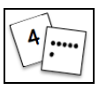
Strategies for Counting On
Tracking
5-group cards
Fingers
6 + 3 =
Lesson 14 and 15
Notes:
INTRODUCE TOPIC D: STRATEGIES FOR COUNTING ON
Topic D consists of 3 Lessons in which students practice the various strategies for counting on.
Ideally, we want all students to be able to extend their fingers as a way to track their counting on.
Some children will be able to visualize, or imagine, to track as they count on.
These skills will help students throughout the year, particularly as they move to more complex addition and subtraction, where they will count on in larger groups.
Tracking Counting On:
Consider 6 + 3. What strategies have students used thus far? (take ideas)
Earlier in the module, students have used
student actors
bears
pictures
5-group cards
Drawings
Now we ask students to use fingers rather than the cards, where they have to determine when to stop counting. (Model by extending your fist, or tap your head and say “sixxx,” and then extend a finger for each number being counted on: “seven, eight, nine.” 3 fingers are extended by the last count.)
TIME ALLOTTED FOR THIS SLIDE:
2 minutes
MATERIALS NEEDED:
5-group cards per participant

Slide 41
Strategies for Counting On
Let’s play Count On!
Lesson 15
Notes:
PLAY COUNT ON
In the classroom, you would have number sentences with the total covered by a sticky. These are represented here on the slide so we can play together. In the classroom, you pair students to play as partners.
1. Partners A and B, lay all of the number sentence cards in front of you.
2. Partner A, you touch the card you want to take.
3. Count on or use the 5-group cards to solve for the total under the sticky note.
4. When you do, your partner lifts the sticky. If you are right, your partner says, “Go ahead and take it!”
5. Partner B takes a turn. Continue until all the cards are taken.
TIME ALLOTTED FOR THIS SLIDE:
2 minutes
MATERIALS NEEDED:
5-group cards per participant

Slide 42
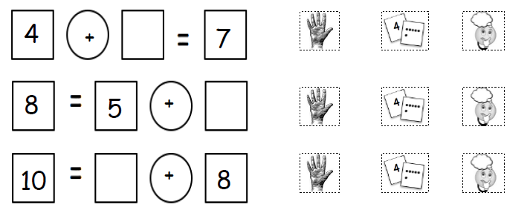
Strategies for Counting On
Counting On to Find the Unknown Addend
Lesson 16
Notes:
TRACK THE COUNT (TO COUNT ON TO FIND MISSING ADDEND)
When students are able to track to count on, they next learn to employ the same strategy to find the unknown addend. This time, they need to see how many times they counted on to reach the total. Let’s start at 6 and count on until we reach our total of 9.
Sixxx (fist out). Seven, eight, nine (extending finger for each count.)
How many more did we count on from 6 to get to 9? (3)
Some students may still rely on 5-group cards to track while other students may already know their facts within 10 and not need to track to solve.
TIME ALLOTTED FOR THIS SLIDE:
2 minutes
MATERIALS NEEDED:
X

Slide 43
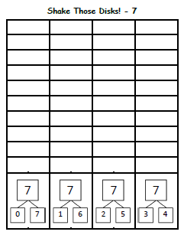
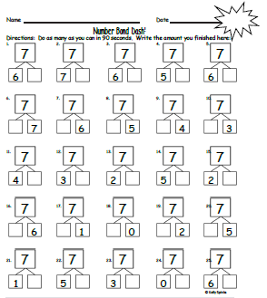
Fluency to Practice Topics A through C
Shake Those Disks
Number Bond Dash
Count On Drums
Penny Drop
Fluency Activities within Module 1
Notes:
PLAY FLUENCY GAMES:
Students continue to practice the concepts and skills through various fluency activities. Let’s take a look at a sample of 4 such Fluency Activities.
Shake Those Disks - Have participants play Shake Those Disks. (7 counters per pair, shake & spill counters, write expression (or color in box) above the matching number bond on the template. Invite participants to play for 3 minutes. (See G1-M1-Lesson 7 for more detailed directions.)
Number Bond Dash - Participants have 90 seconds to complete the Number Bond Dash of 7. (From G1-M1-Lesson 6, 17, 18.)
Count on Drums – Give students a number, then “drum 3 times” together as a group. Snap to have choral response for total. (e.g. 5 “tap, tap, tap.” Snap to class. “8!”) Start with various numbers within 10 such 3, 6, 7.
Penny Drop - Similar to Count on Drums, but students listen as the additional pennies are dropped in container rather than drumming. (“I have 5 pennies in this cup.” Without speaking, drop in 2 more pennies, one at a time. “How many pennies are in the cup now?” Students respond, “7!”) Repeat with various starting numbers, adding 1, 2, or 3 pennies each time.
TIME ALLOTTED FOR THIS SLIDE:
10 minutes
MATERIALS NEEDED:
10 2-sided counters per pair
Shake Those Disks Template per participant
Number Bond Dash Template per participant
10 pennies and a container for presenter
Stopwatch/timer

Slide 44
Commutative Property of Addition and the Equal Sign
Pairs of Expressions and the Meaning of the Equal Sign
Lesson 17
Notes:
INTRODUCE TOPIC E: THE COMMUTATIVE PROPERTY OF ADDITION AND THE EQUAL SIGN
PLAY MAKE IT EQUAL – Participants decide who will be Partner A and who will be Partner B.
T: Let’s play a game called Make it Equal. Partner B, close your eyes. Partner A, make your linking cubes look exactly like mine. (Show 4 red and 1 yellow cubes as a stick.) Hide your stick behind you and close your eyes.
T: Partner B, open your eyes. Make your linking cubes look exactly like mine. (Show 3 red and 2 yellow cubes as a stick.)
T: Partner A, open your eyes. Everyone, write the expression that shows how many cubes you have. (Partner A writes 4 + 1; Partner B writes 3 + 2.)
T: Show each other your linking cube stick. How are they the same? How are they different?
T: Even though you have different parts, do you have the same total? (Yes.)
T: Put your expressions next to each other. Now, put your sticks in between the expressions by putting them one above the other. What do the 2 sticks look like now?
S: An equal sign!
T: Hmmm….does this make sense? How many cubes do you have on the left side of the equal sign? (5.)
T: How many cubes do you have on the right side of the equal sign? (5.)
T: Does 5 equal 5? (Yes!)
T: Does 4 + 1 equal 3 + 2? (Yes!)
T: Let’s say the number sentence.
T/S: 4 + 1 = 3 + 2.
T: This is called a TRUE NUMBER SENTENCE.
TIME ALLOTTED FOR THIS SLIDE:
3 minutes
MATERIALS NEEDED:
10 linking cubes of one color per participant (partners should each have a different color)

Slide 45
Commutative Property of Addition and the Equal Sign
Pairs of Expressions and the Meaning of the Equal Sign
Lesson 17
Notes:
ELICIT TRUE NUMBER SENTENCES TO MATCH PICTURES
What expression should we put under the plate on the left? (Click to advance animation.)
To the right? (Click to advance animation.)
Do these two plates have the same amount of food? (Yes.)
How do we show that? (with an equal sign.) (Click to advance animation.)
This is called a true number sentence. It is true that 3 plus 4 is the same as 2 plus 5.
Click to advance slide again and repeat the process with the second example.
TIME ALLOTTED FOR THIS SLIDE:
3 minutes
MATERIALS NEEDED:
X

Slide 46
Commutative Property of Addition and the Equal Sign
True and False Number Sentences
7 + 1 = __ + __
4 + 2 = 5 + 3
Lesson 18
Notes:
EXPLORE TRUE V. FALSE NUMBER SENTENCES
Once students are comfortable at the concrete and pictorial level, we can help them see the application of equivalent expressions at the abstract number sentence level.
Make it true: 7 + 1 = __ + __
T: On the back of your personal white board, complete this equation to make a true number sentence.
T: Hold up your true number sentences. Look around the class.
Did everyone use the same numbers? (No.)
They don’t all use the same numbers, but are all of them equal to 8? (Yes.)
TIME ALLOTTED FOR THIS SLIDE:
4 minutes
MATERIALS NEEDED:
Personal white board per participant
5-group cards per participant

Slide 47
Commutative Property of Addition and the Equal Sign – HIDDEN SLIDE (p. 2 of notes)
True and False Number Sentences
7 + 1 = __ + __
4 + 2 = 5 + 3
Lesson 18
Notes:
EXPLORE TRUE V. FALSE NUMBER SENTENCES
In the previous lesson, students made a lot of true number sentences. Now, students learn that number sentences can be false, as well.
Prove it is false: 4 + 2 = 5 + 3
T: Use your 5-group cards to tell me why this number sentence is NOT true. (Click to advance slide to the UNTRUE number sentence.)
S: (Build 4 + 2 = 5 + 3 with 5-group cards, and solve for each side.)
T: Is 4 + 2 = 5 + 3 true or false?
S: False!
T: Talk with your partner. How do you know that 4 + 2 = 5 + 3 is not equal, or false? (As students share, circulate and listen. Then call on one student.)
S: 4 + 2 is 6, and 5 + 3 is 8, so they are not equal because 6 is not the same as 8!
T: Talk with your partner. How can you fix this number sentence to make it equal or true? (As students share, circulate and listen. Then call on a couple of students.) (Click to advance slide to see one way to make this a true number sentence. Some students, and participants, may make other types of changes that would still yield a true number sentence such as: 4 + 4 = 5 + 3.)
T: Is there more than 1 way to fix this number sentence to make it true?
S: Yes!
TIME ALLOTTED FOR THIS SLIDE:
4 minutes
MATERIALS NEEDED:
Personal white board per participant
5-group cards per participant

Slide 48
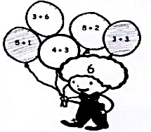
Commutative Property of Addition and the Equal Sign
True and False Number Sentences
Lesson 18
Notes:
EXPLAIN LESSON 18’S PROBLEM SET
As students move to the Problem Set, they work the concept by finding two expressions that equal the number in the child’s mind and then write the true number sentence to show that the expressions are equal.
EXPLAIN RATIONALE (UNDERSTANDING EQUAL SIGN)
T: What does all this work with true and false number sentences help students realize?
S: (Share out ideas.)
T: Working with true number sentences strengthens students understanding of the equal sign. These activities help students understand the equal sign as showing equivalence NOT as “the part that shows the answer is coming” as they may have previously thought.
TIME ALLOTTED FOR THIS SLIDE:
2 minute
MATERIALS NEEDED:
X

Slide 49
Commutative Property of Addition and the Equal Sign
The Commutative Property
Lesson 19
Notes:
DEMONSTRATE COMMUTATIVE PROPERTY WITH ACTORS
Note to the Presenter: Use a different context that fits the audience, such as women and men OR short hair and long hair.
Use 7 participants and elicit a choral response:
How many women?
How many men?
Say the number sentence, starting with the number of women.
MOVE VOLUNTEERS to show COMMUTATIVE PROPERTY
How many men?
How many women?
Say the number sentence, starting with the number of men.
Is that the same total or a different total of children as we had the last time we added the women and men? (Same.)
Did the number of women change? (No.) Did the number of men change? (No.) What changed? (The order!)
Though we like to think of the commutative property as “switch arounds,” it is important to realize that it is the the order of the addends that switch not the referents. When we change the placement of the materials when adding, we find that the exact same four number sentences also describe the materials in different positions.
Invite participants to work on the 2 problems on the slide. (Click to advance to 2nd example.)
TIME ALLOTTED FOR THIS SLIDE:
4 minutes
MATERIALS NEEDED:
7 participants

Slide 50
Commutative Property of Addition and the Equal Sign
Counting On from the Larger Addend
1 + 7 = 7 + 1
Knowing 1 + 7 is the same as 7 + 1, which would be a faster way to find out the total?
Should we start at 1 and count on 7?
Should we start at 7 and count on 1?
Lesson 20
Notes:
EXPLORE COUNTING ON EFFICIENTLY
Students use their new understanding of the Commutative Property to compare efficiency of start numbers when counting on.
T: Count on with me from 1. Use one of the tracking strategies students have learned thus far.
T: Count on from 7.
What observations might students make after doing this activity?
How are they alike? (Same numbers.)
How are they different? (Different start number. → One way was faster. → One way took longer.)
Which is more efficient? (Counting on from 7.)
TIME ALLOTTED FOR THIS SLIDE:
2 minutes
MATERIALS NEEDED:
X

Slide 51
Development of Addition Fluency Within 10
Using one math fact to solve another:
Use Doubles……
Lesson 21
Notes:
INTRODUCE TOPIC F: DEVELOPMENT OF ADDITION FLUENCY WITHIN 10
Core Fluency: Addition Fluency within 10 is a year-long goal for Grade 1.
In this topic, students work with developing efficiency of adding within 10.
They see that knowing the solution to one addition problem can help them quickly solve other addition problems.
In Lesson 21, students use their fingers to practice their doubles, which they will use to help them solve what are called “doubles plus one” or “near doubles” facts.
Model illustration: With participants, chorally say the doubles facts, starting with 1 + 1 = 2 as you extend fingers as shown in slide.
TIME ALLOTTED FOR THIS SLIDE:
2 minutes
MATERIALS NEEDED:
X

Slide 52
Development of Addition Fluency within 10
Using one math fact to solve another:
….To Solve Doubles Plus One
4 + 4 = 4 + 5 =
Lesson 21
Notes:
INTRODUCE DOUBLES PLUS 1
T: What is 4 + 4? (Model on fingers.)
T: 4 + 4 = 8, what does 4 + 5 equal? (Model on fingers.)
Repeat with other examples.
T: We can use 5-group cards to help us with doubles, as well.
T: (Show two 4 cards under document camera.) Raise your hand if you know what 4 + 4 equals. (Signal.)
S: 8!
T: If we know 4 + 4 = 8, what is 4 + 5? (Signal.)
S: 9!
T: How did you know?
S: I imagined 1 more dot.
Ask participants to name other facts that use this same “Doubles Plus One” strategy. (e.g., 3 + 4 and 3 + 2, 5 + 6).
If desired, have participants use 5-group cards to show their doubles plus one fact to their partner. Have participants show the “hidden double” within the two cards. (4 + 5….find the 4 + 4 on the two cards, along with the “1 more” dot.)
TIME ALLOTTED FOR THIS SLIDE:
2 minutes
MATERIALS NEEDED:
5-group cards per pair of participants

Slide 53
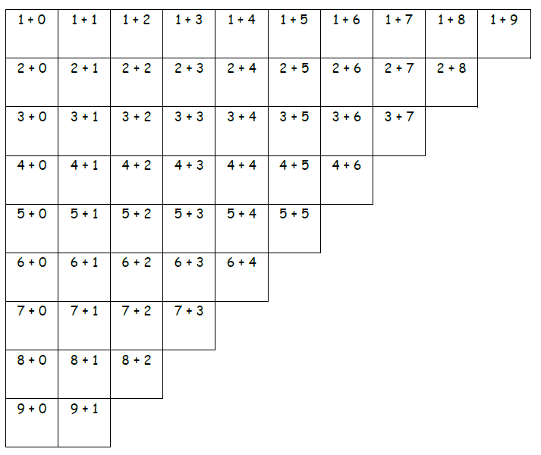
Development of Addition Fluency within 10
Using one math fact to solve another:
Lesson 22
Notes:
FIND PATTERNS ON THE ADDITION TABLE
Note to the Facilitator: You may want to do this on the document camera with addition chart in personal white board so the totals can be recorded.
Cover the addition chart so only the column on the left is revealed. (Click to advance animation.)
Read column together.
What do you notice?
All add 0.
As we move down, each expression starts with and addend that is one more.
Write totals.
UNCOVER THE NEXT COLUMN (Click to advance animation.):
What do you notice? (All +1)
Find 5 + 1. Say total on my signal.
How is it related to the expression below it? (The total is 1 more.)
This exercise helps students monitor their own learning.
students to begin to realize how many addition facts within 10 they know
or that they can solve efficiently by using another fact that they know well.
TIME ALLOTTED FOR THIS SLIDE:
3 minutes
MATERIALS NEEDED:
Document camera
Personal white board with Addition Chart template for Presenter only

Slide 54
Development of Addition Fluency within 10
Lesson 22
Notes:
GUIDE PARTICIPANTS TO SHADE PATTERNS ON THE ADDITION TABLE
Students use colors. We’ll use our personal boards and draw a line with our dry erase markers.
(Once a box is colored, they do not need to color it again. )
0 as an addend (click to advance animation after each direction.)
1 as an addend.
2 as an addend.
3 as an addend.
Color the remaining boxes.
This exercise is also a chance for students to begin to realize how many addition facts within 10 they know well, or that they can solve efficiently by using another fact that they know well.
TIME ALLOTTED FOR THIS SLIDE:
4 minutes
MATERIALS NEEDED:
Personal white board with Addition Chart template per participant

Slide 55
Development of Addition Fluency within 10
Using one math fact to solve another:
Lesson 23
Notes:
ERASE BOARD AND EXPLORE OTHER PATTERNS:
Totals of 10:
Point to 5 + 5. What’s the total?
Point to 4 + 6. What the total?
(Repeat through 1 + 9.)
Talk to a partner.
What do you notice about the totals? (They are all 10.)
How are they organized on the table? (Students might say they look like a staircase.)
Color in the expressions that equal 10. (Click to advance slide.)
Totals of 9:
What is 4 + 5?
Color all the expressions that equal 9.
Totals of 8:
What might students predict about totals of 8? (They will be on the next staircase)
TIME ALLOTTED FOR THIS SLIDE:
3 minutes
MATERIALS NEEDED:
Personal white board with Addition Chart template per participant

Slide 56
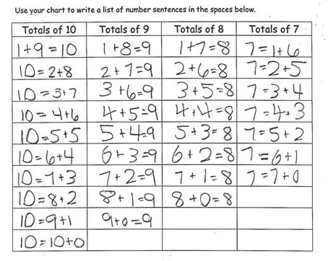
Development of Addition Fluency within 10
Using one math fact to solve another:
Lesson 23
Notes:
DESCRIBE LESSON 23’S PROBLEM SET
After students color the addition chart, they will use the table on the Problem Set, as shown on the slide, to organize and list the various combinations of each total.
TIME ALLOTTED FOR THIS SLIDE:
2 minutes
MATERIALS NEEDED:
X

Slide 57
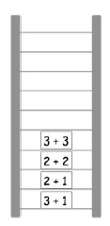
Development of Addition Fluency within 10
Using one math fact to solve another:
Lesson 24
Notes:
INTRODUCE THE RELATED FACT LADDER:
In Lesson 24, students explore how knowing any 1 fact can help them solve other related facts.
Let’s look at this related fact ladder.
3 + 1 → 2 + 1
The bottom rung starts with 3 + 1.
Because I know that 3 + 1 is 4, I can use that fact to help me solve 2 + 1.
How did I know that? (They both add 1 more → 2 + 1 is 1 less than 3 + 1.)
3 + 1 and 2 + 1 can be considered related facts because they share a pattern; one fact can help you solve another fact.
How each problem help solve the next problem?
2 + 1 → 2 + 2 (1 more.)
2 + 2 → 3 + 3 (1 more than each number → They are both doubles.)
Create a related number ladder on chart paper.
TIME ALLOTTED FOR THIS SLIDE:
2 minutes
MATERIALS NEEDED:
X

Slide 58
Development of Addition Fluency within 10
Using one math fact to solve another:
Lesson 24
Notes:
INVITE PARTICIPANTS TO EXTEND ONE OF THE LADDERS ON THE SLIDE
Invite participants to add more facts to one of the related fact ladders on the slide.
Ask participants to share the types of relationships they used on their ladders.
Discuss the importance of the debrief in this lesson.
Teachers can see which students can only think of one pattern (e.g., adding 1), and which can use many of the patterns learned.
Students can learn from each other’s choices.
TIME ALLOTTED FOR THIS SLIDE:
3 minutes
MATERIALS NEEDED:
Chart paper
Personal white board per participant

Slide 59
Subtraction as an Unknown Addend
Once upon a time, 4 little bears went to play tag in the forest. Some more bears came over. In the end, there were 6 little bears playing tag in the woods.
How many more bears came to play?
Lesson 25
Notes:
INTRODUCE TOPIC G: SUBTRACTION AS AN UNKNOWN ADDEND
As we read and solve, think about the perspectives your students would have, based on what they’ve learned thus far in Module 1.
FIRST SOLVE AS UNKNOWN ADDEND PROBLEM
T: Once upon a time, 4 little bears went to play tag in the forest. Some more bears came over. In the end, there were 6 little bears playing tag in the woods. (Place 6 bears under doc cam.)
T: How many more bears came to play? Turn and talk to a partner to share a strategy you used.
Review the strategy of counting on to solve. Ask participants to write the number sentence (4 + 2 = 6) and the number bond. Circle or box the solution in both. Write the number sentence and the number bond on the board. Identify what parts of the story the numbers represent:
T: What does 6 stand for?
S: The number of bears playing at the end.
T: (Gesture over the 6 bears on the floor.)
T: What does 4 stand for?
S: The number of bears playing in the beginning.
T: (Separate 4 bears slightly from the group.)
T: How many bears came over to play?
S: 2 bears. (Point to 2 bears.)
T: We can make an imaginary line with our finger to show the two parts. (Draw an imaginary line between the two groups.) Four bears were there first, and then 2 more bears came. (Point to each part accordingly.)
TIME ALLOTTED FOR THIS SLIDE:
4 minutes
MATERIALS NEEDED:
Document camera
6 bears
Personal white board with Number Bond and Number Sentence template per participant

Slide 60
Subtraction as an Unknown Addend - HIDDEN SLIDE (p.2 of notes)
Once upon a time, 4 little bears went to play tag in the forest. Some more bears came over. In the end, there were 6 little bears playing tag in the woods.
How many more bears came to play?
Lesson 25
Notes:
NOW SOLVE USING SUBTRACTION
T: Many of you used addition to figure out how many bears came over to play. When we checked our work just now, we separated the 4 bears from the total group of 6 bears. (Write 4 + __ = 6 on the board.) Since we know the whole, and one part we can use subtraction to find the other part. Turn and talk to your partner about how we could write this as a subtraction sentence. (Circulate and listen.)
S: (Discuss.)
T: (Choose a student to demonstrate her subtraction sentence using the bears.)
T: We can write 6 – 4 = 2 to show that we had 6 bears and separated 4 of them from the group, leaving us with 2 bears for the unknown part. You write the subtraction sentence on your board as I write it.
S/T: (Write 6 – 4 = 2. Circle the 2 to indicate it is the answer to the question.)
Throughout Topic G, students use their understanding and confidence with solving for missing addends to understand subtraction, forming the relationship in the context of stories.
TIME ALLOTTED FOR THIS SLIDE:
4 minutes
MATERIALS NEEDED:
Document camera
6 bears
Personal white board with Number Bond and Number Sentence template per participant

Slide 61
Subtraction as an Unknown Addend
Using a Number Path
Lesson 26 and 27
Notes:
USE NUMBER PATH TO VISUALIZE RELATIONSHIP BETWEEN ADDITION AND SUBTRACTION
The number path provides a tool to visualize how addition and subtraction are related.
While students CAN count back to solve 3 – 2,
they can ALSO think of subtraction as a missing addend problem and start at 2 to count on to 3. This is shown on the number path on the slide.
TIME ALLOTTED FOR THIS SLIDE:
2 minutes
MATERIALS NEEDED:
X

Slide 62
Subtraction as an Unknown Addend
Should we count on or count back?
9 – 8
What about 9 – 2?
Lesson 26 and 27
Notes:
USE THE NUMBER PATH TO COMPARE EFFICIENCY OF ADDITION OR SUBTRACTION FOR A GIVEN PROBLEM
After using the number path to count on and count back, students then look at the same problem and try both strategies.
This helps them notice that sometimes counting on can be more efficient, and sometimes counting back can be more efficient.
Consider 9 – 8. Is it more efficient to count back, as shown in the top number path, or is it more efficient to count on, as shown in the bottom number path?
(Click to show 2 different number path solutions and final question.)
Invite participants to try solving 9 – 2 using the number path template and decide which method is more efficient.
TIME ALLOTTED FOR THIS SLIDE:
3 minutes
MATERIALS NEEDED:
Document camera
Personal white board with Number Path Template per participant

Slide 63
Subtraction Word Problems
Take From with Result Unknown
Put Together/Take Apart with Addend Unknown
Add To with Change Unknown
Take From with Change Unknown
Lessons 28 - 32
Notes:
INTRODUCE TOPIC H: SUBTRACTION WORD PROBLEMS
Like Addition, there are many different Subtraction Word Problem Types that first graders will learn this year. In this topic, students will work with the each of the story problem types listed on the slide.
Add to / Take from - action oriented
Put together / take apart – no action needed
TIME ALLOTTED FOR THIS SLIDE:
2 minutes
MATERIALS NEEDED:
X

Slide 64
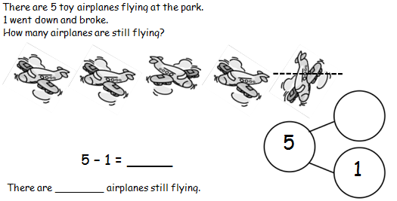
Subtraction Word Problems
Is this a Take From or Take Apart Problem?
Lessons 28
Notes:
USE THE RDW STRATEGY TO SOLVE (TAKE FROM WITH RESULT UNKNOWN)
Invite participants to make a simple math drawing, number bond, and word sentence to match the story.
Facilitator models solution
Is this a Take From or Take Apart Problem? What is our unknown?
In this problem, the total, or start number, is given and one part of the total is being taken away.
The result is our unknown. We want to know how many are still flying.
Note to Facilitator: In lesson 28, the teacher models crossing off a math drawing with a horizontal line, similar to what is pictured on the slide. The teacher then invites students to make the connection between the line used to cross off the picture and the subtraction symbol.
TIME ALLOTTED FOR THIS SLIDE:
2 minutes
MATERIALS NEEDED:
Personal white board per participant

Slide 65
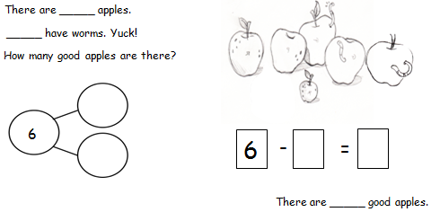
Subtraction Word Problems
Is this a Take From or Take Apart Problem?
Lessons 29
Notes:
USE THE RDW STRATEGY TO SOLVE (TAKE APART WITH ADDEND UNKNOWN)
Invite participants to make a simple math drawing, number bond, number sentence and statement to match the story.
Facilitator models solution
Is this a Take From or Take Apart Problem? What is our unknown?
In this problem, nothing is being taken away. Instead, we are separating the total number of apples into 2 parts.
We know one part, the apples with worms, and we are looking to identify the other part, the good apples.
TIME ALLOTTED FOR THIS SLIDE:
2 minutes
MATERIALS NEEDED:
Personal white board per participant

Slide 66
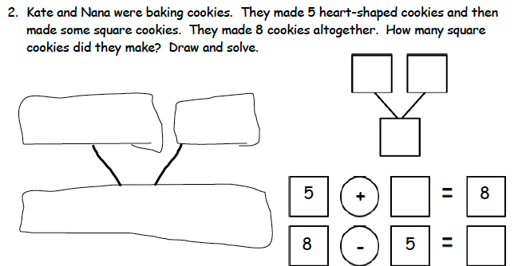
Subtraction Word Problems
Add To with Change Unknown
Lessons 30
Notes:
USE THE RDW STRATEGY TO SOLVE (ADD TO WITH CHANGE UNKNOWN)
Invite participants to make a simple math drawing, number bond, number sentence and word statement to match the story.
Find participants with diverse strategies to share under the document camera. Discuss differences in strategies. (Note: This problem can be solved with missing addend equation OR subtraction equation.)
Notice that in this problem type, one part is given with an unknown part added to it, resulting in the final total of 8 cookies.
TIME ALLOTTED FOR THIS SLIDE:
2 minutes
MATERIALS NEEDED:
Personal white board per participant

Slide 67
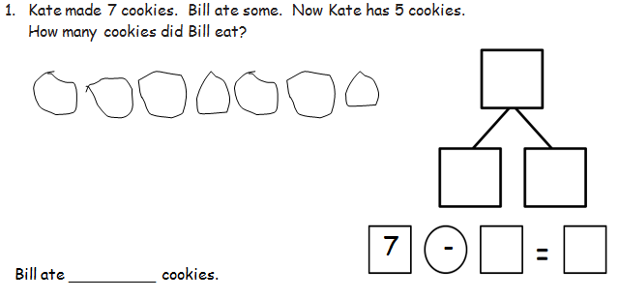
Subtraction Word Problems
Take From with Change Unknown
Lessons 31
Notes:
USE THE RDW STRATEGY TO SOLVE (TAKE FROM WITH CHANGE UNKNOWN)
Invite participants to make a simple math drawing, number bond, and word sentence to match the story.
Find participants with diverse strategies to share under the document camera. Discuss differences in strategies.
What equation would students likely use to solve?
The situation presents a subtraction equation.
We know how many total cookies we had, and the part of the cookies that were taken away, or eaten, is unknown. We know how many cookies are left at the end.
TIME ALLOTTED FOR THIS SLIDE:
2 minutes
MATERIALS NEEDED:
Personal white board per participant

Slide 68
Decomposition Strategies for Subtraction
How many beads on our number bracelet? Take one bead away. How many beads do you have now?
10 – 1 = 9
9 – 1 = 8
8 – 1 = 7
7 – 1 = 6
Lessons 33
Notes:
INTRODUCE TOPIC I: DECOMPOSITION STRATEGIES FOR SUBTRACTION
Context of stories → focus on decomposing strategies
Now that students have explored subtraction within the context of story problems, they begin to explore the patterns around decomposing that can help students solve subtraction problems quickly.
USE REKENREK BRACELET TO MODEL n - 1
We’ll use the Rekenrek bracelets that we made earlier in the lesson progression.
T: Show 10 beads.
T: How many beads are on your number bracelet? (10)
T: Take one bead away. (Push that one bead all the way up until it is hiding in your hand.)
T: How many beads do we have now? (9)
T: Say the number sentence. (10 – 1 = 9.)
Repeat the process with 9 – 1, 8 – 1, and 7 – 1.
Ask participants what pattern students learn to recognize with this activity. (Subtract 1.)
TIME ALLOTTED FOR THIS SLIDE:
3 minutes
MATERIALS NEEDED:
Document camera
Rekenrek bracelet and personal white board per participant

Slide 69
Decomposition Strategies for Subtraction
Take away 0 beads. How many beads do we have now?
4 – 0 = 4
5 – 0 = 5
6 – 0 = 6
7 – 0 = 7
8 – 0 = 8
9 – 0 = 9
10 – 0 = 10
Lessons 33
Notes:
OPEN PIPE CLEANER: MODEL n – 0
Model n - 0 and write number sentence for the following facts (Click to advance slides for each.)
4 – 0
5 – 0
6 – 0
Ask participants what pattern students learn to recognize with this activity. (Subtract 0.)
TIME ALLOTTED FOR THIS SLIDE:
3 minutes
MATERIALS NEEDED:
Document camera
Rekenrek bracelet and personal white board per participant

Slide 70
Decomposition Strategies for Subtraction
How many beads do we have on our bracelet?
Take away 10 beads.
How many do we have now?
10 – 10 = 0
9 – 9 = 0
8 – 8 = 0
7 – 7 = 0
How are these problems similar to each other?
Lessons 34
Notes:
MODEL n - n
Model n - n and write number sentence and a number bond for the facts on the slide.
T: Push all your beads together. How many do we have? (10.)
T: Take away 10 beads.
T: How many beads do we have now?
T: Write a number sentence and number bond.
Repeat for:
9 – 9
8 – 8
7 – 7
How are these problems similar to each other? (We are taking away the total amount → We always end up with 0.)
TIME ALLOTTED FOR THIS SLIDE:
3 minutes
MATERIALS NEEDED:
Document camera
Rekenrek bracelet and personal white board per participant

Slide 71
Decomposition Strategies for Subtraction
How many beads do we have on our bracelet?
Take away 9 beads.
How many do we have now?
10 – 9 = 1
8 – 7 = 1
7 – 6 = 1
How are these problems similar to each other?
Lessons 34
Notes:
MODEL n – (n – 1)
Model n – (n – 1) and write corresponding number sentence and a number bond for the following facts:
10 – 9
8 – 7
7 – 6
Ask, “How are these problems similar to each other? Talk with your elbow partner. Share. (We always end up with 1. We are taking away the amount that is the number right before the total.)
TIME ALLOTTED FOR THIS SLIDE:
4 minutes
MATERIALS NEEDED:
Document camera
Rekenrek bracelet and personal white board per participant

Slide 72
Decomposition Strategies for Subtraction
Show 7 on your hands the Math Way.
Use your hands to show 7 – 5.
7 – 5 = 2
Use your hands to show 7 – 2.
7 – 2 = 5
Lessons 35
Notes:
SUBTRACT USING UNDERSTANDING OF 5-GROUPS
Subtract on fingers the Math Way (7 – 5, 7 – 2)
T: Show 7 on your fingers the Math Way. (Hold up 5 fingers on right hand and thumb and index finger of left hand.)
S: (Hold up 5 fingers on left hand and thumb and index finger of right hand.)
T: Take away 5. (Dramatically hide right hand with 5 fingers behind back).
S: (Take away left hand with 5 fingers.)
T: Take away 2. (Dramatically hide left hand with thumb and index finger.)
S: (Hide right hand with thumb and index finger.)
Repeat using Rekenrek bracelet
Which group did you push away to show 7 – 5? (The red beads.)
Which group did you push away to show 7 – 2? (The white beads.)
Repeat the process:
9 – 5, 9 – 4,
8 – 5, 8 – 3.
Emphasize participants’ strategies who push an entire group at a time, rather than pushing one bead at a time. Like the work on our hands, it can be more efficient and eventually quicker, to visualize larger groups. An example of this is when we visualize and move a full group of 5, rather than separating 1 bead at a time.
TIME ALLOTTED FOR THIS SLIDE:
3 minutes
MATERIALS NEEDED:
Rekenrek bracelet per participant

Slide 73
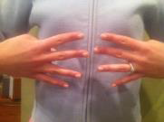
Decomposition Strategies for Subtraction
Consider doubles when subtracting….
Which of the expressions below is made by splitting up a double?
7 – 3 8 – 4 9 – 2
Lessons 35
Notes:
TAKE APART DOUBLES
Lead the group in orally reciting doubles facts as you show them on your fingers.
Show 2 and 2 fingers.
T: If I know 2 + 2 = 4,
T: then I know that 4 minus 2 (take one hand away), equals 2!
Some subtraction facts are made by taking apart a double. Other subtraction facts are not made of doubles.
Which subtraction expression on the slide can be solved by splitting up a double? (8 – 4).
Use your fingers like doubles to show your partner how you could solve 8 – 4 by taking apart your double.
TIME ALLOTTED FOR THIS SLIDE:
3 minutes
MATERIALS NEEDED:
X

Slide 74
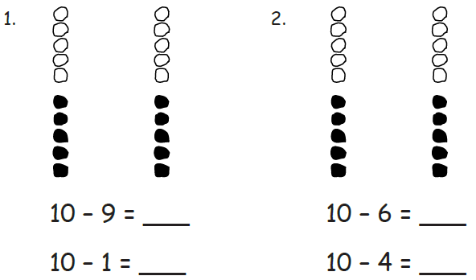
Decomposition Strategies for Subtraction
Subtracting from 10 using partners
Lessons 36
Notes:
DISCUSS RELATED SUBTRACTION FACTS: 10 AS A TOTAL
Students see that each partner of 10 makes a related subtraction fact. Knowing 9 and 1 makes 10 can help you solve 10 – 9 as well as 10 – 1.
TIME ALLOTTED FOR THIS SLIDE:
2 minutes
MATERIALS NEEDED:
X

Slide 75
Decomposition Strategies for Subtraction
Subtracting from 9 using partners
Lessons 36
Notes:
DISCUSS RELATED SUBTRACTION FACTS: 9 AS A TOTAL
Students continue to practice the concept that knowing parts helps them know two related subtraction facts. This time the focus is partners of 9.
TIME ALLOTTED FOR THIS SLIDE:
2 minutes
MATERIALS NEEDED:
X

Slide 76
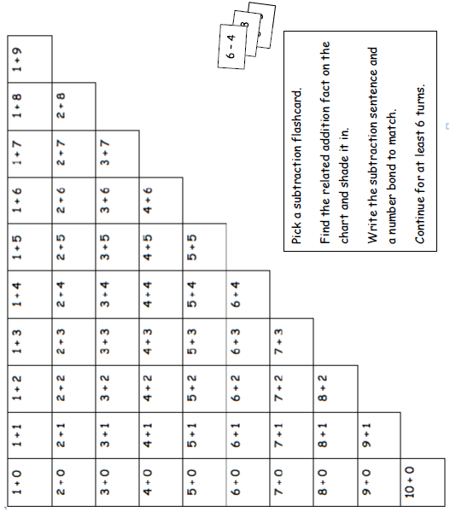
Development of Subtraction Fluency Within 10
Lesson 38 & 39
Notes:
INTRODUCE TOPIC J: DEVELOPMENT OF SUBTRACTION FLUENCY WITHIN 10
At the end of the module, students connect their subtraction work with the same addition chart used at the culmination of the addition lessons earlier in the module.
Students have subtraction expression cards and they look for the related addition fact on the chart.
Let’s use 6 – 4.
What addition expression is related? (4 + 2…or 2 + 4.)
Write the subtraction number sentence starting with 6 – 4.
Create a matching number bond.
As students record the matching number bond, they reinforce the relationship between parts and totals.
A few students MAY need support breaking the misconception that the “total” spot in the number bond is where “the answer” or “unknown number” is shown.
Students who are accurately completing the number bond demonstrate their understanding of the relationship between parts and the total.
To help emphasize this during the lesson, students are asked to color all of the totals with an orange crayon.
TIME ALLOTTED FOR THIS SLIDE:
3 minutes
MATERIALS NEEDED:
Document camera
Personal white board with Addition Chart template per participant

Slide 77
End-of-Module Assessment
How would you solve this problem?
End-of-Module Assessment
Notes:
SOLVE AND DISCUSS THE SAMPLE ASSESSMENT PROBLEM
Invite participants solve
use their personal white boards to show a drawing, number sentence, and solution to the problem. Share various solutions and strategies.
What type of problem is this? (Take Apart with Addend Unknown.)
What number sentences would be acceptable on the line?
7 + 2 = 9
2 + 7 = 9
9 = 2 + 7
9 = 7 + 2
9 – 2 = 7
Please note that, while we certainly have a systematic approach to assessment, we do not provide a complete assessment program. At this point, a primary goal of the project has been to create a curriculum that is free and accessible to anyone, anywhere. By default, that means that the assessments are also free and accessible to anyone, anywhere. The assessments that we provide are worthy assessments, regardless of how much help individual students might have gotten at home. If a student can perform in class, getting the correct answer and demonstrating understanding through models and explanation, then that should be acknowledged and praised. However, these assessments are obviously not sufficient. You’ll need to collaborate with colleagues to develop additional assessments to meet the requirements of your school/district. In doing so, we hope that you will use the curriculum as a resource (i.e., the assessments themselves, as well as the exit tickets and problem sets).
TIME ALLOTTED FOR THIS SLIDE:
4 minutes
MATERIALS NEEDED:
X

Slide 78
Agenda
Lesson Structure
Instructional Sequence
Module Review
Preparation for Implementation
Notes:
INTRODUCE MODULE REVIEW SECTION
As you’ve seen, the sequence of objectives is very intentional. Each one is critical in preparing students for what comes next. We think of these objectives as rungs on a ladder that lead to success of the module’s focus. Collectively, they play a significant role in the students achieving mastery of the grade’s expectations.
Keep in mind that we only sampled a small part of each objective. When looking at the daily lesson, you’ll find that each plan is thoroughly detailed… as you experienced with Lesson 1 at the beginning of this session.
Now, we are going to examine the module in its entirety.
TIME ALLOTTED FOR THIS SLIDE:
1 minute
MATERIALS NEEDED:
X

Slide 79
Progression Study
What are the Progressions?
Explore: K-5, Operations and Algebraic Thinking Progression
Read page 6
Scan page 9
Read pages 13-15 (starting with the 2nd full paragraph on p.13, ending with the 2nd full paragraph on p. 15)
Highlight the information relevant to the content of this module.
Notes:
EXPLAIN WHAT THE PROGRESSIONS ARE
Poll participants using the fist-to-five protocol to gauge how well (if at all) they know the progression documents. Participants show zero fingers/fist if they have never heard of or seen the progressions, show 5 fingers if they have read a majority of the progressions, or some number of fingers if they are relatively familiar or have read some portion of them.
Explain what the progressions are:
The Common Core State Standards for mathematics were built from the progressions. They are a narrative document describing the progression of a topic across a number of grade levels. The progressions were guided by a child’s cognitive development and the logical structure of math when written. These documents were used to create the grade level standards, and therefore can explain why the standards are sequenced the way they are. The progressions also highlight cognitive difficulties and provide pedagogical solutions, and give greater detail on some of the particularly challenging areas of mathematics. As writers, we referred to the progressions often to guide our thinking when sequencing lesson objectives and problems within each lesson.
EXPLORE PROGRESSIONS DOCUMENT:
To continue our study of Module 1, we’re going to first take some time to examine a portion of the Progression document (K-5, Operations and Algebraic Thinking) that serves as the foundation for this module. You’ll have about 10 minutes to read through the document independently or with a partner. As you read, highlight the information that is relevant to the content of this module.
Allow participants time to read independently. Encourage them to highlight and make notes.
TIME ALLOTTED FOR THIS SLIDE:
10 minutes
MATERIALS NEEDED:
Progressions Document: K, Counting and Cardinality; K–5,Operations and Algebraic Thinking
Highlighters (optional)

Slide 80
Progression Study
Study Lessons 6, 14, and 25.
Then, turn and talk:
How do these lessons engage students in the work described in the Progression?
Notes:
CONNECT PROGRESSIONS TO LESSONS
Allow participants time to study Lessons 6, 14, and 25. These are the objectives, for the facilitator’s reference:
Lesson 6: Represent put together situations with number bonds. Count on from one embedded number or part to totals of 8 and 9 and generate all expressions for each total.
Lesson 14: Count on up to 3 more using numeral and 5-group cards and fingers to track the change.
Lesson 25: Solve add to with change unknown math stories with addition and relate to subtraction. Model with materials and write corresponding number sentences.
Then, allow participants time to turn and talk about how these lessons engage students in the work described in the Progressions.
Consider providing sentence frames for the turn and talk.
Facilitate a whole group discussion.
Reference for Facilitator:
P. 9: Story situations table (situations highlighted in Module 1 are the dark grey situations, and Add to with Change Unknown)
P. 13-14: Explanation of situations on table
P. 14-15: Explanation of addition and subtraction strategies levels (table is on p. 6), particularly highlighting counting on for subtraction
TIME ALLOTTED FOR THIS SLIDE:
5 minutes
MATERIALS NEEDED:
M1 Lessons 6, 14, 25

Slide 81
Coherence Within the Module
Analyze the progression of each lesson component across the Module.
What does the sequence of Fluency Practices accomplish as a whole?
How does the sequence of Application Problems connect to topic/module?
How does the sequence of Concept Development and Student Debrief build toward mastery of the topic/module?
Notes:
EXAMINE COHERENCE WITHIN THE MODULE
Earlier, we examined a Lesson 1 in great detail and recognized the coherence within the lesson. Now that you’ve had an opportunity to see the development of the mathematical concepts outlined in the Progression document, let’s take some time to return to Module 1 and take a look at how the module is coherent on a larger scale. Specifically, let’s look for examples of the same scaffolding that we have mentioned all day today: simple to complex and concrete to abstract.
You might each want to divide the questions amongst your tablemates and each select a topic to closely examine.
Be prepared to share your observations with the group.
Allow 15 minutes for participants to complete this analysis. Then advance to the next slide.
TIME ALLOTTED FOR THIS SLIDE:
15 minutes
MATERIALS NEEDED:
G1-Module 1
Chart Paper table or set of partners

Slide 82
Coherence Within the Module
Analyze the progression of each lesson component across the Module.
What does the sequence of Fluency Practices accomplish as a whole?
How does the sequence of Application Problems connect to topic/module?
How does the sequence of Concept Development and Student Debrief build toward mastery of the topic/module?
Notes:
INVITE GROUPS/PARTNERS TO SHARE OUT TOPIC ANALYSIS FOR EACH TOPIC. THEN, DISCUSS COHERENCE WITHIN MODULE 1 AS A WHOLE.
Allow time for turn and talk, then facilitate a discussion. Be sure to include answers to the provided questions, specifically addressing the progression of mathematics in Module 1.
What does the sequence of Fluency Practices accomplish as a whole? (practice with counting, number bonds, addition and subtraction)
How does the sequence of Application Problems connect to topic/module? (they often build on the pervious lesson objective, they provide a variety of problem types (from the OA Progression), they provide continued practice with solution strategies, progress from simple (smaller numbers) to complex (larger numbers, linguistic expectations, and extensions), they allow for practice of simple math drawings (number bonds, equal groups drawings, arrays, etc.)
How does the sequence of Concept Development and Student Debrief build toward mastery of the topic/module? (highlight transition from concrete → abstract, and simple → complex)
TIME ALLOTTED FOR THIS SLIDE:
5minutes
MATERIALS NEEDED:
X

Slide 83
Agenda
Lesson Structure
Instructional Sequence
Module Review
Preparation for Implementation
Notes:
INTRODUCE PREPARATION FOR IMPLEMENTATION SECTION
Now you’ve had a chance to examine this module at several levels. We looked at the lesson components, we explored the instructional sequence from objective to objective, and we’ve thought about what this module accomplishes in the larger scope of mathematical understanding.
Let’s spend some time now discussing strategies for implementation and preparing for the beginning of the upcoming school year.
MODEL SLIDES 83-88 for G1-M1-Topic A, then invite participants to work in pairs and choose a Topic. Facilitate instructions below.
Note to Presenters: We envision this section to flow similar to the “practice” sessions we discussed in NYC at the KIPP training. Rather than going through each slide in 5 minutes, as suggested in the slide deck, model the process with Topic A, since everyone already walked through Lesson 1 at the start of the day. Then have participants work with a partner to choose a topic for themselves and complete the protocol (which is in the PPT for reference). If you have time remaining AFTER this block, you can “pressure test” with pairs. Invite one partnership to tell you about their topic aloud. You’ll ask them some questions to help probe them and clarify what they mean. Then have pairs match up with another set of partners that chose to work through a different topic. They can talk through their work and ask similar probing/clarifying questions. This work will support teachers in both the process of planning using the materials and in hearing two of the topics worked through with that level of specificity, looking for connections and internalizing the coherence.
TIME ALLOTTED FOR THIS SLIDE:
1 minute
MATERIALS NEEDED:
X

Slide 84
Practice a Planning Protocol
With any topic from A Story of Units, read the module overview and the topic opener.
Study the module assessment, paying particular attention to the sample responses provided.
Notes:
PREPARE FOR IMPLEMENTATION: MODULE OVERVIEW, TOPIC OPENER, ASSESSMENT
Click to advance the first bullet. Allow time for participants to look back at the Module Overview and the Topic Opener for the pre-selected topic.
Click to advance second bullet. Allow time for participants to study the sample work provided for the module assessment(s).
NOTE TO FACILITATORS: Since participants will have already studied these documents during there may not be a need to spend additional time on this slide at this point.
TIME ALLOTTED FOR THIS SLIDE:
5 minutes
MATERIALS NEEDED:
The module overview, topic opener, and applicable module assessment(s) for any topic from any module at any grade level

Slide 85
Practice a Planning Protocol
Read through the first lesson of the topic.
Then, take note of the lesson objective and re-examine the exit ticket with the objective in mind. What major concept is necessary to successfully complete the exit ticket?
Study the concept development and problem set. How do the CD/PS develop the major concept that is required in the exit ticket? What parts of the CD/PS go beyond this major concept?
Notes:
PREPARE FOR IMPLEMENTATION: LESSON 1 AND EXIT TICKETS
Click to advance the first bullet. Allow time for participants to read the first lesson of the pre-selected topic.
Click to advance second bullet. Read aloud the objective of the first lesson. Allow time for participants to re-read the exit ticket. Facilitate a discussion about the major concept required by the exit ticket.
Click to advance the third bullet. Allow time for participants to study the Concept Development and Problem Set. If participants have paper copies of the lessons, encourage them to highlight the portions of the CD/PS that are critical in preparation for the exit ticket. Facilitate a discussion about those portions of the lesson that are necessary in preparation for the exit ticket and those that go beyond the major concept needed for the exit ticket.
TIME ALLOTTED FOR THIS SLIDE:
5 minutes
MATERIALS NEEDED:
The preselected topic
Highlighters (optional)

Slide 86
Practice a Planning Protocol
How will this knowledge empower teachers to support specific groups of learners?
Turn to the subsequent lesson, and examine the exit ticket. How does this exit ticket build on the last? How are the two exit tickets similar and how are they different?
Will students have an opportunity in the second lesson to continue development of the first lesson’s objective? What level of mastery of the first lesson’s objective is necessary in preparation for the second lesson?
Notes:
PREPARE FOR IMPLEMENTATION: SUBSEQUENT OBJECTIVE AND EXIT TICKET
Click to advance the first bullet. Facilitate a discussion about how participants’ previous observations might be further impacted as they consider the needs of a specific group of students. As appropriate, draw attention to any relevant notes boxes in the margins of the lesson.
Click to advance second bullet. Allow time for participants to read the exit ticket for the next lesson. Facilitate a discussion about the relationship between the two exit tickets.
Click to advance the third bullet. Facilitate discussion about how these new observations might further impact their decisions regarding implementation of the first lesson.
TIME ALLOTTED FOR THIS SLIDE:
5 minutes
MATERIALS NEEDED:
The preselected topic

Slide 87
Practice a Planning Protocol
How does the new plan for implementation impact the student debrief?
Are any adjustments needed to the fluency and/or application components of the lesson?
Notes:
PREPARE FOR IMPLEMENTATION: ADJUSTMENTS
Click to advance the first bullet. Facilitate a discussion about how the student debrief is impacted by the implementation decisions made thus far.
Click to advance second bullet. Facilitate a discussion about the other lesson components and the need to ensure that the balance of rigor is maintained.
TIME ALLOTTED FOR THIS SLIDE:
5 minutes
MATERIALS NEEDED:
The preselected topic

Slide 88
Practice a Planning Protocol
Repeat this process for each lesson.
Read lesson.
Study exit ticket. Identify critical portions of concept development and problem set.
Consider needs of specific students.
Refer to subsequent exit ticket. Revise implementation plan as needed.
Make adjustments to the student debrief as needed.
Consider the other lesson components, ensuring a balance of rigor.
Notes:
Review the planning protocol. If time allows, have participants go through the cycle again for the second lesson of the topic.
TIME ALLOTTED FOR THIS SLIDE:
5 minutes
MATERIALS NEEDED:
The preselected topic

Slide 89
Biggest Takeaway
I now know…
I need to figure out…
Notes:
DISCUSS BIGGEST TAKEAWAY
Take two minutes to turn and talk with others at your table. During this session, what information was particularly helpful and/or insightful? What new questions do you have?
Allow 2 minutes for participants to turn and talk. Bring the group to order and advance to the next slide.
TIME ALLOTTED FOR THIS SLIDE:
3 minutes
MATERIALS NEEDED:
X

Slide 90
Key Points
When making instructional decisions in order to meet the needs of specific students, there are only two rules:
Honor the objective!
Honor the balance of rigor!
Add key points about the content of M1 here…
Notes:
REVIEW KEY POINTS
Let’s review some key points of this session.
To presenter: Leave slide as is so that participants can help compile key points. They should include:
There is a sequence that scaffolds student learning from seeing embedded numbers through developing fluency in addition and subtraction.
Addition problems with a missing addend can create a strong foundation for developing understanding of subtraction and its relationship to addition.
Composing and decomposing numbers relate to addition and subtraction, and are a critical foundation for the year.
Experiences composing and decomposing also provide a foundation for solving varied problem types, including put together, take apart, add to with change unknown, etc.
Fluency with abstract addition and subtraction facts comes AFTER many experiences with the patterns and structures of addition and subtraction.
TIME ALLOTTED FOR THIS SLIDE:
2 minutes
MATERIALS NEEDED:
X

Slide 91
Next Step
The first thing I’ll do to prepare is…
Notes:
EXIT TICKET
Turn and talk to a partner about the first thing you will do to prepare to implement Eureka Math.
For your Exit Ticket for today’s session, please take these last few minutes to write your thoughts on an index card. ☺
TIME ALLOTTED FOR THIS SLIDE:
5 minutes
MATERIALS NEEDED:
Index cards

