Slide 1
eDIRECT: Navigating Interactive Reporting
Notes:
Welcome and introduce yourself

Slide 2
Today’s Goals
By the end of today’s session, you should be able to:
Understand the purpose of Interactive Reporting
Understand dynamic filters
Navigate Student History
Navigate Student Response Lookup

Slide 3
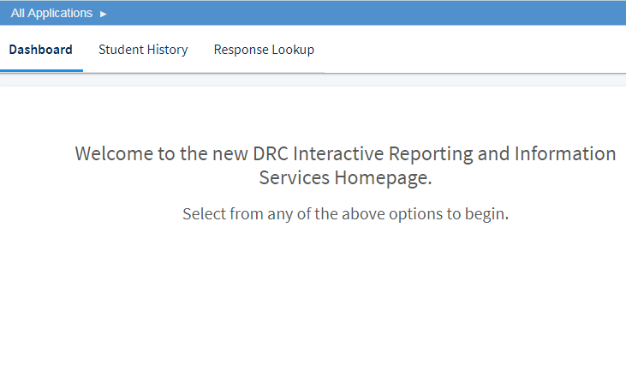
Interactive Reporting Overview
Interactive Reporting is a tool that includes:
Student History for districts, schools, and teachers to view student nonsummative test scores
Response Lookup for teachers to view student response data and item responses for all students within a test session
In order to view student responses through Interactive Reporting, the teacher must be the assigned TA for the test session or have a student group
Detailed directions for Interactive Reporting can be found in the eDIRECT User Guide posted in eDIRECT under General Information.

Slide 4
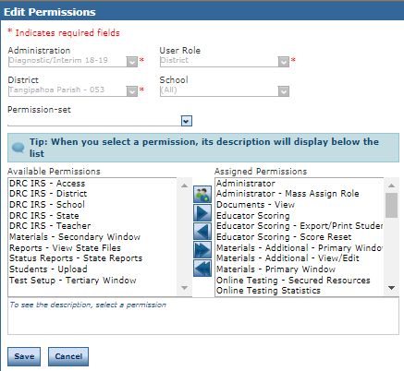
Interactive Reporting
Permissions must be added to give access to Interactive Reporting. Permissions can be added through the User Management tab in eDIRECT.
Details on how to add/edit user permissions can be found in the User Management one-pager or in the eDIRECT User Guide posted in eDIRECT under General Information.

Slide 5
Accessing Interactive Reporting
Once logged into eDIRECT, choose All Applications → Interactive Reporting.

Slide 6
Interactive Reporting Filters
Interactive Reporting uses dynamic filters that when selected update the displayed data. Filters for Student History and Reponse Lookup include:
Admin
School System
School Name
Test Session Name
LASID
First Name (Student History only)
Last Name (Student History only)
When a Filter is selected, the Filter page will display available options. When desired filters are selected, select ADD FILTER to apply the filters to the displayed data.

Slide 7
Interactive Reporting Column Filters
When navigating Interactive Reporting, you can sort the order of each column in a data table and set filters at the data column level.
To rest the data to the default select the reset arrow at the bottom of the screen.

Slide 8
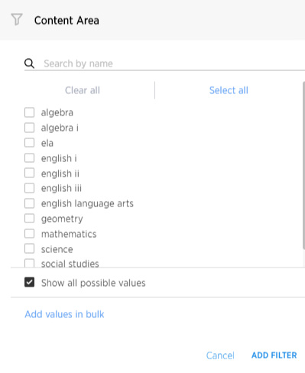
Interactive Reporting Column Filters
To filter column data, hover your cursor over the column heading, select the three vertical dots to display the Filters dialog, then click Filters.
Select only the options to display in the column, then click ADD FILTER.

Slide 9
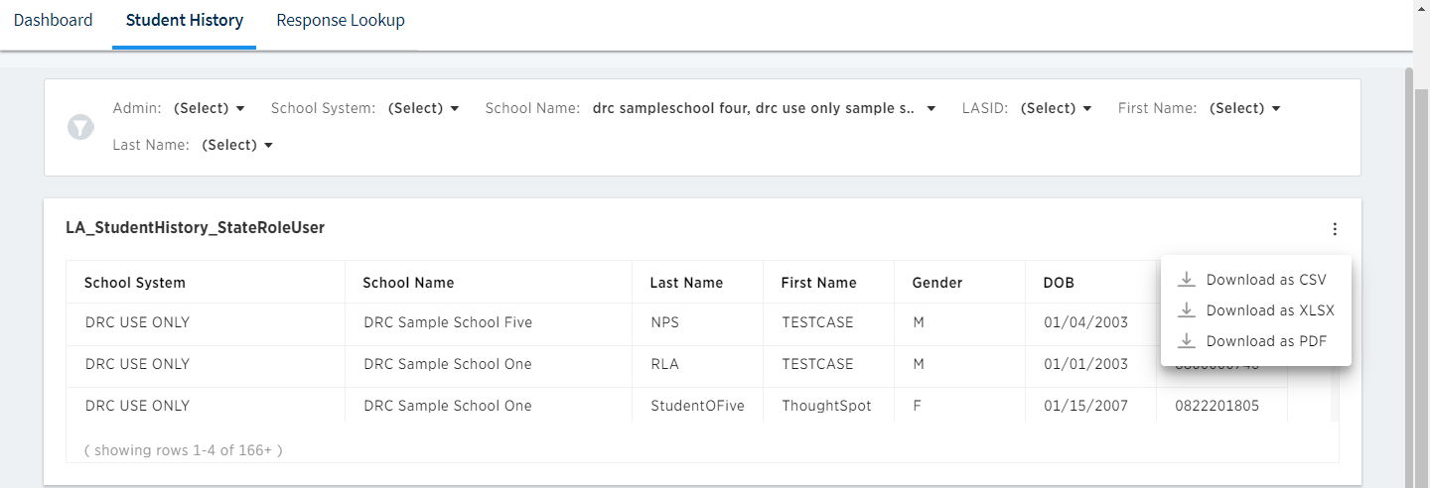
Interactive Reporting: Student History
The Student History report allows you to display nonsummative student and test information from the current and previous year’s administrations. You must have permissions for the current administration to display results from last year’s administration. The information is displayed in three areas: Student History, Scores per Assessment, and Score Detail
The Student History report can be downloaded as an Excel, CSV, or PDF document.

Slide 10
Interactive Reporting: Response Lookup
The Response Lookup report allows you to display student responses and other testing information from the current year’s administrations. The Response Lookup section displays test score data, such as Test Points Earned and Test Points Possible.
The Response Lookup report can be downloaded as an Excel, CSV, or PDF document.

Slide 11
Interactive Reporting: Response Lookup Detail
The Response Lookup Detail displays item type and item points detail, and allows you to display the student’s response and the correct item response. Teachers / Test Administrators can display responses for the students in their test sessions only.
The Response Lookup Detail can be downloaded as an Excel, CSV, or PDF document.

Slide 12
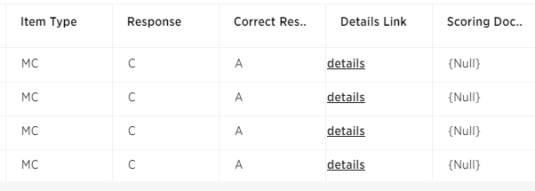
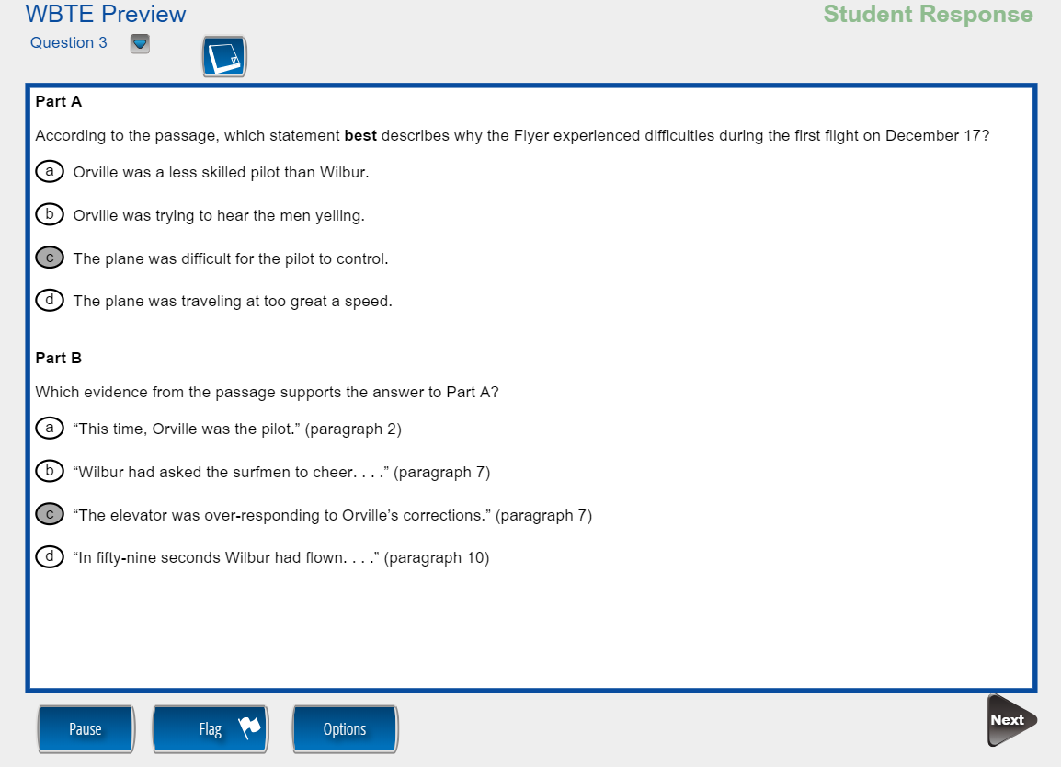
Interactive Reporting: Response Lookup Detail
In the Response Lookup Detail section, scroll to the far right to display a student’s response to a test item. Either the student’s answer displays or a reference to the Details Link column displays.
Click Details to display the student’s response for the item in a new browser window; Click Next to view the correct answer for items

Slide 13
Support

Slide 14
User Guides
The following user guides are posted in eDIRECT under General Information:
eDIRECT User Guide
Technology User Guide
EAGLE 2.0 User Guide

Slide 15
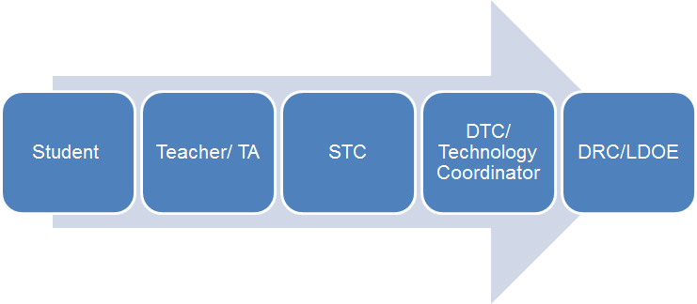
Technical Assistance Protocol
If technical problems occur, school and district staff should follow the protocol presented below.
DRC Louisiana Customer Service
1-888-718-4836 LAHelpDesk@datarecognitioncorp.com
LDOE
1-844-268-7320
assessment@la.gov

